Slide 1
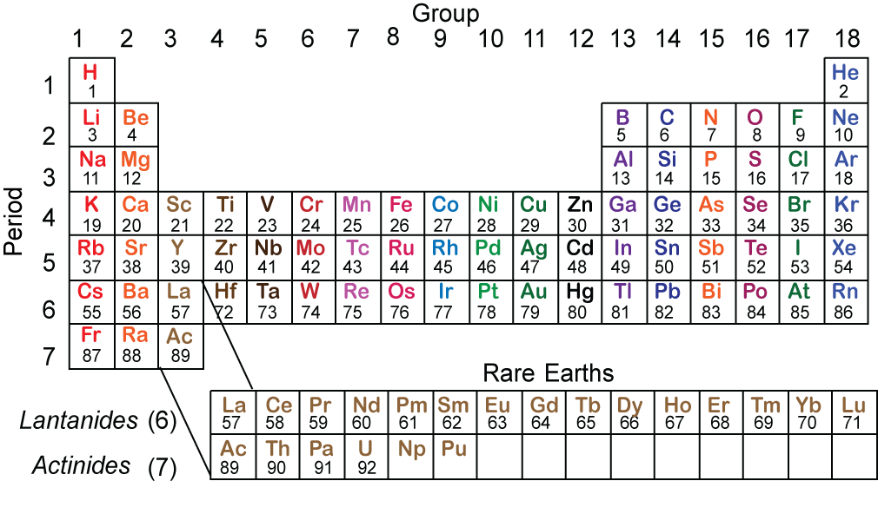
Building Earth or What we (think we) know about the composition and evolution of the Earth and how we know it.
William M. White
Cornell University

Slide 2
Outline
Meteorites, Chondrites and Chondritic Abundances
Chemical variation in the solar nebula
Volatile vs. refractory elements
Models of Earth’s composition
Implications for heat production
Early differentiation of planets into mantles and cores
Lithophile vs. siderophile elements
Differentiation of the Silicate Earth
Partition coefficients and the behavior of trace elements during melting.
Compatible vs. incompatible elements
Rare earth elements and rare earth patterns
Spider diagrams
Mobile vs. immobile elements
Formation of the crust by island arc volcanism
Origin of mantle heterogeneity and mantle reservoirs.

Slide 3
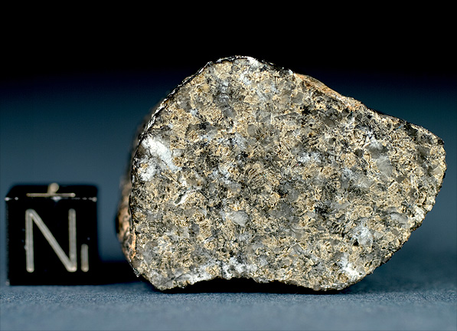
Meteorites
Differentiated (parts of differentiated planetesimals)
Achondrites
Irons
Stony-Irons
Chondrites (collections of nebular dust)
Carbonaceous (volatile-rich)
CI
CM
CV
CO
etc.
Ordinary (most common)
H
L
LL
Enstatite (highly reduced)
EH
EL
others

Slide 4
Chondrite Components
CAI’s
calcium-aluminum inclusions
condensates or evaporate residues at very high temperature
Chondrules
Once molten droplets of nebular dust
Most often olivine-rich, but other minerals and iron metal also common.
Show evidence of rapid cooling.
Up to 75% of volume of chondrites
Ameboidal Olivine Aggregates (AOA’s)
Fine grained high temperature condensates
Matrix
Fine grained material richer in the more volatile elements.
Includes ‘presolar’ grains in some cases.
Allende CV3

Slide 5
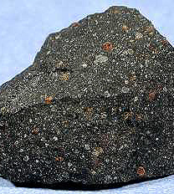
Significance of Chondrites
Although variably metamorphosed and altered* on parent bodies, chondrites are composed of nebular dust from which the planets were built.
Compositions vary mainly in:
Ratio of volatile to refractory material
Oxidation state
Ratio of metal to silicate
Murchison CM2
*denoted by petrologic grade: 1 & 2: hydrous alteration; 3: least altered; 4-6 increasing thermal metamorphism.

Slide 6
Chondrites: Model Solar System Composition
The CI group, which consists only of chondritic matrix, matches solar composition of condensable elements.

Slide 7
Volatility
Where elements are found in chondrites is governed by volatility:
Volatile elements: Matrix
Main Group: Chondrules
Refractory elements: ‘CAI’s’
Condensation temperatures are different than boiling point of elements because elements generally condense as compounds.
The terrestrial planets are strongly depleted in volatile elements compared to the nebula from which the formed.
Leoville CV3

Slide 8
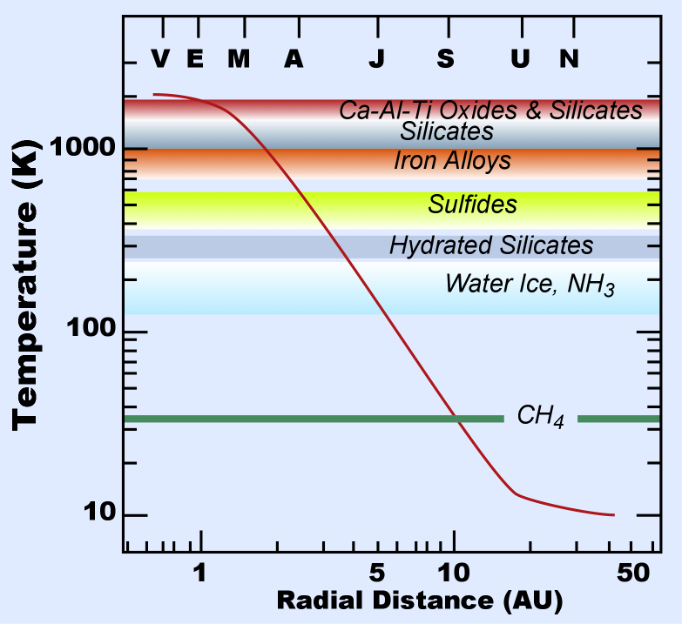
Temperatures in Protoplanetary Disk

Slide 9
Volatility in the Solar Nebula
50% Condensation temperatures of the elements from a low pressure nebula of solar composition.
Data from Lodders, 2003

Slide 10
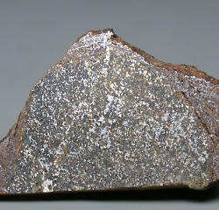
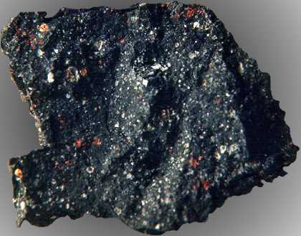
Oxidation State & Fe/Si Ratios
Chondrites also vary in oxidation state and in the ratio of metal to silicate.
Carbonaceous chondrites are highly oxidized, enstatite chondrites are highly reduced.
Enstatite Chondrite
Carbonaceous Chondrite

Slide 11
Building Terrestrial Planets
Terrestrial planets formed by a process of accretion and oligarchic growth.
This processes produced bodies the size of Vesta within a few million years.
Nearly simultaneously with accretion, asteroid-sized bodies differentiated into mantles, cores, and protocrusts.
This is a consequence of extensive melting, produced by release gravitational energy (and in the earliest formed bodies ²⁶Al decay).
4 Vesta

Slide 12
Goldschmidt’s Classification
rock-loving
iron-loving
sulfur-loving

Slide 13
Distribution of the Elements in Terrrestrial Planets
Atmophile in the atmosphere.
Siderophile (and perhaps chalcophile) in the core.
Lithophile in the mantle and crust.
Abundances of refractory lithophile elements are key to building models of Earth’s composition.
Incompatible elements, those not accepted in mantle minerals, are concentrated in the crust.
Compatible elements concentration in the mantle.

Slide 14
Estimating the Silicate Earth’s Composition

Slide 15
Assumptions about Silicate Earth Composition
The Earth formed from a solar nebula of chondritic composition.
Any successful model of Earth composition must relate to that of chondrites through plausible processes.
Composition must match seismic velocity and density profiles.
Composition of the mantle should match that of the ‘mantle sample”, i.e., ‘peridotite’.
Composition of the upper mantle should yield basalt upon melting.
Crust + Mantle = Bulk Silicate Earth (BSE)=Primitive Mantle

Slide 16
Refractory Lithophile Elements & Earth Models
Despite the variety of chondrite compositions, the relative (but not absolute) abundances of refractory lithophile elements (RLE’s) are very similar in all classes.
This implies nebular processes did not fractionate refractory elements from one and other.
Models of Earth’s composition rely, to varying degrees, on the assumption that the Earth too has chondritic relative abundances of refractory elements.

Slide 17
Refractory Elements

Slide 18
‘Geochemical Models’
Geochemical models of Earth’s composition begin by estimating major element (Mg, Fe, Si, Ca) concentrations from peridotites.
Once CaO and Al₂O₃ are determined, concentrations of other refractory lithophile elements (RLE’s) are estimated from chondritic ratios.

Slide 19
‘Canonical Ratios’ & Estimating Volatile Element Abundances
Ratios of some elements show relatively little variation in a great variety of mantle and crustal materials.
Sn/Sm: 0.32
Rb/Ba: 0.09
K/U:
crust: 11,300 Rudnick & Gao
MORB: 13,000 Gale et al.
OIB: 11,050 Paul et al.
With this approach, the BSE concentrations can be estimated for most elements.

Slide 20
Silicate Earth Composition
McDonough & Sun ‘95 Bulk Silicate Earth Composition; 6 elements make up >99% of BSE.

Slide 21
Competing Models
Enstatite Chondrite
Collisional Erosion

Slide 22
Comparison of Silicate Earth Compositions
 | CI Chondrite | CI Chondritic Mantle | Hart & Zindler 87 | McDonough & Sun 95 | Palme & O’Neill 03 | Lyubetskaya & Korenga 07 | O’Neill & Palme 08 | Javoy 1999 2010
SiO₂ | 22.9 | 49.8 | 46.0 | 45.0 | 45.4 | 45.0 | 45.4 | 51.6
Al₂O₃ | 1.6 | 3.5 | 4.1 | 4.5 | 4.5 | 3.5 | 4.3 | 2.4
FeO | 23.71 | 6.9 | 7.5 | 8.1 | 8.1 | 8.0 | 8.1 | 11.1
MgO | 15.9 | 34.7 | 37.8 | 37.8 | 36.8 | 40.0 | 36.8 | 31.7
CaO | 1.3 | 2.8 | 3.2 | 3.6 | 3.7 | 2.8 | 3.5 | 1.8
Na₂O | 0.67 | 0.29 | 0.33 | 0.36 | 0.33 | 0.30 | 0.28 | 0.22
K₂O | 0.067 | 0.028 | 0.032 | 0.029 | 0.031 | 0.023 | 0.019 | 0.046
Cr₂O₃ | 0.39 | 0.41 | 0.47 | 0.38 | 0.37 | 0.39 | 0.37 | 0.39
MnO | 0.250 | 0.11 | 0.13 | 0.14 | 0.14 | 0.13 | 0.14 | 0.87
TiO₂ | 0.076 | 0.17 | 0.18 | 0.20 | 0.21 | 0.16 | 0.18 | 0.12
NiO | 1.37 | 0.24 | 0.28 | 0.25 | 0.24 | 0.25 | 0.24 | 0.24
CoO | 0.064 | 0.012 | 0.013 | 0.013 | 0.013 | 0.013 | 0.013 | 0.014
P₂O₅ | 0.21 | 0.014 | 0.019 | 0.021 | 0.20 | 0.15 | 0.015
Sum | 69.79 | 100.0 | 100.0 | 100.2 | 99.8 | 100.0 | 99.3 | 100.5

Slide 23
Pros and Cons of an Enstatite Chondrite Earth
Terrestrial O, Cr, and Ti isotopic compositions of the Earth best match those of enstatite chondrites.
Earth is more reduced that ordinary/carbonaceous chondrites.
If the Earth has the same δ³⁰Si as enstatite chondrites, the core must contain 28% Si.
Predicted mantle composition is quite different from what is observed, requiring a two-layer mantle.
from Warren, ESPL 2011

Slide 24
Collisional Erosion
The Earth and Moon have excess ¹⁴²Nd, which is the decay product of the extinct radionuclide ¹⁴⁶Sm (68 Ma half-live), compared to chondrites.
This should not be the case if the Sm/Nd ratio were chondritic, as expected.
Sm and Nd are RLE’s so fractionation is not expected in the nebula.
This has led to the hypothesis that the planet-building process was non-conservative. Specifically, that a low Sm/Nd protocrust was lost to space during accretion of the planetesimal precursors of the Earth.
The implication of this is that the Earth would have lost a significant fraction of other incompatible elements, including heat-producers K, Th, and U.

Slide 25
Alternative EER Model
The alternative (actually, original) explanation posits a deep mantle reservoir with lower than chondritic Sm/Nd – so called ‘early enriched reservoir’, EER, of Boyet & Carlson.
Must have formed very early – well before the Moon-forming event.
One possibility is that the LLSVP’s are this hidden reservoir.
These would contain ~40% of the Earth’s heat production.

Slide 26
Implications for Heat Production
 | Heat Pro- duction µW/kg | McDonough & Sun ‘95 | O’Neill & Palme ‘03 | Lyubetskaya & Korenaga ‘07 | Eroded Earth (3-6% higher Sm/Nd) | E. Chondrite Javoy ‘99
K | 0.00345 | 240 ppm | 260 ppm | 190 ppm | 166-219 ppm | 445 ppm
Th | 26.36 | 80 ppb | 83 ppb | 63 ppb | 46-61 ppb | 30.7 ppb
U | 98.14 | 20 ppb | 20 ppb | 17 ppm | 12-16 ppb | 10.3 ppm
Heat production |  | 19.7 TW | 20.3 TW | 16 TW | 11.9-15.8 TW | 10.3 TW
Urey ratio* |  | 0.49 | 0.51 | 0.40 | 0.30-0.39 | 0.26
Mantle heat production |  | 12.5 TW | 13.1 TW | 8.8 TW | 4.7-8.6 TW | 6.5 TW
Mantle Urey ratio |  | 0.32 | 0.34 | 0.23 | 0.12-0.22 | 0.08
*ratio of heat production to heat loss.

Slide 27
Differentiation of the Silicate Earth
An early protocrust likely formed by crystallization of magma oceans (or ponds) as the Earth accreted (as it did on Vesta and the Moon), but no vestige of this crust remains.
While the Earth’s core formed early, the present crust has grown by melting of the mantle over geologic time (rate through time is debated).
Partitioning of elements between crust and mantle depends on an element’s compatibility.

Slide 28
The Partition Coefficient
Geochemists find it convenient to define a partition or distribution coefficient of element i between phases α and β:
Where one phase is a liquid, the convention is the liquid is placed in the denominator:
(Note: metal-silicate partition coefficients relevant to core formation are defined in an exactly analogous way.)

Slide 29
Incompatible elements are those with D^{s/l} ≪ 1. Compatible elements are those with D^{s/l} ≥ 1.
These terms refer to partitioning between silicate melts and phases common to mantle rocks (peridotite). It is this phase assemblage that dictates whether trace elements are concentrated in the Earth’s crust, hence the significance of these terms.

Slide 30
Importance of Ionic Size and Charge
To a good approximation, most lithophile trace elements behave as hard charged spheres, so behavior is a simple function of ionic size and charge.
Transition series element behavior is more complex.
Many of these elements, particularly Ni, Co, and Cr, have partition coefficients greater than 1 in many Mg–Fe silicate minerals. Hence the term “compatible elements” often refers to these elements.
Ionic radius (picometers) vs. ionic charge contoured for clinopyroxene/liquid partition coefficients. Cations normally present in clinopyroxene M1 and M2 sites are Ca²⁺, Mg²⁺, and Fe²⁺, shown by ✱ symbols. Elements whose charge and ionic radius most closely match that of the major elements have the highest partition coefficients

Slide 31
Bottom Line:
Incompatible elements are those that are too fat or too highly charged to substitute in mantle minerals

Slide 32
Batch Melting Model
Batch melting assumes complete equilibrium between liquid and solid before a ‘batch’ of melt is withdrawn. It is the simplest (and least realistic) of several melting models.
From mass balance:
where i is the element of interest, C° is the original concentration in the solid (and the whole system), C^{l} is the concentration in the liquid, C^{s} is the concentration remaining in the solid and F is the melt fraction (i.e., mass of melt/mass of system). Since D = C^{s}/C^{l}, and rearranging:
or
We can understand this equation by thinking about 2 end-member possibilities.
First, where D ≈ 0 and D<<F (the case of a highly incompatible element), the C_{l}/C_{o} = 1/F.
Second where F ≈ 0, then C_{l}/C_{o} = 1/D. Thus the maximum enrichment of an incompatible element (or maximum depletion of a compatible one) in the melt is the inverse of the partition coefficient.

Slide 33
The Rare Earth Elements

Slide 34
The Rare Earth Elements
The lanthanide rare earths are in the +3 valence state over a wide range of oxygen fugacities.
They behave as hard charged spheres; valence electron configuration similar.
Ionic radius, which decreases progressively from La³⁺ to Lu³⁺, governs their relative behavior.

Slide 35
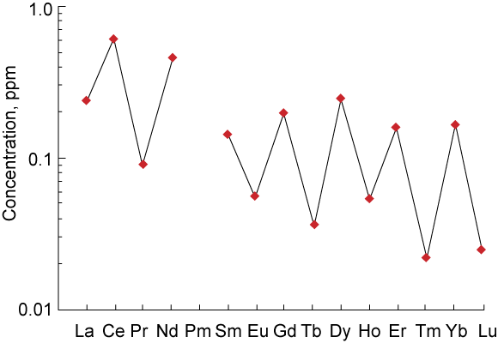
Rare Earth Diagrams
Relative abundances are calculated by dividing the concentration of each rare earth by a reference concentration, such as chondrites.
Rare earths are refractory elements, so that their relative abundances are the same in most primitive meteorites - and presumably (to a first approximation) in the Earth.
Why do we use relative abundances? To smooth out the saw-toothed pattern abundance of cosmic abundances (a result of nuclear stability.
Abundances in chondritic meteorites are generally used for normalization. (However, other normalizations are possible: sediments (and waters) are often normalized to average shale.)

Slide 36
Rare Earth Partition Coefficients

Slide 37
Rare Earths in Melts

Slide 38
Rare Earths in the Mantle & Crust
As refractory lithophile elements, relative (but not absolute) abundances are the same in chondrites.
The systematic decrease in ionic radius of the rare earths results in the light rare earths being concentrated in melts relative to the heavy ones.
Consequently, the light rare earths are concentrated in the crust and depleted in the mantle to a greater degree than the heavy rare earths.

Slide 39
‘Mobility’
This relates to the ability of an element to dissolve in aqueous fluid and thus be lost or gained from a rock during weathering and metamorphism.
Consequently, alkali, alkaline earth and U concentrations in weathered or metamorphosed rocks are suspect.
These elements also concentrate in fluids released by dehydrating subducting lithosphere and consequently present in high concentration in island arc magmas and the crust.
Pb in particular appears to be enriched in the crust as a consequence of fluid transport.

Slide 40
Incompatible elements in the Crust
In a ‘extended rare earth’ or ‘spider’ diagram such as this, elements are ordered based on expected incompatibility.
The continental crust shows a characteristic incompatible element enrichment, but with relative Ta and Nb depletion and Pb enrichment.
Notes:
The continental crust is characteristically

Slide 41
Island Arc Volcanics
Island arc volcanics match the incompatible element pattern of continental crust, suggesting they are the principal source of such crust.

Slide 42
Mantle Reservoirs
Mid-ocean ridge basalts (MORB) typically exhibit light rare earth element (LREE) depleted patterns.
Suggests the MORB source was “depleted” by previous melting events.
Most oceanic island basalts (OIB) exhibit LREE- enriched patterns.
This is prima fascia evidence of distinct modern mantle reservoirs (supported by isotopic evidence). Broadly:
One that gives rise to MORB
One that gives rise to OIB

Slide 43
Mantle Reservoirs
Other incompatible elements also depleted in MORB and enriched in OIB. Pb depletion, Ta-Nb enrichment is compliment of continental the crust.
Notes:
Spider diagrams are produced by ordering trace elements according to their ‘incompatibility’.
The LREE depletion of MORB extends to the more incompatible elements as well, while OIB are generally enriched in these elements.
MORB show a systematic Pb & Sr depletion; these probably a result of plagioclase fractionation.

Slide 44
Mantle Mineralogy
At 660 km depth, silicate minerals transform into a structure in which the Si atoms are coordinated by 6 oxygen, rather than 4 as they are in the upper mantle.
Partitioning of trace elements between these deep mantle silicates, Mg-perovskite (MgSiO₃) and Ca-perovskite (CaSiO₃), is dramatically different than in the upper mantle.

Slide 45
Mg-Pv strongly retains Hf & Zr, while Ca-Pv retains U, Th, & REE while rejecting K, Pb, and Sr.
Patterns are quite different from an upper mantle melt of garnet peridotite.

Slide 46
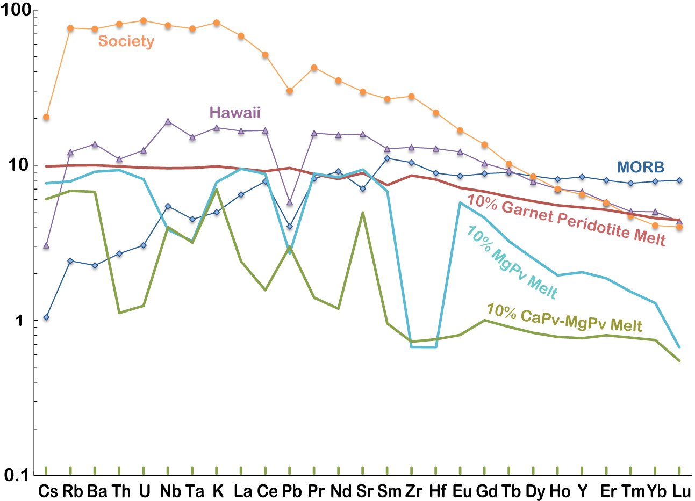
Melts of either Mg-perovskite (MgSiO₃) or Mg-perovskite plus Ca-perovskite produce fractionation patterns not observed in basalts.

Slide 47
Mantle Evolution
Mantle heterogeneity is a consequence of processes occurring in the upper mantle.
Stable isotopes allow us to deduce involvement of material from the near surface.
Although plumes rise from the deep mantle, rock in them acquired its chemical properties in the upper mantle.
Three candidate processes:
Subduction
Subduction erosion
Lower crustal floundering
Hofmann & White ‘82

Slide 48
Radiogenic Isotope Geochemistry

Slide 49
Isotopically Defined Mantle Reservoirs

Slide 50
