Slide 1


Early History of Mantle Mixing & the Search for Earth’s Building Blocks
Richard J. Walker
Isotope Geochemistry Laboratory
Department of Geology
University of Maryland
College Park, MD 20742 USA

Slide 2
Roadmap for Exploring Early Mantle Mixing and for Identifying Primordial Heterogeneities
Review promising tools.
Identify types of primordial heterogeneities that are/might be identifiable in the terrestrial rock record.
Discuss why the time may now be ripe for advancing this type of study.

Slide 3

Basics of Planetary Formation
You Are What You Accrete

Slide 4
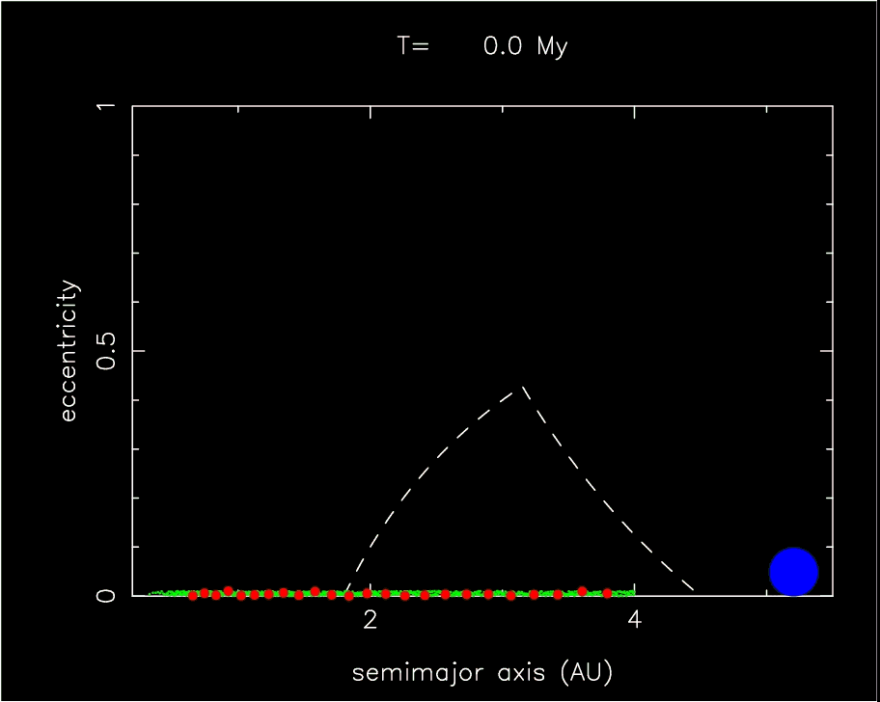
Dynamical models of early solar system evolution provide constraints on possible genetics of the terrestrial planets. (this model provided by W. Bottke).

Slide 5
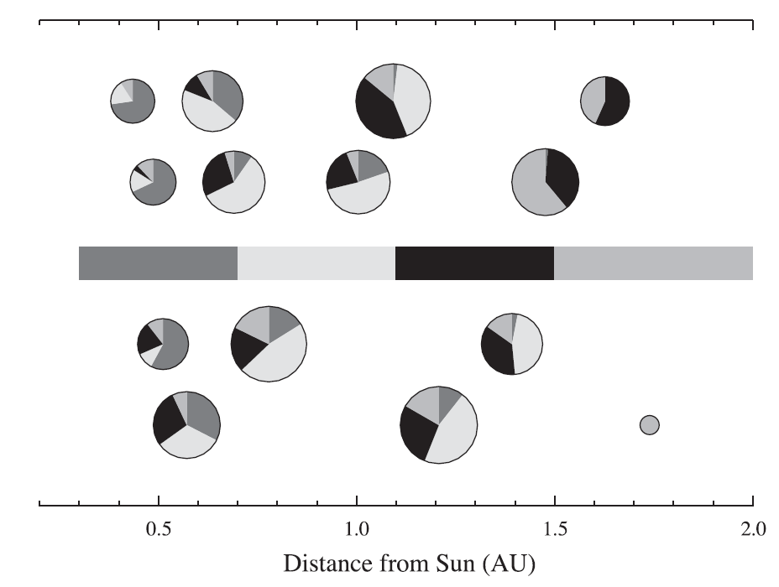
End result of such models includes distributions of the resulting bodies and genetic origins of building blocks. (from Chambers, 2004).

Slide 6

Conclusion: Earth was likely constructed from compositionally diverse materials, of which only the average composition (maybe) is accessible for study.

Slide 7

Comparative planetology is necessary to define bulk planetary compositions, as well as the differences in bulk compositions between planets (e.g., is the Earth like an enstatite chondrite?).
This talk is not about that…

Slide 8
Theoretical Basis
The final stages of terrestrial growth and differentiation led to the creation of mantle domains with unique isotopic characteristics resulting from radioactive decay, and may also have involved addition of genetically distinct materials to the mantle.
Some of these early-formed mantle domains remained chemically distinct for long periods of time following primary accretion.

Slide 9
Theoretical Basis
It is now possible to identify disparate primordial mantle components (radiogenic and possibly even nucleosynthetic) in the terrestrial rock record, and use them to examine mantle mixing during the first 2 to ? billion years of Earth history.

Slide 10
First, a bit of terminology…

Slide 11
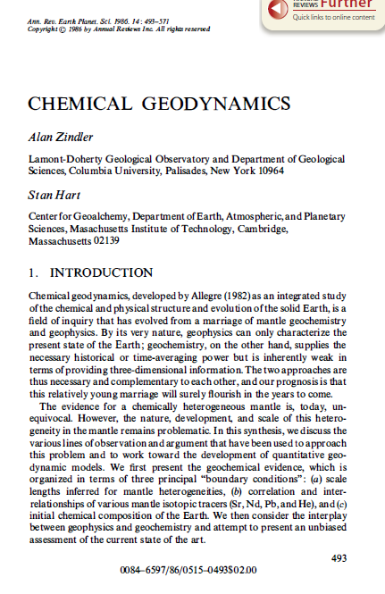
Chemical Geodynamics
Term coined by Claude Allegre (1982) describing the “linkage of geodynamics phenomena to major chemical fractionations”. Formalized by Zindler & Hart.
Chemical Geodynamics has mainly taken isotopic and chemical data from modern rocks and projected backwards in time.

Slide 12
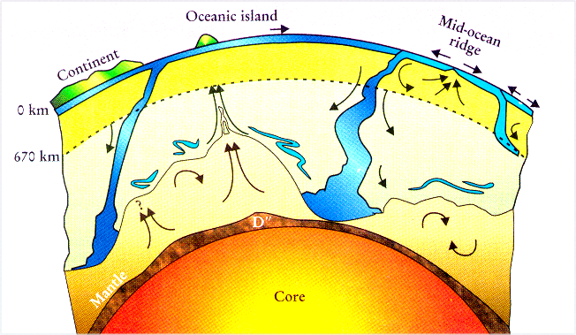
One contemporary view (ok, 15 year old view) of complexities in the operation and structure of the present mantle is based on chemical/isotopic data from (mostly) young rocks, coupled with geophysical data (classic figure from L. Kellogg).

Slide 13
Primordial Chemical Geodynamics
But what was the chemical structure of the early mantle and how did it operate?

Slide 14
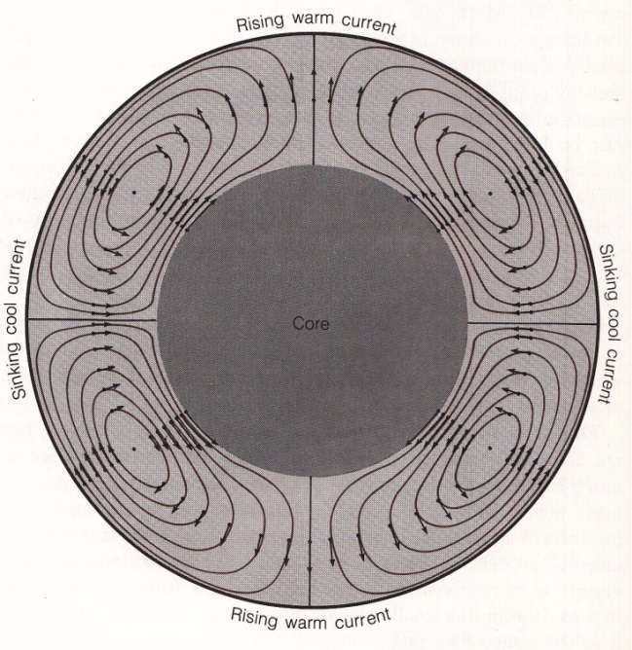
Was the mantle much less complex in its operation and structure >4 billion years ago?
(old = black and white)

Slide 15

To consider this, we have to use tools that allow us go back in time to examine the final stages of Earth’s construction and primary differentiation…..

Slide 16
Introduction to Tools:
Siderophile Elements
Elements strongly affected by core formation and post core formation processes.
Moderately Siderophile Elements (MSE)
Low P-T metal/silicate D values of 10-1000
Co, W, Ni, Ag, Ge and Mo
Highly Siderophile Elements (HSE)
Low P-T metal/silicate D values >10,000
Re, Os, Ir, Ru, Pt, Pd and Au

Slide 17
Why are siderophile elements ideal for studying late stages of planetary accretion and early mantle mixing?
High abundances in impactors with chondritic bulk compositions. Relatively low abundances in mantles because they are extracted into cores.
Bonus! Some siderophile elements involve short-lived radiogenic isotope systems and some show large isotopic heterogeneities among early solar system bodies.

Slide 18
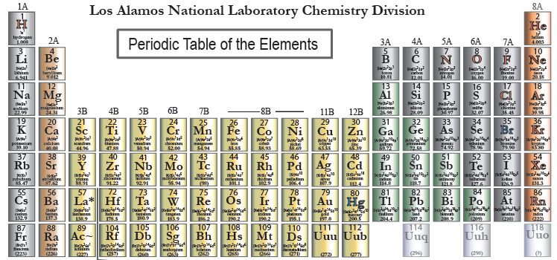

Slide 19
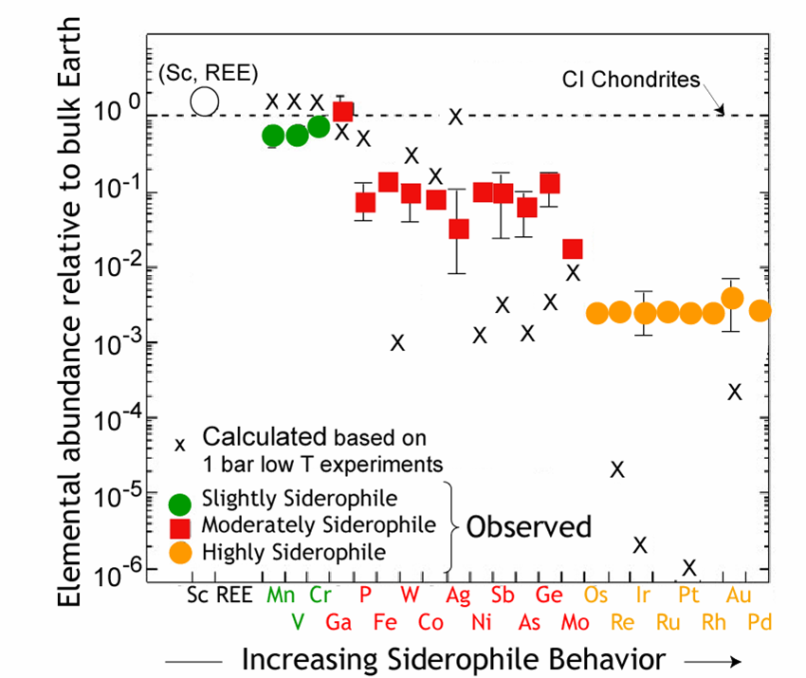
Moderately Siderophile Elements (MSE)
Typical 1 bar metal-silicate D values of 1-1000.
Abundances of MSE in mantle are both higher and lower than predicted by metal-silicate partitioning at 1 bar.
Figure from Cottrell

Slide 20
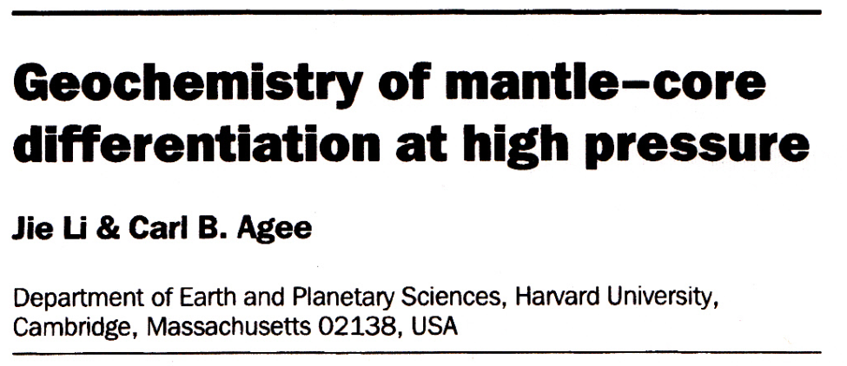
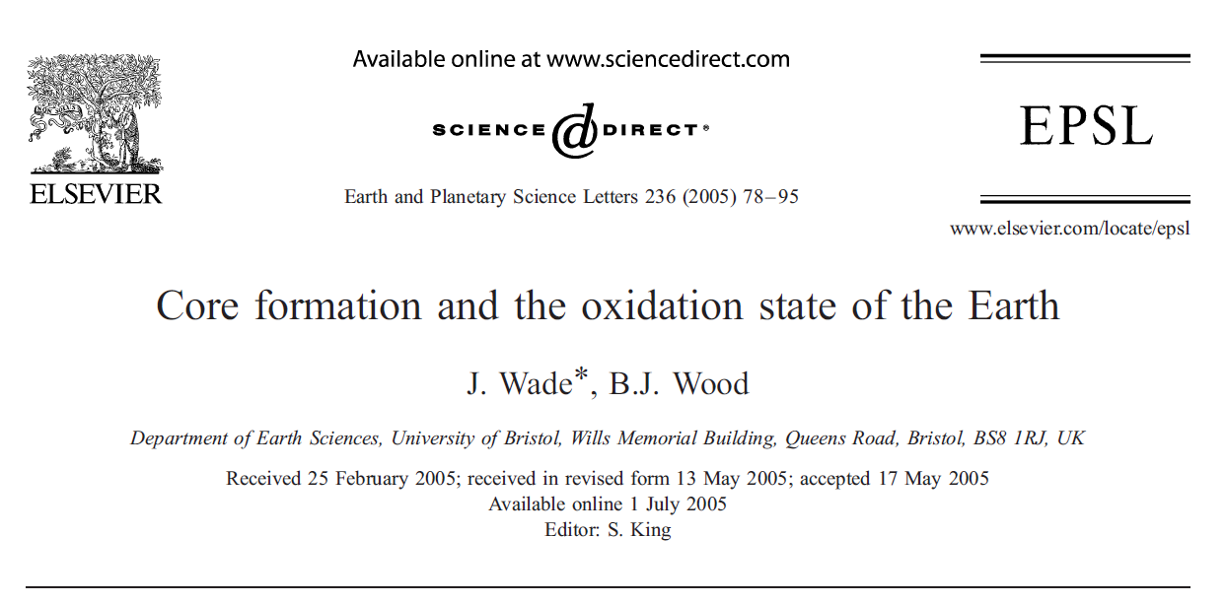
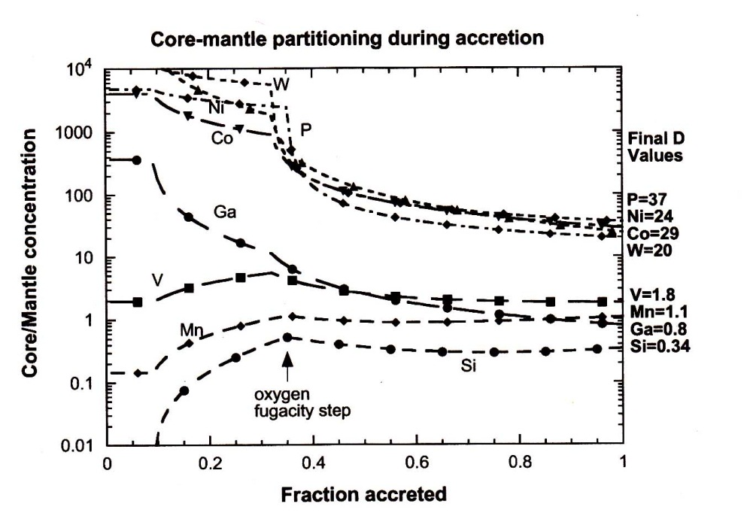
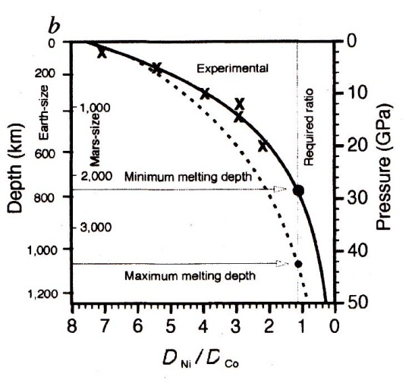
Most modern interpretations of MSE invoke high pressure/temperature, metal-silicate partitioning.

Slide 21
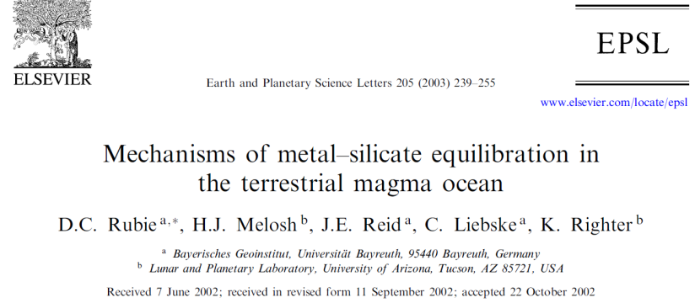
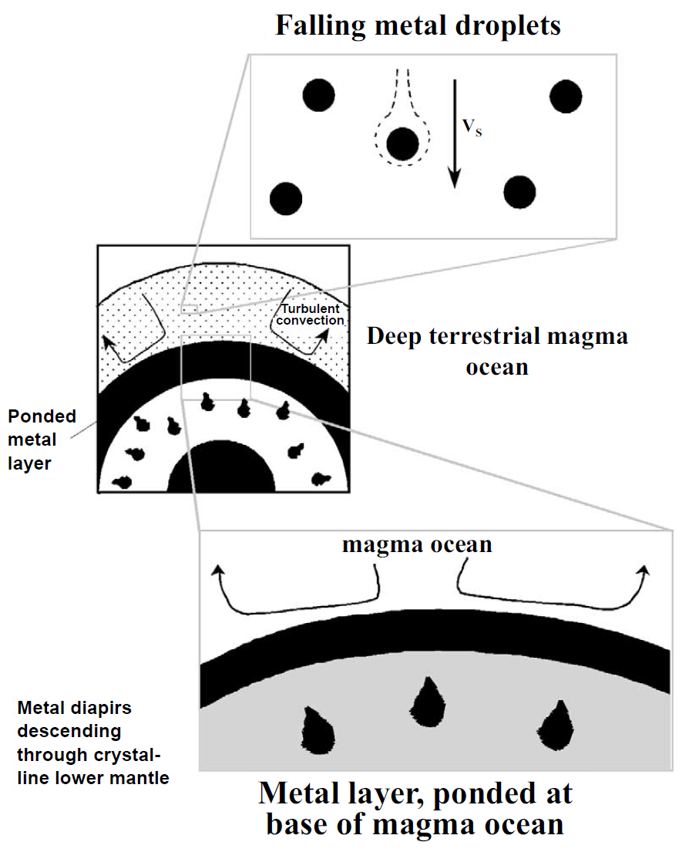
Issues remain.
Did metal-silicate equilibration occur between metal droplets and magma ocean?
Did metal-silicate equilibrium occur at the base of a magma ocean in a ponded metal layer?
How many magma ocean events?

Slide 22

Despite these controversies, most seem to accept the magma ocean(s) model to explain MSE abundances in mantle.

Slide 23
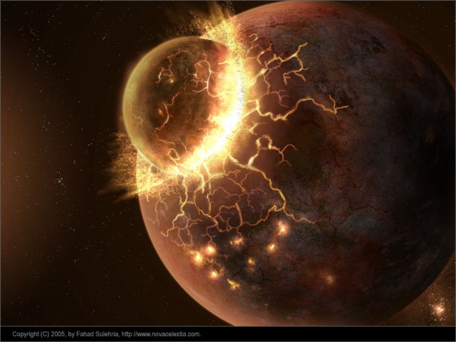
So, final ~10% mass addition to Earth, such as by a giant impact, likely strongly affected the abundances of the moderately siderophile elements in the mantle, such as W and Mo.

Slide 24
Overview of Highly Siderophile Elements (HSE)
Typical 1 bar metal-silicate D values of >10,000.
Abundances of HSE in mantle are only ~200 lower than chondritic, and occur in approximately chondritic relative abundances.
Figure from Cottrell

Slide 25




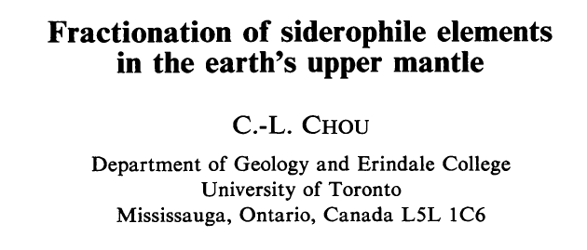

In contrast to MSE, the HSE were likely added after cessation of core segregation by a process commonly termed late accretion. Final addition of ~0.5 wt% of “chondritic” material to the Earth’s mantle. Sometimes referred to as a “late veneer”.
Origin of HSE to Silicate Earth

Slide 26
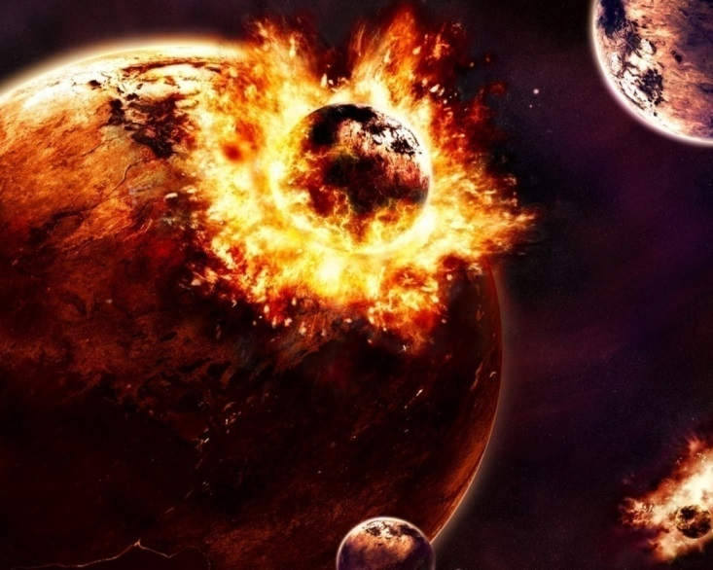
So, final ~0.5% mass addition to Earth, such as by a late accretion, likely strongly affected the abundances of the highly siderophile elements in the mantle, such as Os and Ru.

Slide 27

What does all this have to do with early mantle mixing!?

Slide 28

Like the “silly little mm longer” cigarette ads of the 1960’s (that attached great importance to the additional mm), recent advances in mass spectrometry allow us to resolve very small differences in isotopic composition between rocks (those silly little ppm!). Although tiny, knowledge of the differences have had a huge impact on our understanding of the early Earth.

Slide 29
Let’s start off with an example of an isotopic system that does not consist of siderophile elements.

Slide 30
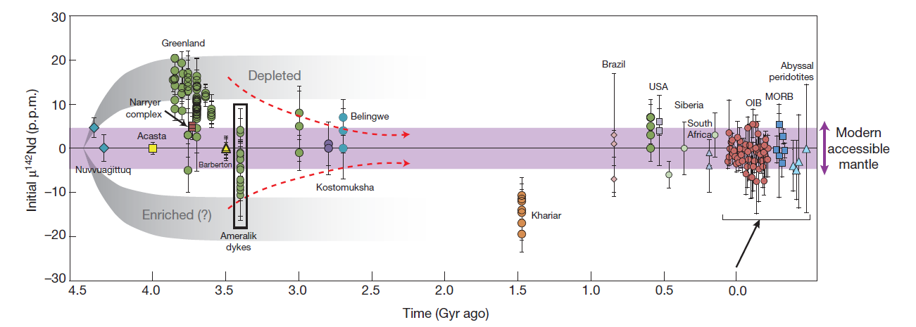
¹⁴⁶Sm→¹⁴²Nd + α (t_{½}= 68 Myr)
¹⁴²Nd isotopic heterogeneities in early Earth rocks (Isua, Greenland) were created in mantle domains with fractionated Sm/Nd very early in Earth history. “Anomalies” mixed away by the end of the Archean.
From: Rizo et al. (2012)

Slide 31
Now consider some examples of the application of siderophile elements to the mixing history of the early mantle.

Slide 32

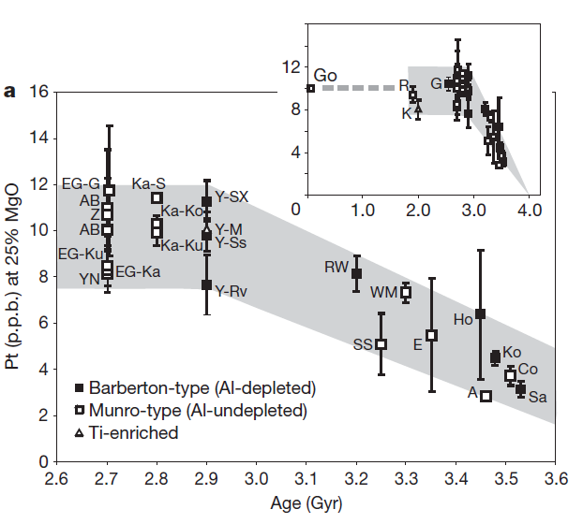
Poorly mixed state of late accreted materials suggested by HSE abundances in komatiite sources.
Maier et al. (2009), argued for slow, progressive downward mixing of a late veneer rich in HSE.

Slide 33
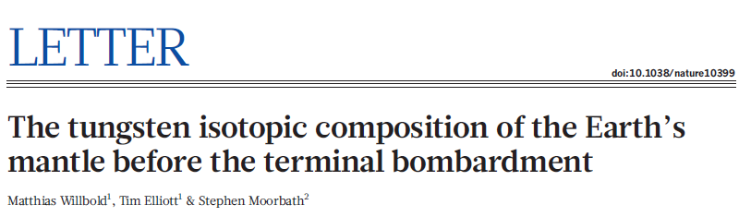
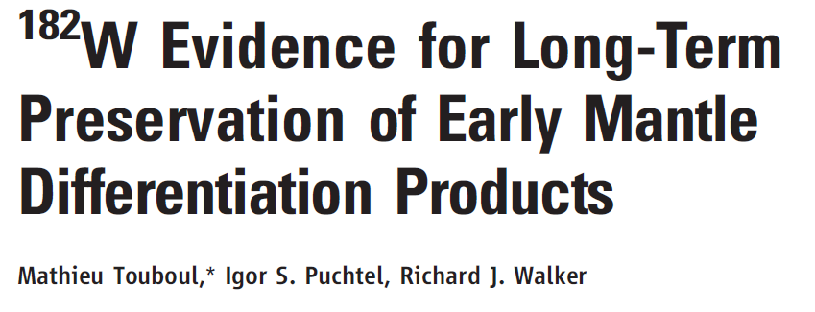
Two Flavors of ¹⁸²W Isotopic Anomalies also Consistent with Sluggish Mantle Mixing

Slide 34
Lithophile (Hf) –Siderophile (W) System
¹⁸²Hf → ¹⁸²W
t_{½} = 8.9 x 10⁶ yr
Hf (ppb) W (ppb) Hf/W μ¹⁸²W
Chondrites 200 180 1.2 -200
Mantle 280 15 19 0
Core 0 470 0 -220
μ¹⁸²W is the deviation in parts per million of ¹⁸²W/¹⁸⁴W ratio from standards.

Slide 35
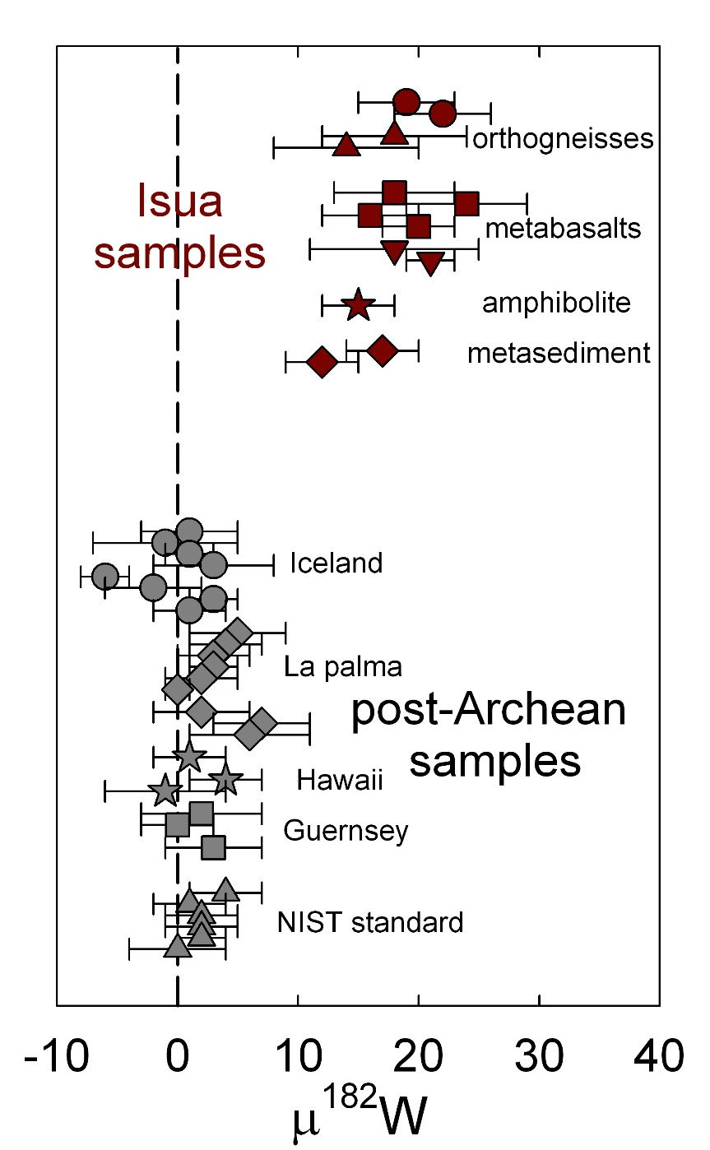
Example 1:
Willbold et al. (2011) reported ~13 ppm positive ¹⁸²W anomalies in ~3.8 Ga supracrustal rocks from Isua, Greenland (which also show variable ¹⁴²Nd enrichments).

Slide 36
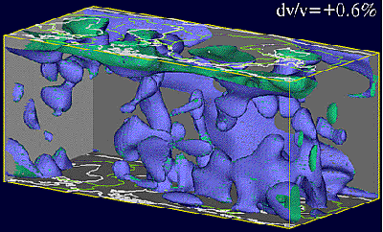

Willbold et al. concluded that the Isua rocks were derived from mantle that formed prior to, and remained isolated from late accretion.
They speculated that most HSE and a modest proportion of the MSE (including W) were added to the mantle after the mantle precursors to the Isua lithologies formed.
HSE-free
¹⁸²W enriched
HSE-rich
¹⁸²W depleted

Slide 37

Isua results are consistent with mass balance arguments that late accretion of 0.5 wt.% of chondritic material to Earth’s mantle would lower the ¹⁸²W/¹⁸⁴W of the mantle by 10 to 40 ppm.
If correct, this means a siderophile element poor (but ¹⁸²W rich) domain formed within the Hadean mantle survived 10’s to 100’s of Myr until the Isua rocks formed during the Archean.

Slide 38
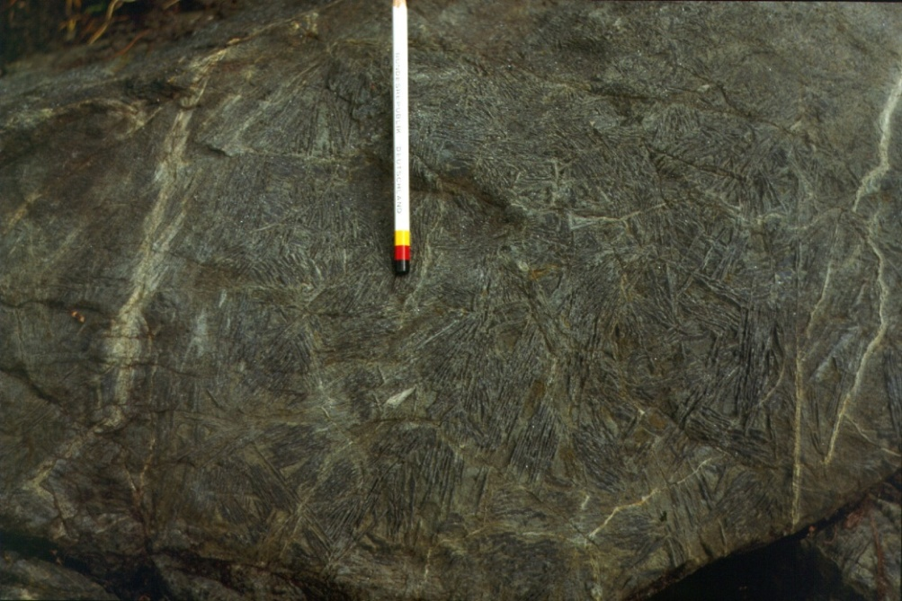
Example 2:
Touboul et al. (2012) reported ¹⁸²W data for some 2.8 Ga komatiites from Kostomuksha, Russia.
The komatiites are high MgO rocks that were likely produced by large extents of melting of a sizeable, deep mantle domain.

Slide 39
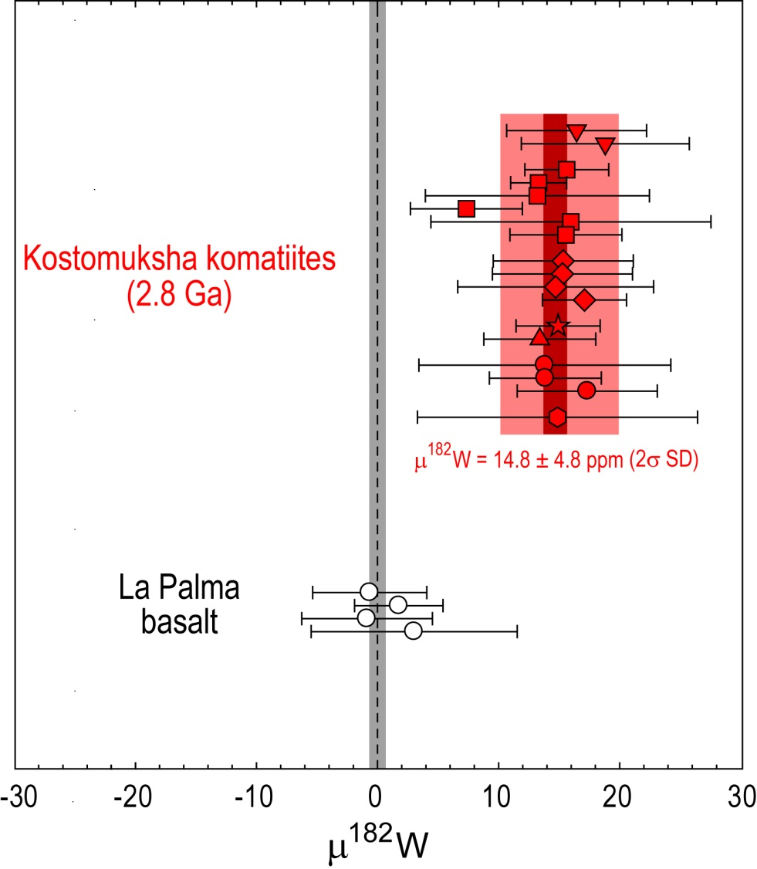
These komatiites are characterized by a uniform +14.8 ppm enrichment in ¹⁸²W.
The elevated ¹⁸²W is best explained as a result of the endogenous ingrowth of ¹⁸²W within first 30 Myr after solar system formation (while ¹⁸²Hf was still relatively plentiful).

Slide 40
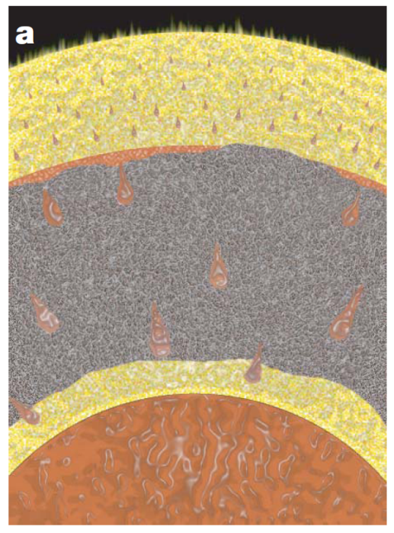
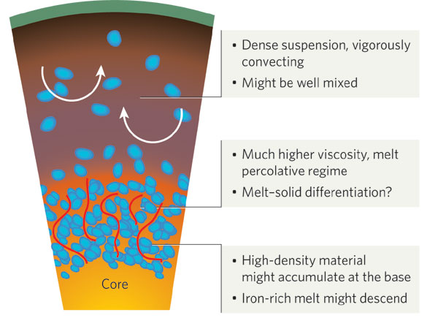
Source Included Primordial Mantle Processed By…
High pressure/ temperature metal-silicate partitioning in a basal magma ocean (makes high Hf/W rocks).
Silicate crystal-liquid fractionation in a magma ocean.
From: Labrosse et al., 2007
From: Stevenson, 2008

Slide 41
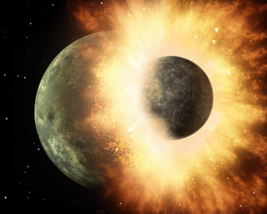
If the Moon formed more than 50 Myr after the formation of the solar system, the observation that the mantle source reservoir for the komatiites included an older component that remained unmixed until at least 2.8 billion years ago means that even the putative Moon-forming giant impact did not completely melt and chemically homogenize the mantle!

Slide 42
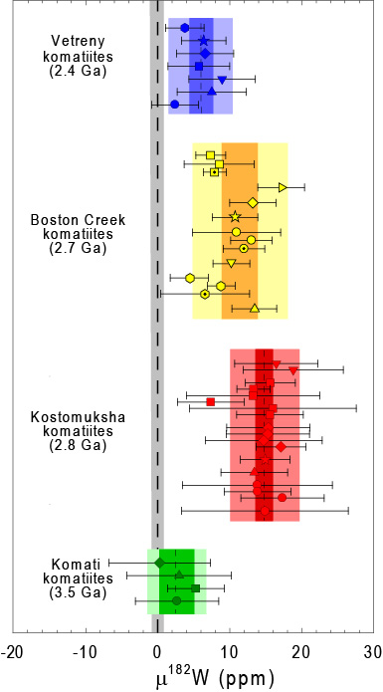
As with ¹⁴²Nd, do ¹⁸²W anomalies mix away by the end of the Archean?
Insufficient data so far, but it appears unlikely.

Slide 43
Many surprises await!

Slide 44
Lack of ¹⁸²W anomaly for 3.5 Ga Komati komatiites poses a problem for the Maier et al. hypothesis.

Slide 45
Where to from here?
Improved analytical methods allow very high precision measurements of W, Ru and Mo.

Slide 46

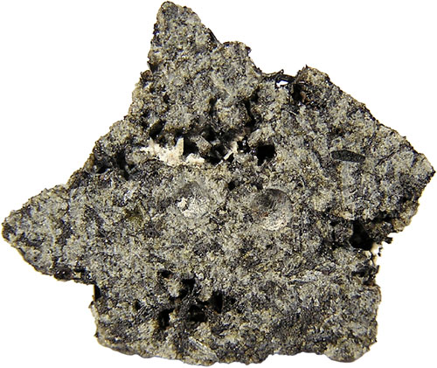
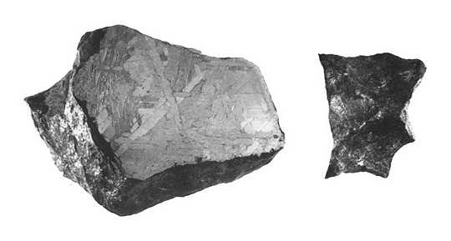
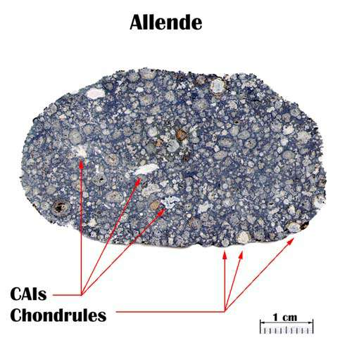
Cut to the Meteorites!
Meteorites come in many different forms (groups). Key to our interests is that different groups formed either in different parts of the nebula or at different times, and incorporated different proportions of isotopically diverse matter from the nebula.

Slide 47
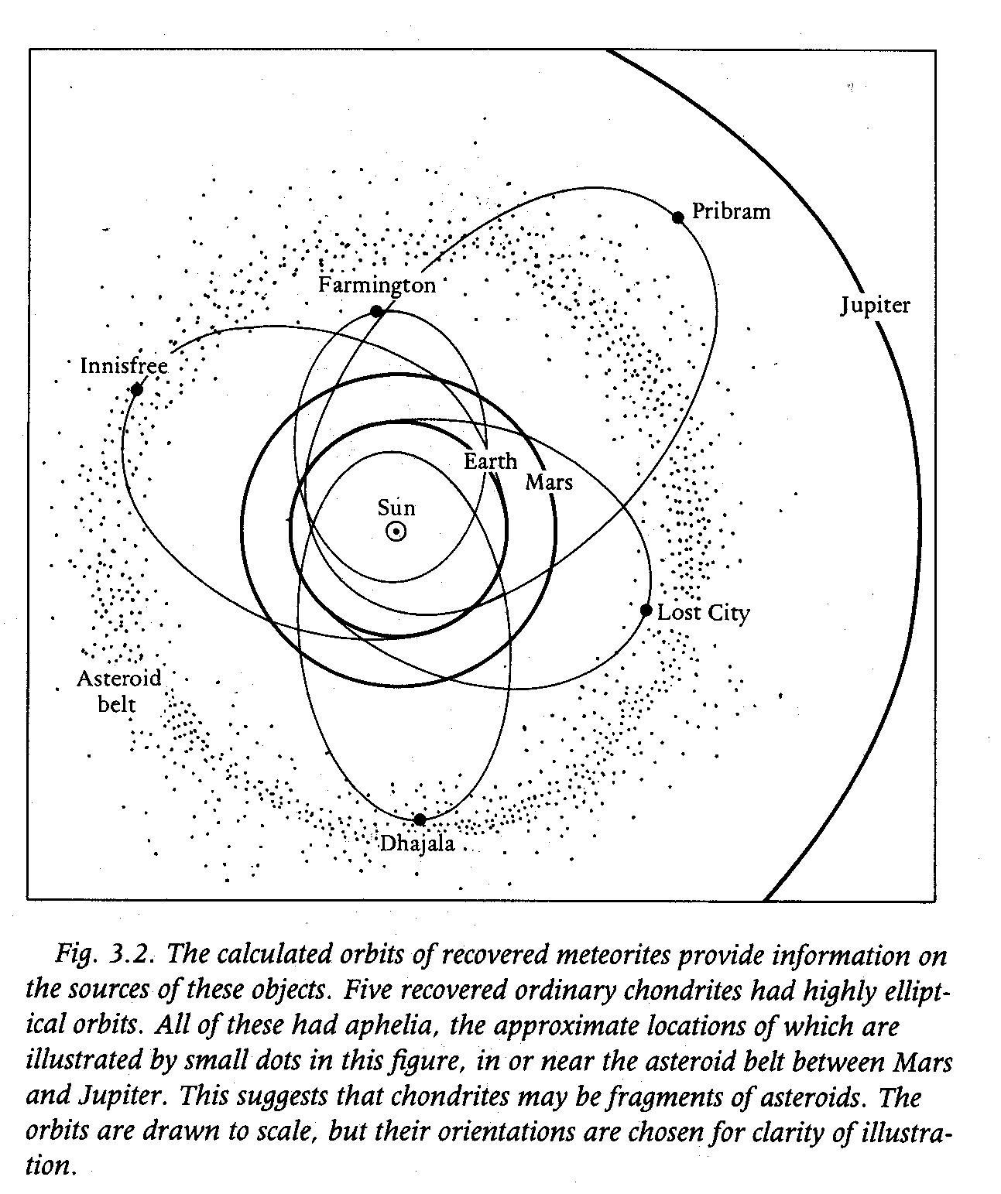
Today, meteorites sample different parts of the asteroid belt, and their compositions tell us that they formed under different conditions, such as fO₂.
Figures from : McSween, 1988

Slide 48
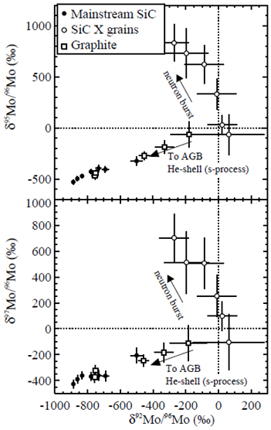
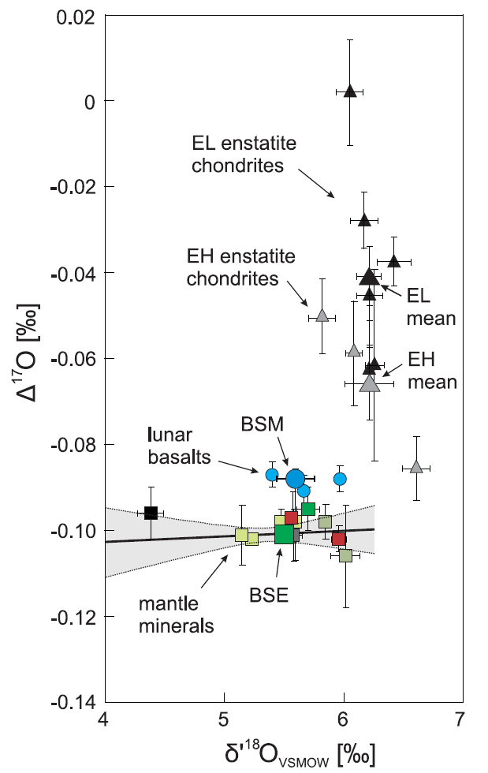
The parent bodies of different groups of meteorites were built from materials that are isotopically distinct due to incorporation of diverse nucleosynthetic materials (Mo), elements that were modified by early stellar processes (O), or elements that were differentially modified by radioactive decay (W).
Nittler, 2004
Herwartz et al., 2014

Slide 49
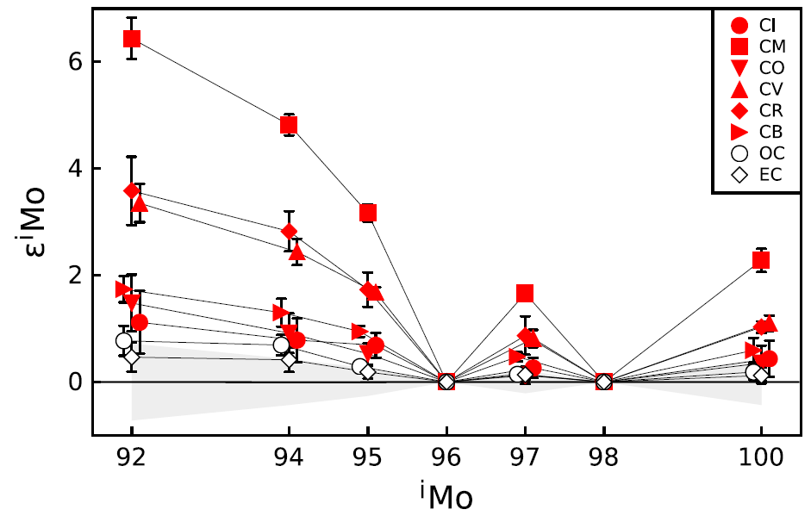
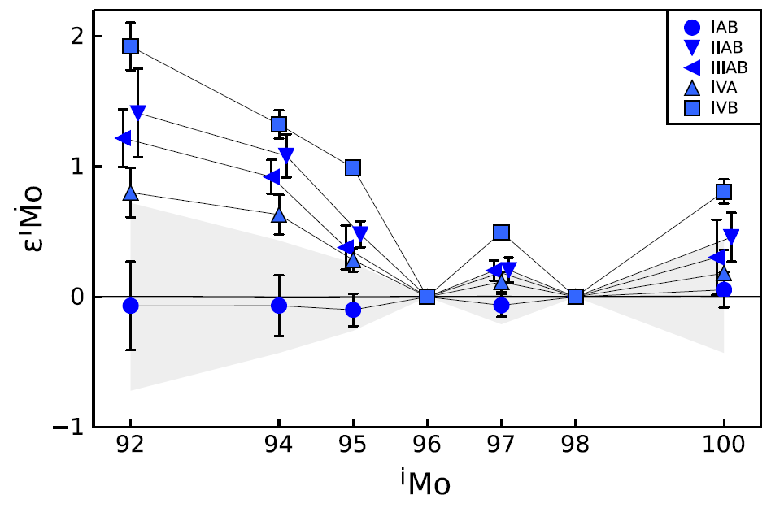
Molybdenum (MSE):
Variable mixtures of presolar components in materials that represent the bulk compositions of early solar system bodies evidenced in Mo isotopes.
From: Burkhardt et al., 2011

Slide 50
From: Burkhardt et al., 2011
Mantle Mo is isotopically most similar to enstatite chondrites.

Slide 51
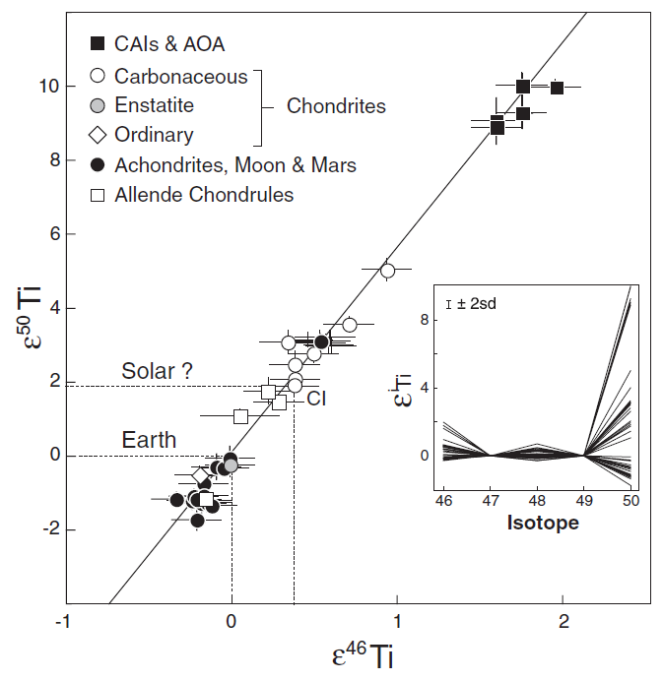
Some other elements show isotopic similarities with enstatite chondrites, including Cr and Ti. In contrast to Mo, these are not elements that would be strongly affected by late stage planetary accretion.
Does this mean that primary and late stage accretion of Earth was dominated by similar materials?
Trinquier et al., 2009

Slide 52
Should we expect to find Mo isotopic variations among early Earth rocks?
Probably not, if mantle Mo abundance (and isotopic composition) was established by one or more large, global magma ocean events (well mixed?).
But what if we do find isotopic anomalies?
Essentially no data of high enough precision to assess at present.

Slide 53
What about the genetics of the final ~0.5% wt. % material added to Earth?

Slide 54
Ruthenium (HSE), may be the ideal tracer to examine this:
Variable mixtures of presolar components in materials that represent the bulk compositions of early solar system bodies evidenced in Ru isotopes.
From: Chen et al., 2010

Slide 55

Some have argued that late accretion may have been dominated by a limited number of large impacts, not a gentle snow of matter that formed a veneer.
This
Not this

Slide 56
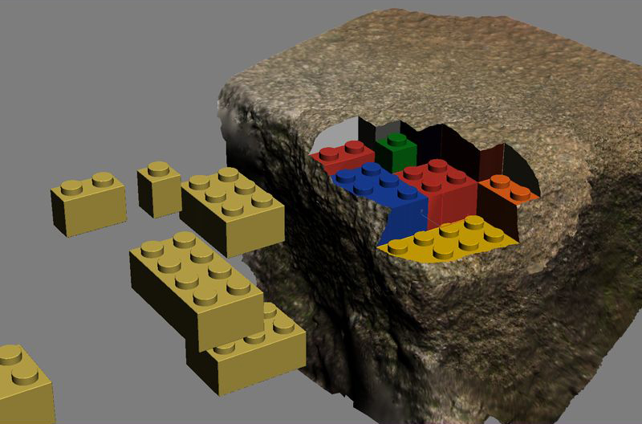


¹⁰⁰Ru poor?
If so, did late accretion create isotopically “tagged” domains in the mantle?
Could such domains have survived long enough to produce lasting evidence?

Slide 57


