Slide 1
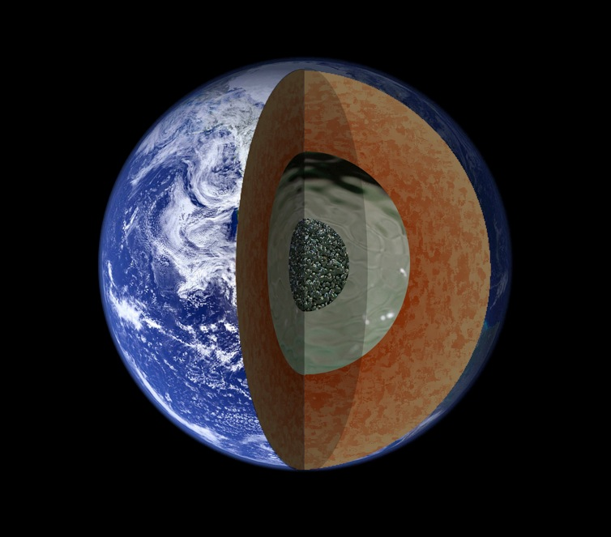
Planetary Dynamos
Bruce Buffett, University of California, Berkeley
Notes:
Physical properties of core and mantle. Flow in the core may be driven by mK temperature anomalies.

Slide 2

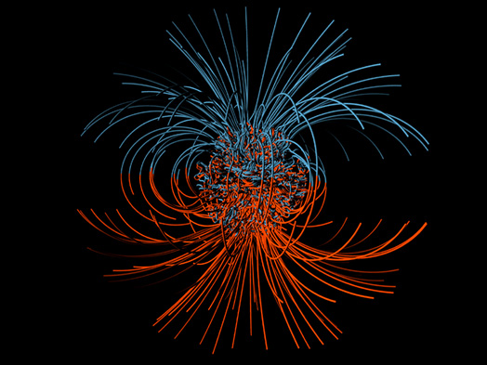
er
Geodynamic Questions
Flow in rotating fluid
Magnetic Field
Notes:
How do fluid motions in the core of terrestrial planets generate magnetic fields?

Slide 3
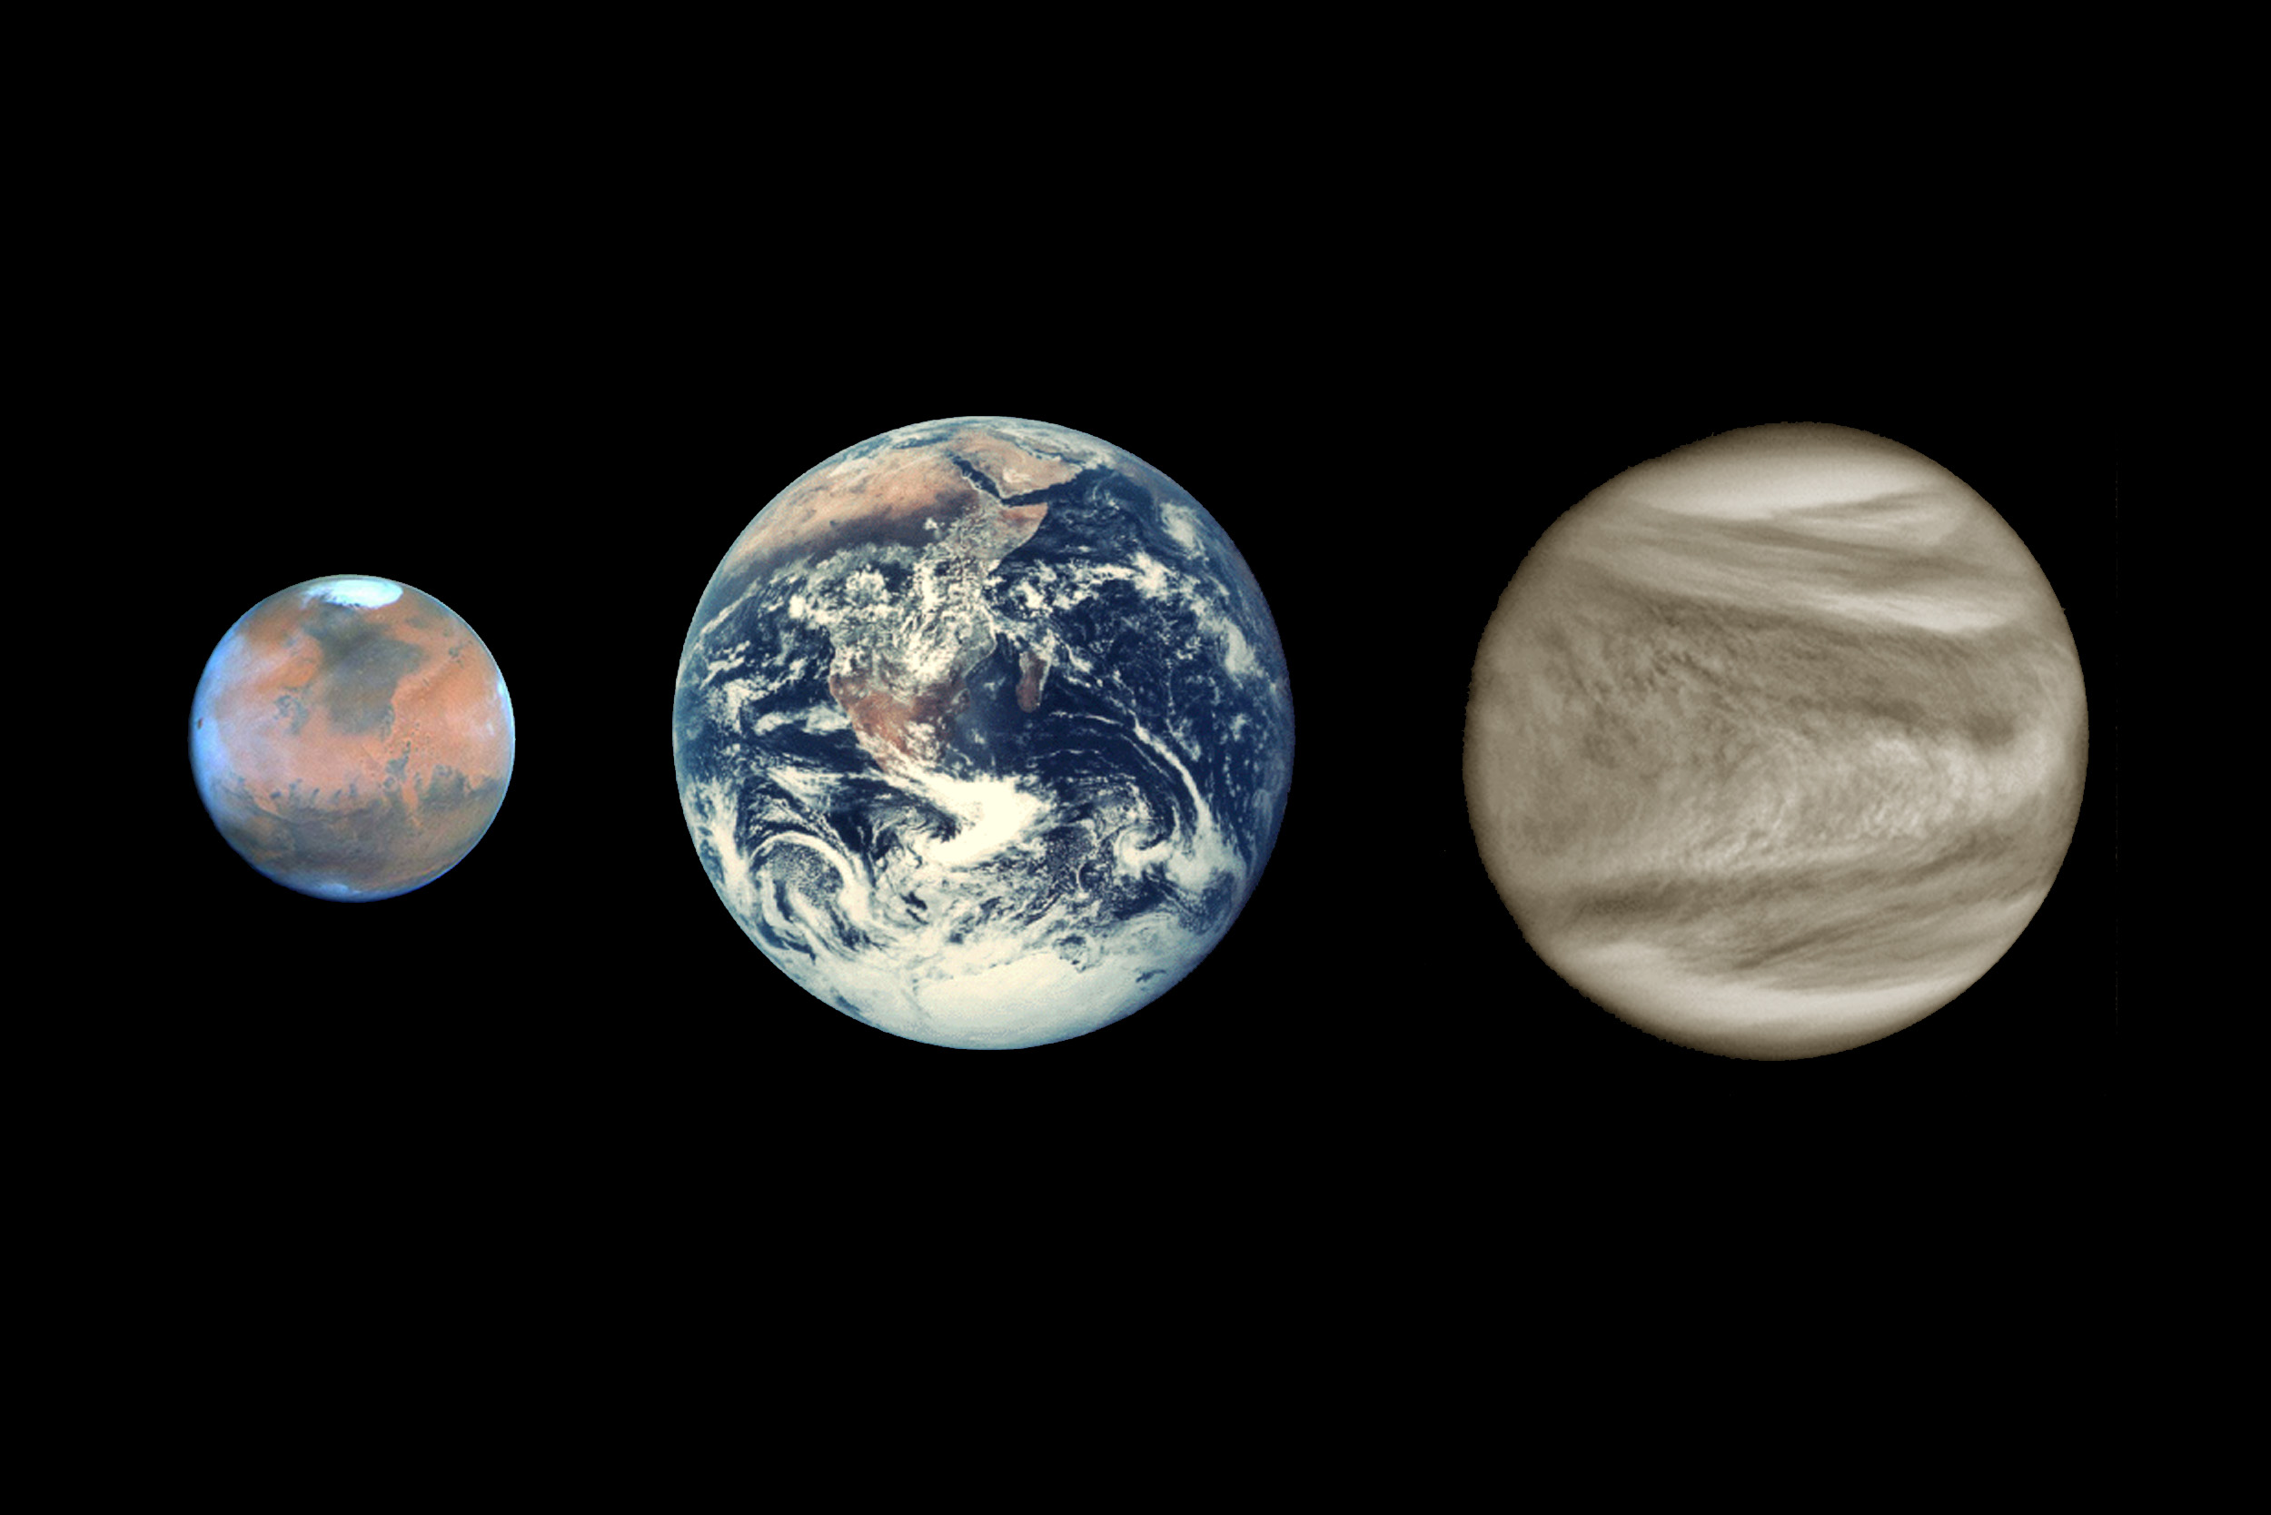
Geodynamic Questions
Planetary dynamos are useful diagnostic of geological activity
Notes:
The existence of a magnetic field tells us a lot about the internal dynamics of a planet

Slide 4

Did the Early Earth have a Magnetic Field?
Evidence for magnetic field at 3.4 Ga (Tarduno et al. 2010)
Notes:
Magnetic inclusions in silicate crystals suggest a magnetic field 3.4 Ga

Slide 5
Physical Processes
Present day
contraction
Cooling of the core is controlled by mantle convection
Notes:
The evolution of the core is driven by the heat flux Q into the base of the mantle. This value is set by the dynamics of the mantle. Cooling of the core causes growth of the inner core by solidification, releasing latent heat and compositional buoyancy. Cold downwellings may also form at the core-mantle boundary.

Slide 6
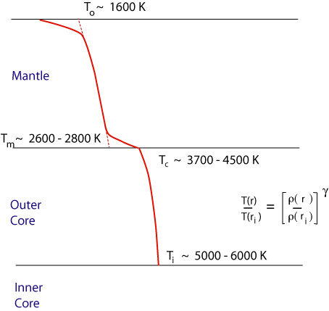
Present-Day Temperature
D”
temperature drop across D”: ΔT = 900 - 1900 K
Notes:
An estimate of the CMB heat flow can be assessed using knowledge of the internal temperature. The surface (potential) temperature is set by melting at midocean ridges and the thickness of the oceanic crust. Continuing along an adiabat give 2600 to 2800 K near the base of the mantle. Similarly, the temperature in the core is set by the melting temperature at the inner core boundary. Continuing along an adiabat to the top of the core gives 3700 to 4500 K. The difference is the temperature drop across the boundary layer at the base of the mantle.

Slide 7
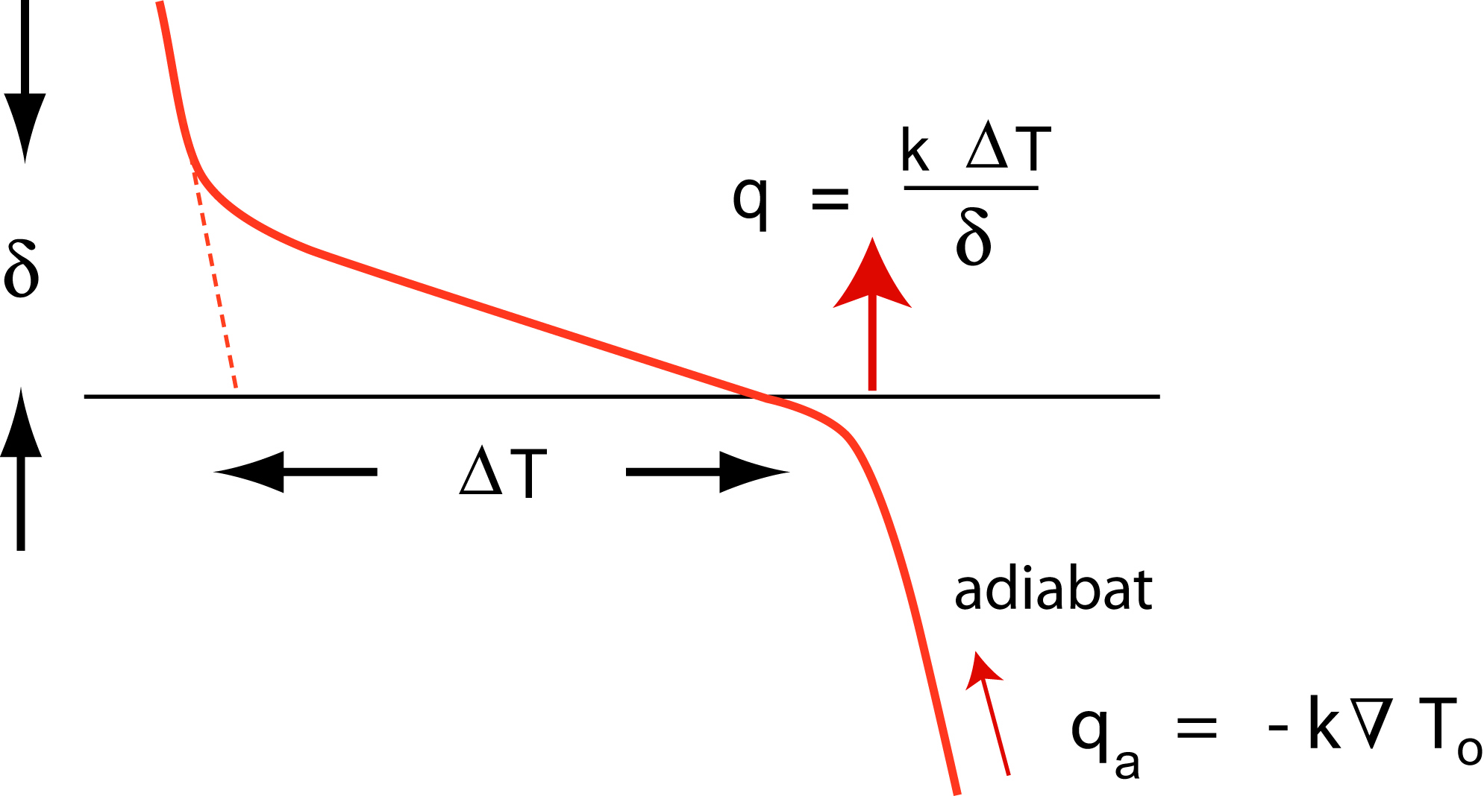
Core Heat Flow
~ 5 to 15 TW
900 – 1900 K
adiabat
thermal boundary layer on the core side?
Notes:
Representative estimates of the CMB heat flow are roughly suggest 5 to 15 TW. By comparison the surface heat flow is 44 TW; however the surface area is 4x larger than the CMB. The existence of a boundary layer on the core side of the boundary depends on the heat conducted down the adiabat.

Slide 8
Core Heat Flow
~ 5 to 15 TW
~ 5 to 8 TW
conduction along adiabat is comparable to mantle heat flow
Notes:
When the core is well mixed (and adiabat) a lot of heat is conducted through the core because the thermal conductivity is high. The total conducted heat flow could be 3 to 5 TW compared with 5 to 10 TW into the base of the mantle.

Slide 9
Recent Estimates of Conductivity
Fe alloys
Fe alloys
Pozzo et al. (2013)
Notes:
Red (Fe82Si10O8) at 5700K
Green (Fe79Si8O13) at 5500 K

Slide 10
Core Heat Flow
~ 5 to 15 TW
~ 5 to 8 TW
10 to 16 TW
conduction along adiabat is comparable to total heat flow
Notes:
However, recent estimates of thermal conductivity increase the conducted heat flux to 10 to 15 TW; comparable or larger than the CMB heat flux.

Slide 11
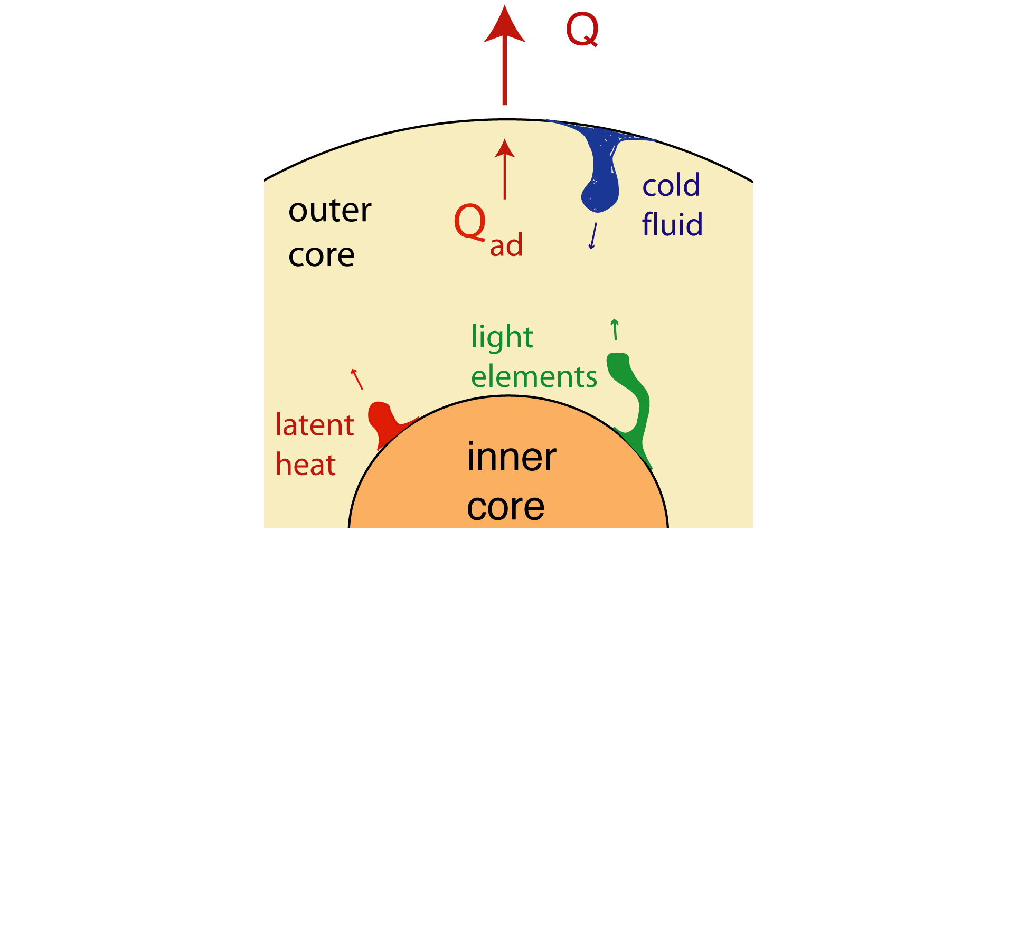
Convection in the Core
Q > Q_{a}
Fe alloy
cold thermal boundary layer
Notes:
When the CMB heat flow Q is larger than the conducted adiabatic heat flow Qa we expect cooling near the boundary and thermal downwelling.

Slide 12
Convection in the Core
Q < Q_{a}
Options
i) compositional buoyancy mixes warm fluid
ii) thermally stratified layer develops
( -> compositional instability)

Slide 13

Convection in the Core
Q < Q_{a}
Double Diffusive Convection
“salt finger” instability

Slide 14
Early Earth
i) Q > Q_{a}
- a geodynamo is possible
ii) Q < Q_{a}
- convection ceases
- geodynamo fails *
(* with some qualifications)

Slide 15
Chemical Interactions
Early Earth
Cooling reduces solubility of
dissolved components
Energy Supply depends on
- abundance of element
- T-dependence of solubility
O and/or Si appear to be undersaturated at present
Notes:
It is possible that chemical interactions could help, but this remains a speculative idea.

Slide 16
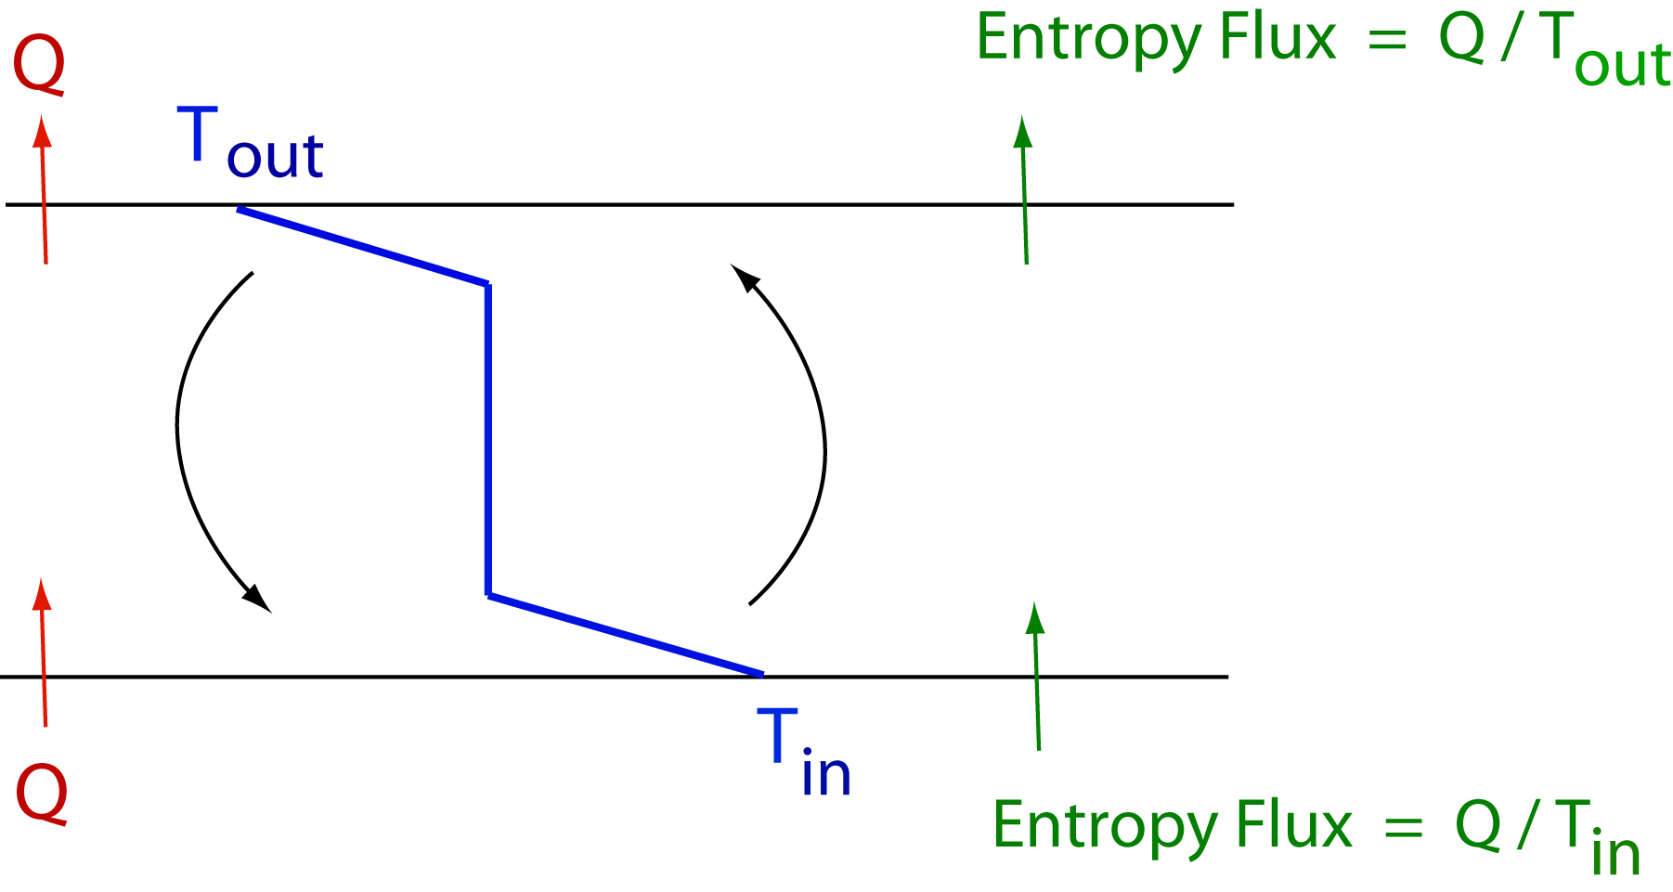



A Primer on Convective Power
dissipation
convection
Entropy Balance
Carnot efficiency

Slide 17
High Thermal Conductivity
entropy production
convection
Entropy Balance

Slide 18
High Thermal Conductivity
entropy production
convection
Entropy Balance

Slide 19
Power Available to Dynamo
Dynamo Power Φ
thermal
latent heat
composition
Notes:
Extending these ideas to the core, including all of the entropy sources. The efficiencies (epsllon) often depend on the size of the inner core (see plot).

Slide 20
Implications for Thermal Evolution
heat flow
thermal history
inner core
Notes:
Dynamo power has implications for thermal evolution because we need to ensure a flow of heat that sustains the magnetic field

Slide 21



How is the Magnetic Field Generated?
Magnetic Induction
Maxwell
threshold for field generation ~ 10
Without flow V
decay time τ ~ R² / π² η ∼ 25 kyr

Slide 22
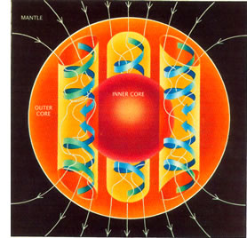


Convection in Rotating Fluid
Momentum equation (ma = f)
Coriolis
buoyancy
viscous
Character of Flow
Gubbins and Bloxham (1985)
Notes:
Rotation has a large influence on convection in the core (unlike the mantle). We add the coriolis force to the momentum equation. The centrifugal force is absorbed into the pressure gradient. Both the influence of viscosity and inertia (v.grad v) are very small. The ratio of viscosity to coriolis is the Ekman number E; the ratio of inertia to coriolis is the Rossby number Ro.

Slide 23
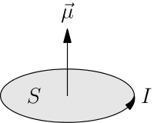
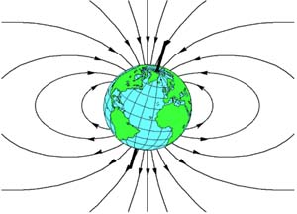
Origin of Dipole Field
Magnetic Moment
current
In the absence of external sources
μ - magnetic permeability

Slide 24
Effects of Helical Flow
Magnetic Moment
Helical flow lifts and twists B_{φ}
B
- both upward and downward B_{z}
- cancellation in axial moment m_{z}
V
(Parker, 1955)

Slide 25
Effects of Helical Flow
Magnetic Moment
Strategy
- separate upward and downward segments
B
- expel one segment from the core
V
- sometimes called α-effect
(Parker, 1955)

Slide 26
Numerical Model
Olson et al. (1999)

Slide 27
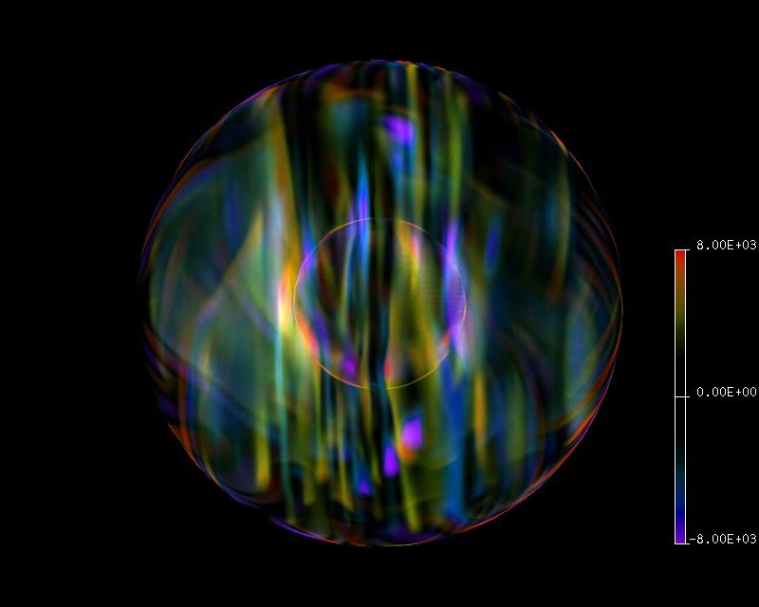
Planetary Dynamo
Vertical Vorticity
Notes:
Ekman E = 5 x 10^-5, Pr = 1, Pm = 0.5

Slide 28
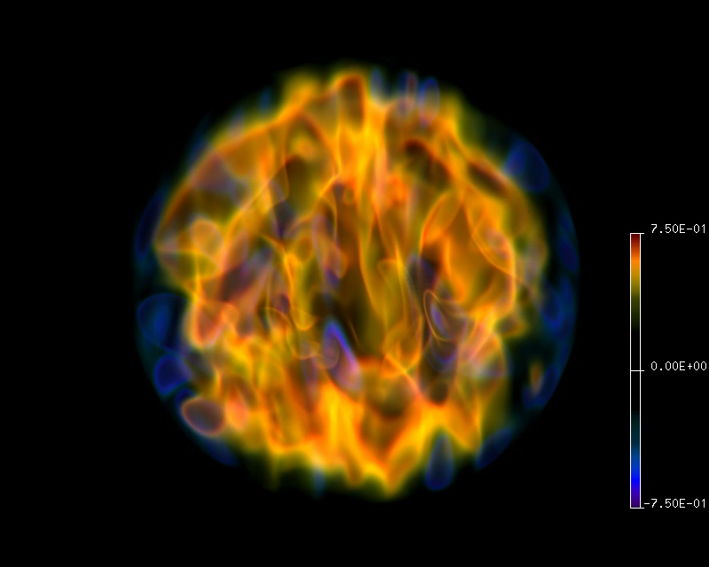
Vertical Field
Magnetic Field
Notes:
E = 5x10^-5, Pr = 1, Pm = 0.5

Slide 29
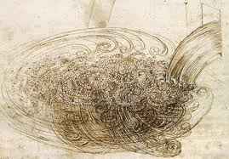
The Challenge for Numerical Models
“Big whirls have little whirls
that feed on their velocity,
and little whirls have lesser whirls
and so on to viscosity”
Richardson, 1922
Da Vinci, 1509
Viscosity ν (i.e. momentum diffusion) limits the length scale of flow
Magnetic diffusivity (η = 1/μσ) limits the length scale of magnetic field
Notes:
What about turbulence? The diffusivities set the smallest scales of the various fields. Velocity should have small scales whereas magnetic field should have larger scales because of the relative size of their diffusivities.

Slide 30

Fluid Mechanics of the Liquid Metal
Viscosity ν ~ 10⁻⁶ m²/s
Thermal Diffusivity κ ~ 10⁻⁵ m²/s
Magnetic Diffusivity η ~ 1 m²/s
Prandtl Numbers
Notes:
A comparison of the velocity, thermal and magnetic diffusivities in liquid metal. The Prandtl numbers compare with the relative size of the minimum length scales.

Slide 31
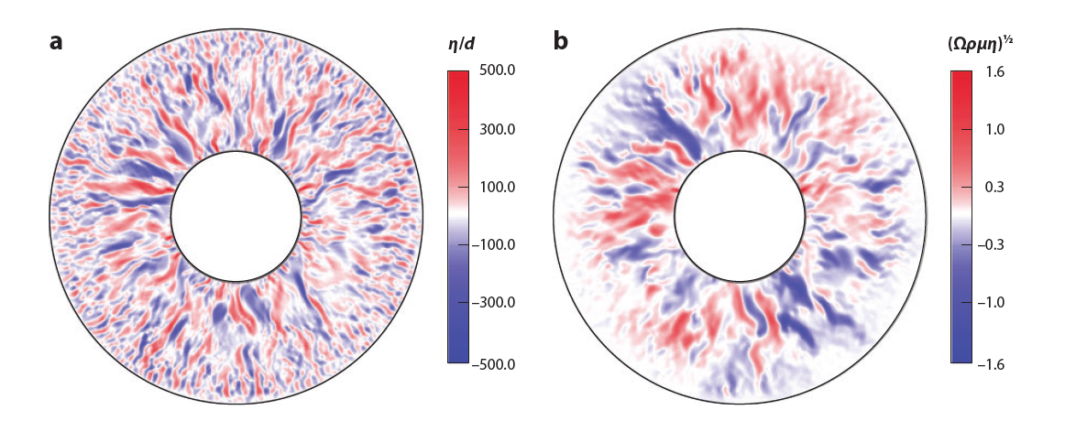
Characteristic Scales
Velocity (radial)
Magnetic Field (radial)
(Jones, 2011)
Model Parameters (Earth)
E = 3x10⁻⁶ (10⁻¹⁶) P_{m} = 0.1 (10⁻⁶)
Notes:
In our best simulations Pm = 0.1 and we already see a distinction in the length scales (small scale velocity and larger scale magnetic field). What happens as Pm goes to 1.0e-6. Good question. It is likely that the separation of scales become more extreme. Remember that Rm = VL/eta. When L gets small the effect of magnetic induction becomes weak and possibly ineffective.

Slide 32
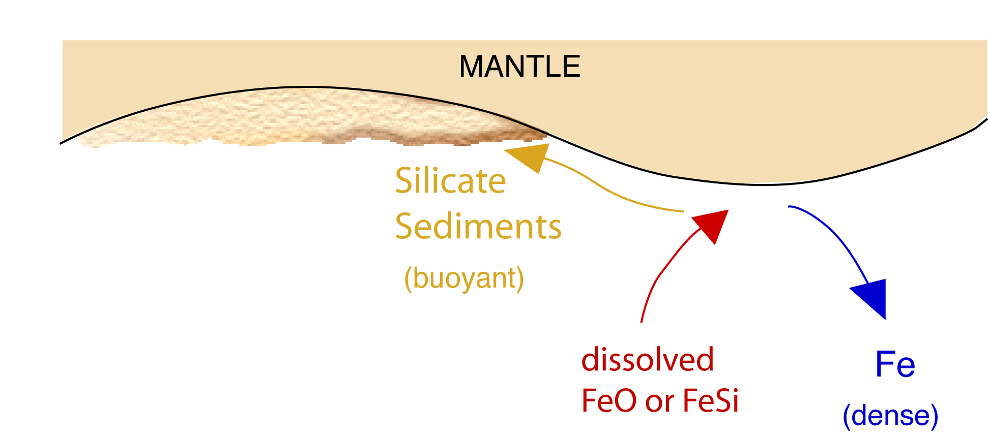
Other Sources of Buoyancy?
e.g. chemical disequilibrium due to cooling and inner-core growth
Provides an additional source of compositional buoyancy

Slide 33
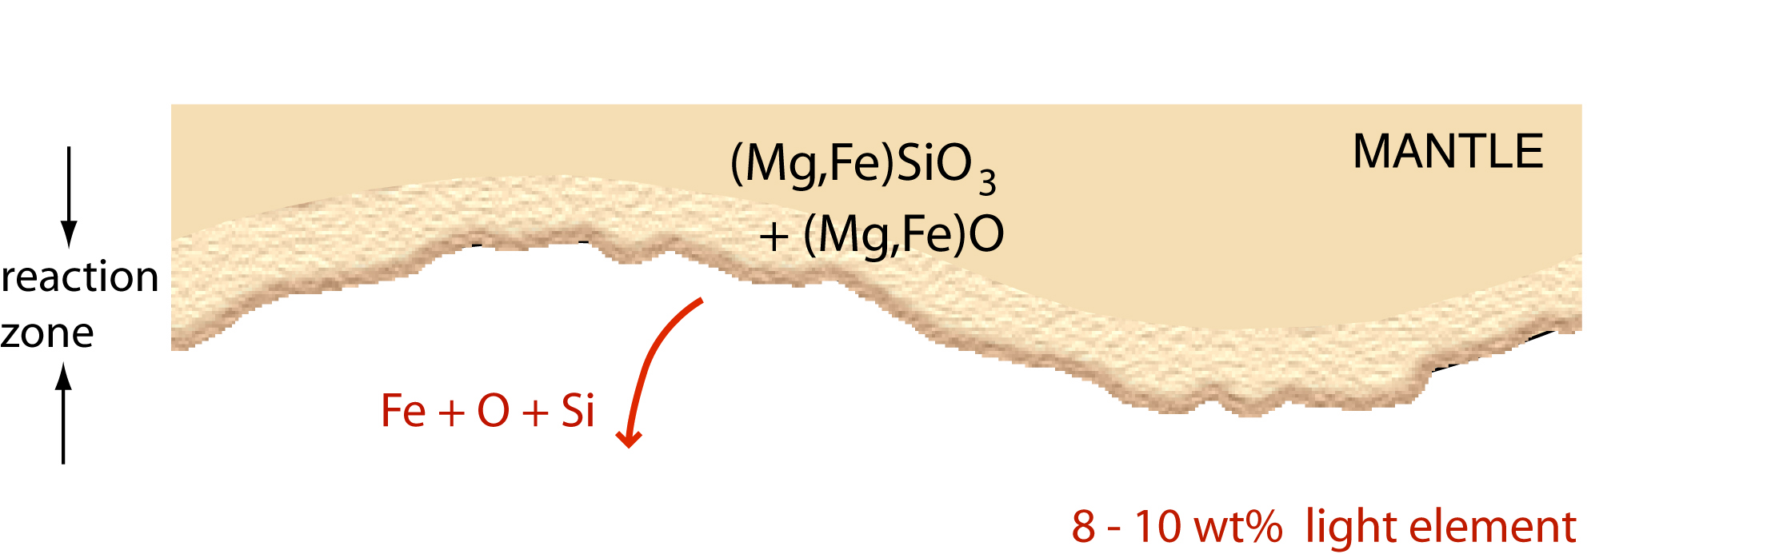
Not so simple in detail…
The experiments suggest substantial disequilibrium at core-mantle boundary
Si and O in core are under-saturated relative to mantle minerals.
What about other major elements? Mg?

