Slide 1
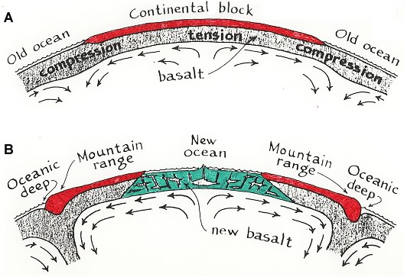
Arthur Holmes (1945)

Slide 2
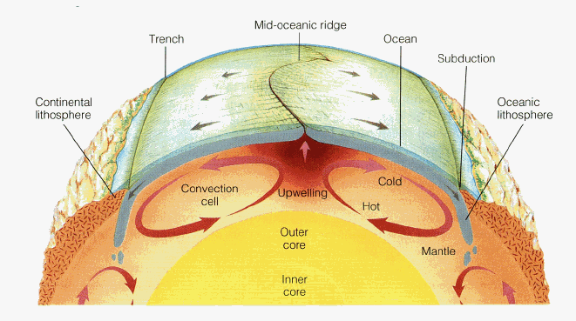
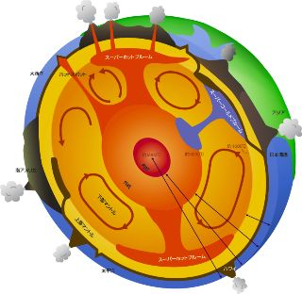
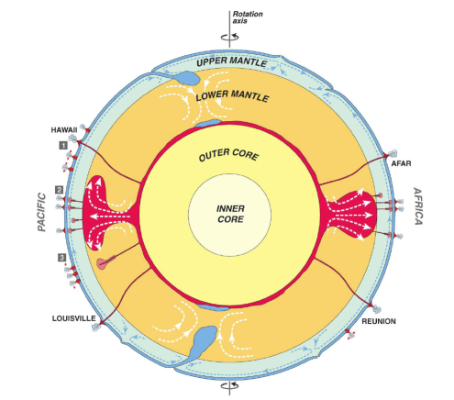
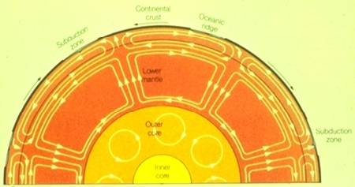
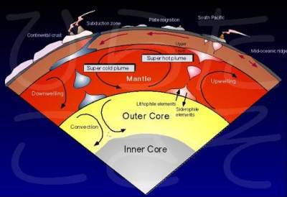
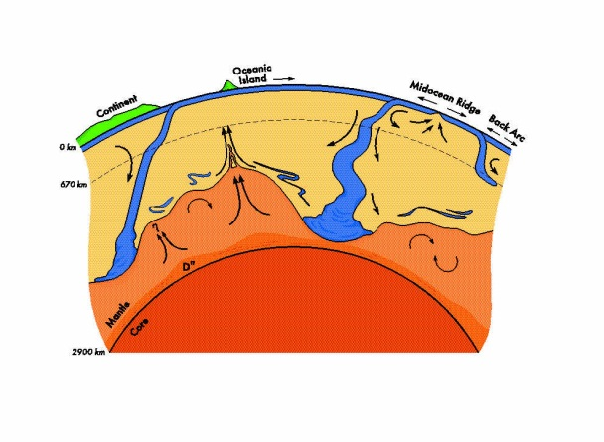
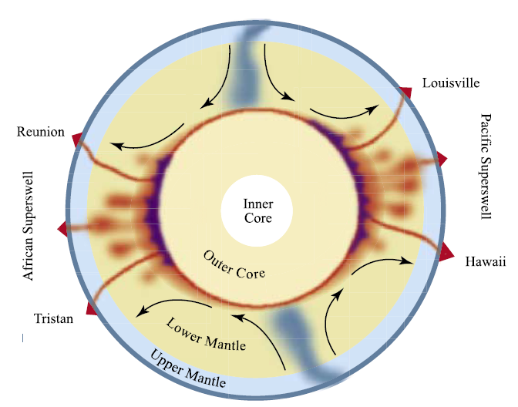
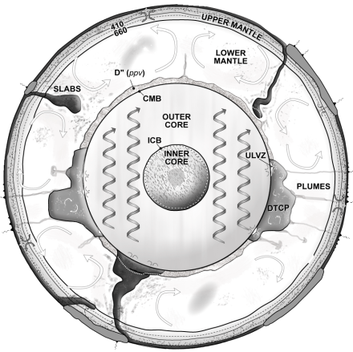
?
Various Conceptual Models (i.e., hypotheses) of Large-Scale Mantle Convection Inspired by Seismology and/or geochemistry.
Each hypothesis has fundamentally different consequences for our understanding of mantle convection and how it cools the Earth and drives plate tectonics.
Dziewonski et al. (2010)
Courtillot et al. (2003)
Kellogg et al. (1999)
Jellinek and Manga (2004)
Garnero (web)

Slide 3
?
Discovering which, if any, of these are occurring in the Earth is critical toward building the foundation for our understanding of:
Driving forces of mantle convection and plate tectonics
(e.g., slab-driven versus superplume-driven convection)
Heat transport and thermal evolution
Chemical evolution and MORB/OIB chemistry.
The geodynamo
Hotspots and the morphology, size, temperature, and the chemistry of plumes.
Dziewonski et al. (2010)
Courtillot et al. (2003)
Kellogg et al. (1999)
Jellinek and Manga (2004)
Garnero (web)

Slide 4
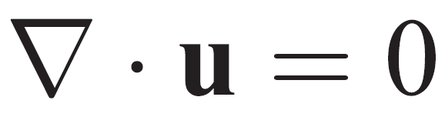

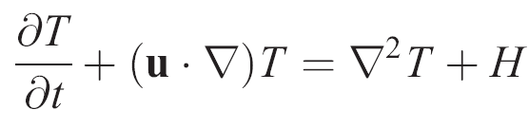
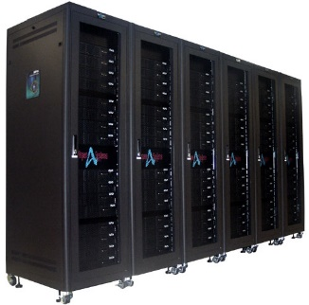
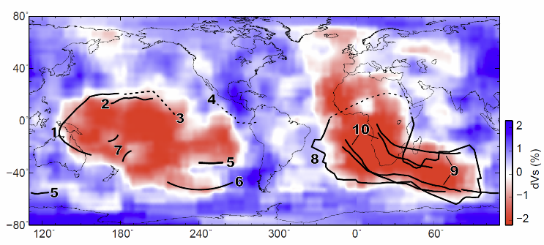
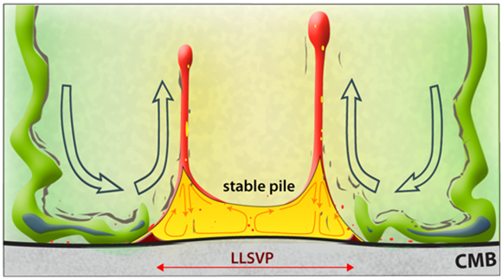
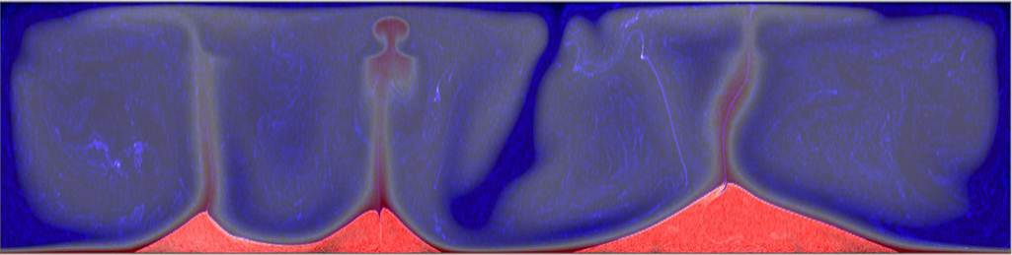

Geodynamics of Mantle Convection
Physics (Conservations of mass, momentum, and energy)
Application/Modeling (Numerical modeling, laboratory experiments)
Science (Observations, hypothesis development, hypothesis testing)

Slide 5
Conservation of Mass
Rate of mass change in a volume
Rate of mass entering the volume
Rate of mass exiting the volume
=
-
Independent Variables:
t = time
x, y, z = position
Dependent Variables:
Density (scalar field)
This is identical to:
Velocity (vector field)

Slide 6
Conservation of Momentum
Rate of momentum change per volume
Rate of momentum entering the volume
Rate of momentum exiting the volume
+
Force acting on the volume
=
-

Slide 7
Conservation of Momentum
Derivation includes using conservation of mass.
Independent Variables:
t = time
x, y, z = position
Dependent Variables:
Density (scalar field)
Stress (tensor field)
Velocity (vector field)
Gravitational acceleration (vector field)

Slide 8
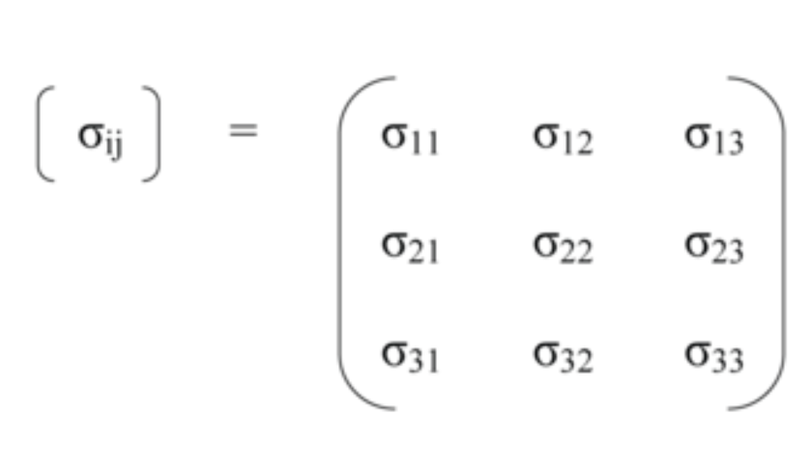
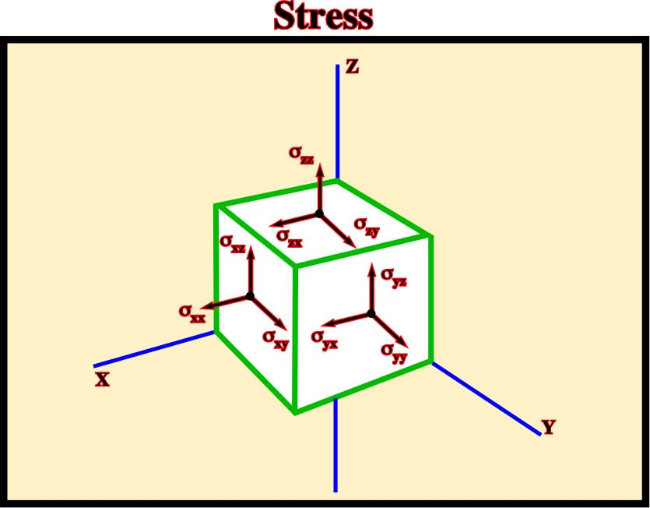
Stress
“a” is the normal to the plane that the stress acts upon
“b” is the direction of the stress
NOTE: 1, 2, 3 are the same as x, y, z
Image from http://homepage.ufp.pt/biblioteca/GlossarySaltTectonics/Pages/PageS.html

Slide 9
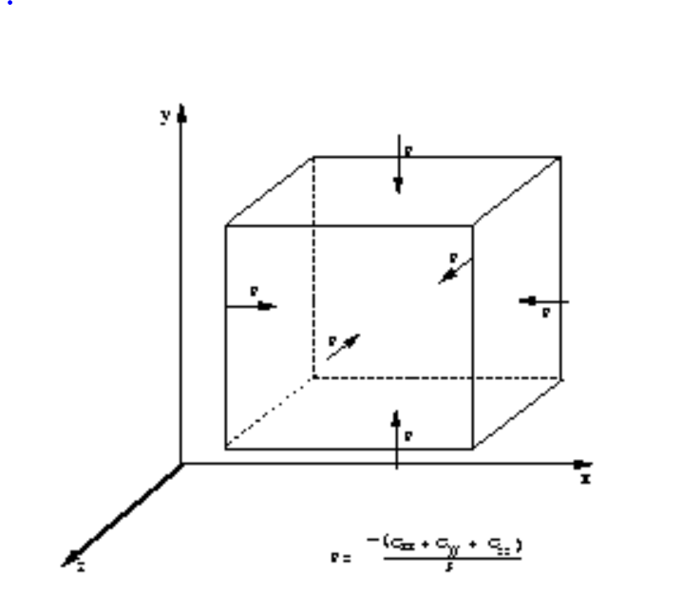
It is often convenient to decompose the stress tensor into 2 parts:
Pressure, p (scalar)
Deviatoric Stress, (tensor field)
Pressure is defined to be the average of normal stresses:
Pressure acts only in the normal direction.
Pressure is the same in each direction.
By convention, pressure is in the opposite direction of stress direction.
Image from http://www.see.ed.ac.uk/~johnc/teaching/fluidmechanics4/2003-04/fluids5/stress.html

Slide 10
By construction:
Note that:
Therefore, the deviatoric stress is defined as:
Important note: directions for stress, deviatoric stress, and pressure are not a universal convention, so be careful!

Slide 11
Let’s look at the following term in the momentum equation:

Slide 12
Conservation of Momentum (different form, with pressure)
Independent Variables:
t = time
x, y, z = position
Dependent Variables:
Deviatoric stress (tensor field)
Density (scalar)
Gravitational acceleration (vector field)
Velocity (vector field)
Pressure (scalar)

Slide 13
Conservation of Energy
Rate of internal energy change in a volume
Rate of heat transferred to the volume
Rate of heat exiting the volume
Rate of work performed by the volume
=
_
_
This is the time derivative of the first law of thermodynamics.

Slide 14
Conservation of Energy
Derivation includes using conservation of mass, conservation of momentum, and dU = TdS – PdV (1st and 2nd laws of thermo).
Independent Variables (x,y,z,t)
Dependent Variables:
Thermal conductivity (scalar field)
Density (scalar field)
Thermal expansivity [V is volume] (scalar field)
Specific heat at constant pressure (scalar field)
Deviatoric stress (tensor field)
Temperature (scalar field)
Entropy changes related to processes other than those for a homogenous material undergoing changes in temperature and pressure.
Velocity (vector field)

Slide 15
Some Explanation:
During the derivation, entropy changes were split into 2 types:
Entropy changes due to single phase, homogeneous material undergoing changes in temperature and pressure.
All other entropy changes are lumped into: S* These include things such as radioactive heat production, phase changes, chemical reactions, nuclear reactions, etc. These items are best extracted as needed for the particular problem at hand. Radioactive heat production of uranium, thorium, and potassium is often extracted as:

Slide 16
Conservation of Energy (with heat production explicitly defined)
Derivation includes using conservation of mass, conservation of momentum, and dU = TdS – PdV (1st and 2nd laws of thermo).
Independent Variables (x,y,z,t)
Dependent Variables:
Thermal conductivity (scalar field)
Density (scalar field)
Thermal expansivity [V is volume] (scalar field)
Specific heat at constant pressure (scalar field)
Deviatoric stress (tensor field)
Temperature (scalar field)
Entropy changes related to “extra” processes
Heat production (power per mass)
Velocity (vector field)

Slide 17
Some Explanation on Notation:
This is a scalar, defined by:
This term describes the heat produced by friction, and is often called the “viscous dissipation.”

Slide 18
Some Explanation on Notation:
Is called the “material derivative,” and it is defined as:
The material derivative can act on a scalar or a vector. For example:

Slide 19
Summary: Conservation Equations (No approximations)
Mass
Momentum
Energy

Slide 20
Summary: Conservation Equations (No approximations)
Mass
Inertia term. Material remains in constant motion unless acted upon by forces on the R.H.S.
Momentum
Energy

Slide 21
Summary: Conservation Equations (No approximations)
Mass
Pressure term: material typically flows from high to low pressure.
Momentum
Energy

Slide 22
Summary: Conservation Equations (No approximations)
Mass
Stress term: viscous and elastic processes that transfer stress.
Momentum
Energy

Slide 23
Summary: Conservation Equations (No approximations)
Mass
Buoyancy term: the weight of the volume.
Momentum
Energy

Slide 24
Summary: Conservation Equations (No approximations)
Mass
Momentum
Conduction term: heat diffuses from hot to cold
Energy

Slide 25
Summary: Conservation Equations (No approximations)
Mass
Momentum
Adiabatic term: rising material expands and cools, vice versa.
Energy

Slide 26
Summary: Conservation Equations (No approximations)
Mass
Momentum
Viscous dissipation term: viscous friction generates heat.
Energy

Slide 27
Summary: Conservation Equations (No approximations)
Mass
Momentum
Heat production term: can be prescribed as needed.
Energy

Slide 28
Summary: Conservation Equations (No approximations)
Mass
Momentum
Additional entropy changes: can be prescribed as needed.
Energy

Slide 29
We haven’t made any approximations thus far.
Now, we’ll work toward transforming these equations into the forms that we typically use in modeling.
This involves 3 things:
Definition of a reference model.
Non-dimensionalization of variables
Approximations of physics and material parameters.

Slide 30
Reference Model
If the dynamics are largely driven by perturbations to a stable reference state, then it often becomes convenient to decompose some variables into 2 parts, a reference part and a perturbation part.
Density:

Slide 31
Pressure:
Note: The perturbation for pressure is given the name: dynamic pressure
Gravitational acceleration:
Temperature:

Slide 32
In our reference model, the reference pressure should be a self-consistent hydrostatic pressure due to the reference density and reference gravity.

Slide 33
Conservation of Mass:

Slide 34
Conservation of Momentum:

Slide 35
Conservation of Energy:

Slide 36
So

Slide 37
Summary: Conservation Equations, with reference model.
(Still no approximations)
Mass
Momentum
Energy

Slide 38
Non-dimensionalization of variables.
Why!?
To make the problem scalable. For example, we can model mantle convection in a fish tank, as long as we scale the parameters appropriately.
Leads to non-dimensional collection of variables that can be used to characterize the system. For example, Rayleigh number, Reynolds number, Dissipation number, Buoyancy number.
Allows for a better understanding of parameter trade-offs. For example, if you double both density and viscosity, the system remains unchanged. For example doubling density is equivalent to halving the viscosity.
Numbers are closer to unity. Allows better computational applicability.

Slide 39
There are many ways to non-dimensionalize a system. The key is: we make the rules. Choose transformations that will be useful. For thermal convection problems, we can transform the following:
Note: primed variables are non-dimensional

Slide 42
Summary: Non-dimensional Conservation Equations, with reference model. Primes have been dropped. (Still no approximations)
Mass
Momentum

Slide 43
Energy

Slide 44
We introduce the following collections of variables:
Rayleigh number
Dissipation number
Prandtl number

Slide 45
Summary: Non-dimensional Conservation Equations, with reference model. Primes have been dropped. (Still no approximations)
Mass
Momentum
Energy

Slide 46
Now, lets examine various approximations appropriate for mantle convection modeling:
Assumption:
Justification: This term is mainly relevant if the system has shock waves. Shock waves can be important if convection velocities are comparable to the speed of sound. Mantle convection velocities are much slower! cm/yr versus km/s.
Conservation of mass
This is called the anelastic liquid approximation (ALA)

Slide 47

The Prandtl number is a measure of the viscous resistance to inertia.
Viscous stresses act to resist continued motion. They diffuse momentum.
Imagine stirring a pot of honey and a pot of water. When you stop stirring, the water will continue to flow, but the honey will stop.
For Earth’s mantle:
Therefore 1/Pr is close to zero!

Slide 48
Assumption:
This is called the infinite Prandtl number approximation
Justification: The Earth’s mantle has such a high viscosity that it requires constant forcing to continue to flow.
Conservation of momentum

Slide 49
Assumption: There are no perturbations to the reference gravitational acceleration. This term is usually only included if one wishes to include self-gravitation due to internal density heterogeneities and dynamic topography.
Conservation of momentum

Slide 50
Summary: Non-dimensional Conservation Equations, with reference model. Primes have been dropped. Approximations: anelastic liquid (ALA), infinite Prandtl number, static gravitational field.
Mass
Momentum
Energy

Slide 51
Assumption: Truncated Liquid Anelastic Liquid Approximation (TALA)
Dynamic pressure does not contribute to density perturbations:
The material derivative of dynamic pressure is negligible.

Slide 52
Summary: Non-dimensional Conservation Equations, with reference model. Primes have been dropped. Approximations: truncated anelastic liquid (TALA), infinite Prandtl number, static gravitational field.
Mass
Momentum
Energy

Slide 53
Approximation: Extended Boussinesq Approximation (EBA)
Density is constant, ρ_{o}, except for density perturbations in the momentum equation.
Except for in the momentum equation
The main consequence of this approximation is that makes the fluid incompressible:

Slide 54
Summary: Non-dimensional Conservation Equations, with reference model. Primes have been dropped. Approximations: Extended Boussinesq Approximation (EBA), infinite Prandtl number, static gravitational field.
Mass
Momentum
Energy

Slide 55
Approximation: Boussinesq Approximation (BA)
Neglect all terms that include the Dissipation number (viscous dissipation, adiabatic heating/cooling). Specific heat, thermal expansivity, and thermal conductivity is constant.

Slide 56
Summary: Non-dimensional Conservation Equations, with reference model. Primes have been dropped. Approximations: Boussinesq Approximation (BA), infinite Prandtl number, static gravitational field.
Mass
Momentum
Energy

Slide 57
The stress and density perturbation terms are prescribed for the particular problem at hand.
For mantle convection, the stress is usually assumed to be viscous and isotropic.
(ALA and TALA)
(EBA and BA)

Slide 58
Dimensional density perturbation
(ALA)
(TALA)
(EBA and BA)

