Slide 1


Everything you always wanted to know about dynamic compression methods in geophysics, but were afraid to ask (please, ask!)
Paul D. Asimow
California Institute of Technology
Acknowledgements: The late T. J. Ahrens, Jeffrey Nguyen, Lawrence Livermore National Lab and NSF
July 17, 2014 CIDER

Slide 2
Pop quiz: what is wrong with this calculated phase diagram?
MgO
Aguado and Madden
PRL 94 068501 (2005)
Hint: Does everyone in this room know what Schreinemaker’s rules are?
  If not, you should. Start with http://en.wikipedia.org/wiki/Schreinemaker's_analysis

Slide 3
Experimental geoscience classified by strain rate
Static high pressure (cold-seal, piston cylinder, multi-anvil, diamond anvil…)
Quasistatic (Paterson, Griggs, rotating Drickamer, D-DIA…)
Quasi-isentropic dynamic compression (magnetic acceleration, lasers, soft bullets)
Shock waves (guns and lasers)

Slide 4
Why do dynamic compression?
Shock wave experiments:
  Are slow and expensive compared to static high-pressure experiments
  Don’t observe equilibrium phase transitions or multiphase/multicomponent equilibrium reactions
  Don’t have time to make very many observations
So what is the point?
Shock wave experiments have several critical advantages:
  Can achieve highest pressure and know the pressure absolutely
  Naturally obtain high temperature, no extra gear required
  Can measure density absolutely, even for amorphous materials
  Achieve a known internal energy state
  They’re just cool

Slide 5
Shock wave experiments:
What is a shock wave?
ρ
P
E
ρ_{o}
P_{o}
E_{o}
U_{s}
U_{p}
A step in pressure that travels faster than the sound speed in the unshocked material. In reality, there are no discontinuities in the variables; a shock is a very rapid but continuous change in pressure, density, and energy.

Slide 6
Shock wave experiments:
What is a shock wave?
ρ
P
E
ρ_{o}
P_{o}
E_{o}
U_{s}
U_{p}
A shock is an adiabatic change of state: heat-flow across shock front is negligible. However, it is not a reversible process: the entropy increases. This condition is equivalent to the statement that sound speed in the material increases with pressure and is a necessary condition for a compression shock to form and be stable.

Slide 7
Shock wave experiments:
The Rankine-Hugoniot Equations
ρ
P
E
ρ_{o}
P_{o}
E_{o}
U_{s}
U_{p}
Mass
Momentum
Energy

Slide 8
The Rankine-Hugoniot Equations
Six variables: ρ, ρ_{o}, (P–P_{o}), (E–E_{o}), U_{s}, U_{p}
Three constraints (mass, momentum, and energy equations)
Must measure three variables to determine the system.
  For example, measure (ρ_{o}, U_{s}, U_{p}) to determine (ρ, ΔP, ΔE)

Slide 9
Rayleigh Line vs. Hugoniot
The thermodynamic path followed by material undergoing shock compression is called a Rayleigh Line. It really is a line in (P,V) space:
  If we divide a steady plane-wave shock into a series of thin slabs at (P_{i}, ρ_{i}) moving at U_{pi}:
ρ_{o}
P_{o}
ρ
P
U_{s}
U_{p}
ρ_{i}
P_{i}
U_{pi}
  Slope of Rayleigh Line is square of mass flux through shock, constant across a given steady shock front

Slide 10
Shock wave experiments: the Hugoniot
Material properties impose a functional relationship between U_{s} and U_{p}
Hence, for given ρ_{o}, there is a one-parameter family of (P, ρ, E) conditions that can be obtained by shocks of varying strength. This defines a curve called the Hugoniot
  The Hugoniot is not the compression path followed by material in a given shock; rather it is the family of final states for different shocks.
    Material passes through sequence of unstable states along Rayleigh line until it reaches a stable point on its Equation of State, which allows a stable shock to propagate
  The Hugoniot of a simple material is typically linear in (U_{s}, U_{p}) space.

Slide 11
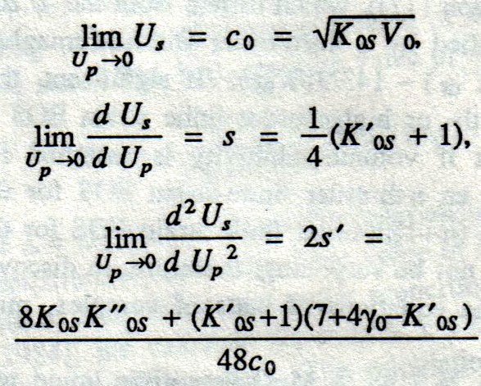
Hugoniot and other EOS formalisms
A linear U_{s}-U_{p} Hugoniot [U_{s} = c_{o} + sU_{p}] is a 3rd order equation of state, related to other 3rd order EOS expansions:
Only at 4th order does the expansion about zero strain contain any quantities not present in isentropic Birch-Murnaghan expansion

Slide 12
the Hugoniot, monatomic ideal gas example
All these curves result from PV=nRT, C_{p}/C_{v} = 5/3, and atomic weight = 40

Slide 13
Experiments: shock & release vs. decaying shock
Asimow, in press, Treatise on Geophysics Chapter 50

Slide 14
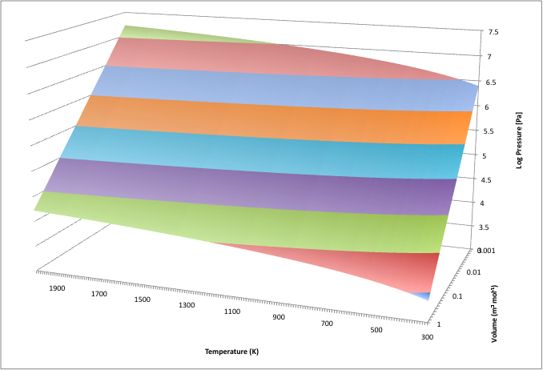
Equation of State: a function of 2 variables
isentrope
isotherm
Hugoniot

Slide 15
Shock wave experiments: getting off the Hugoniot

Slide 16
Shock wave experiments: getting off the Hugoniot
Sometimes, having only one (P, T) path accessible to experiments is a serious handicap. What if we want to access states hotter or colder than the principal Hugoniot of a material?
Colder states can be reached using ramp compression, static pre-compression, or metastable dense starting materials
Hotter states can be reached using porous materials or static pre-heating
  In Caltech lab, we can heat to ~2000 °C before shooting

Slide 17
Equation of State: a function of 2 variables
Precompressed Hugoniot
Preheated Hugoniot
Hugoniot

Slide 18



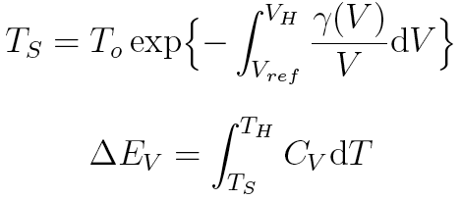
Estimating shock temperature
From Birch-Murnaghan/Mie-Grüneisen EOS
For phase transitions
V_{o} ≠ V_{ref} accounts for porous samples

Slide 19
Methods: guns, lasers, magnetic drive
Reisman et al., 2001
Spaulding Ph.D. thesis, 2010

Slide 20
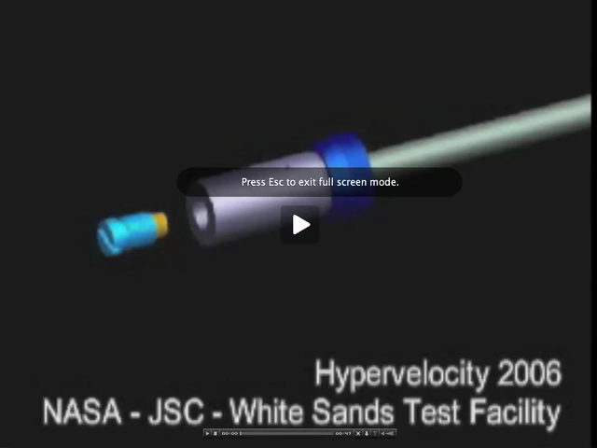
Experiments: Light Gas Gun

Slide 21
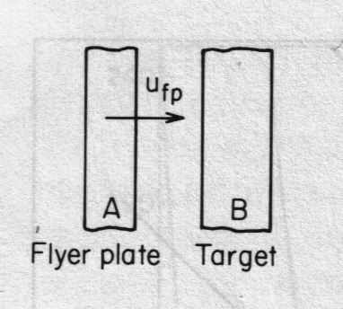
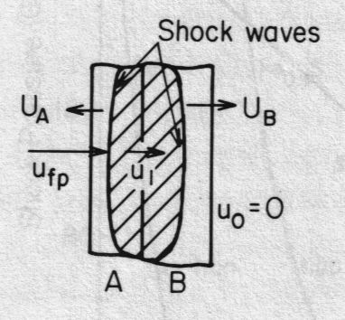
Shock experiments: impedance match
Sometimes U_{p} is measured directly. More often projectile velocity U_{fp} is measured, and then U_{p} is obtained by assuming projectile and target reach velocity and stress continuity:

Slide 22
Diagnostics: streak camera
Shock velocity from streak camera photography
  Streak camera set for 1500 ns streaks, resolution <1 ns
  Typical shock velocity precision ±0.6%

Slide 23
Diagnostics: velocity gauges, pyrometry
Embedded wire loops in magnetic field provide internal velocity profile for multiple-wave structures
Free-surface or interface temperatures from time-resolved pyrometry

Slide 24
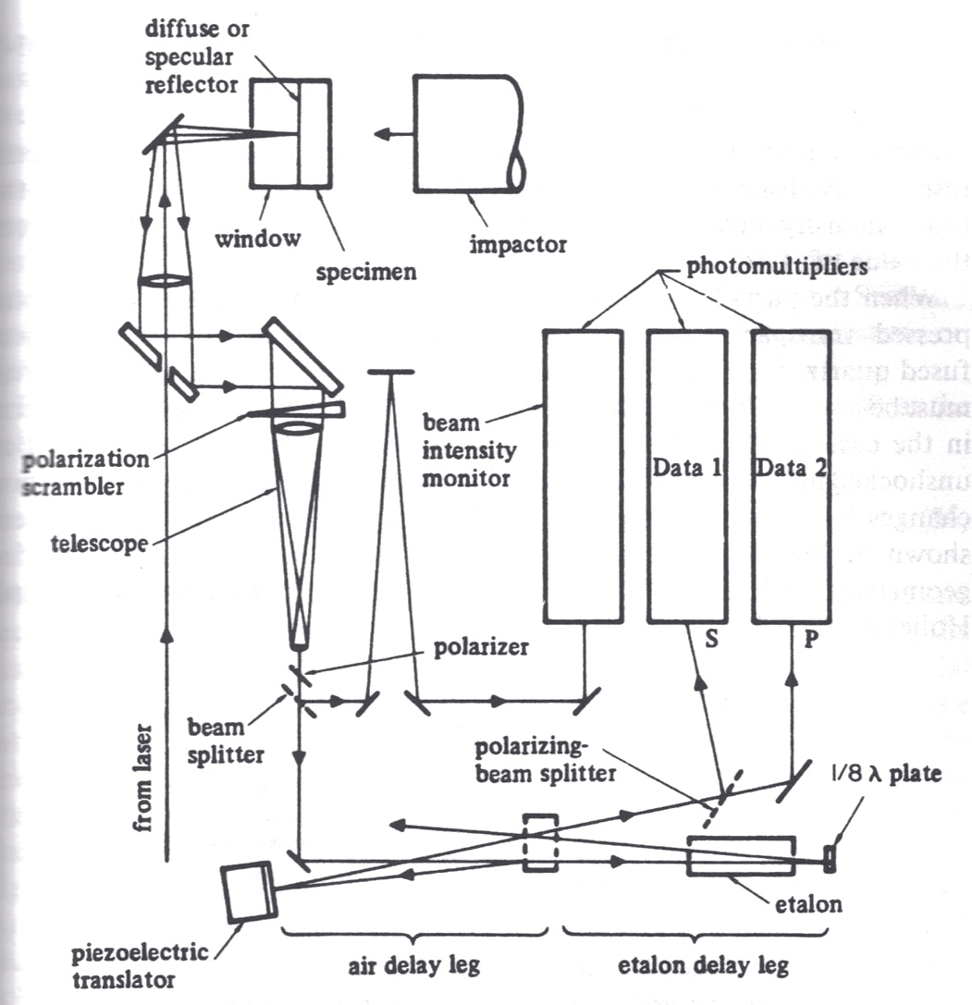
Diagnostics: VISAR and PDV
Two interferometer designs that can measure interface or free surface velocity vs. time
Spaulding Ph.D. thesis, 2010

Slide 25
Diagnostics: VISAR and PDV
Two interferometer designs that can measure interface or free surface velocity vs. time
Jensen et al. (2007)

Slide 26
Diagnostics: other
VISAR total reflectivity gives information about free electron content and therefore conductivity/metallization
Actual DC electrical conductivity can be measured
Shock recovery can be performed up to 10s of GPa, gives information about shock metamorphism
Real-time flash X-ray diffraction and X-radiography are recent developments, have been implemented with split laser-drives; proposed light gas gun on APS beamline…

Slide 27
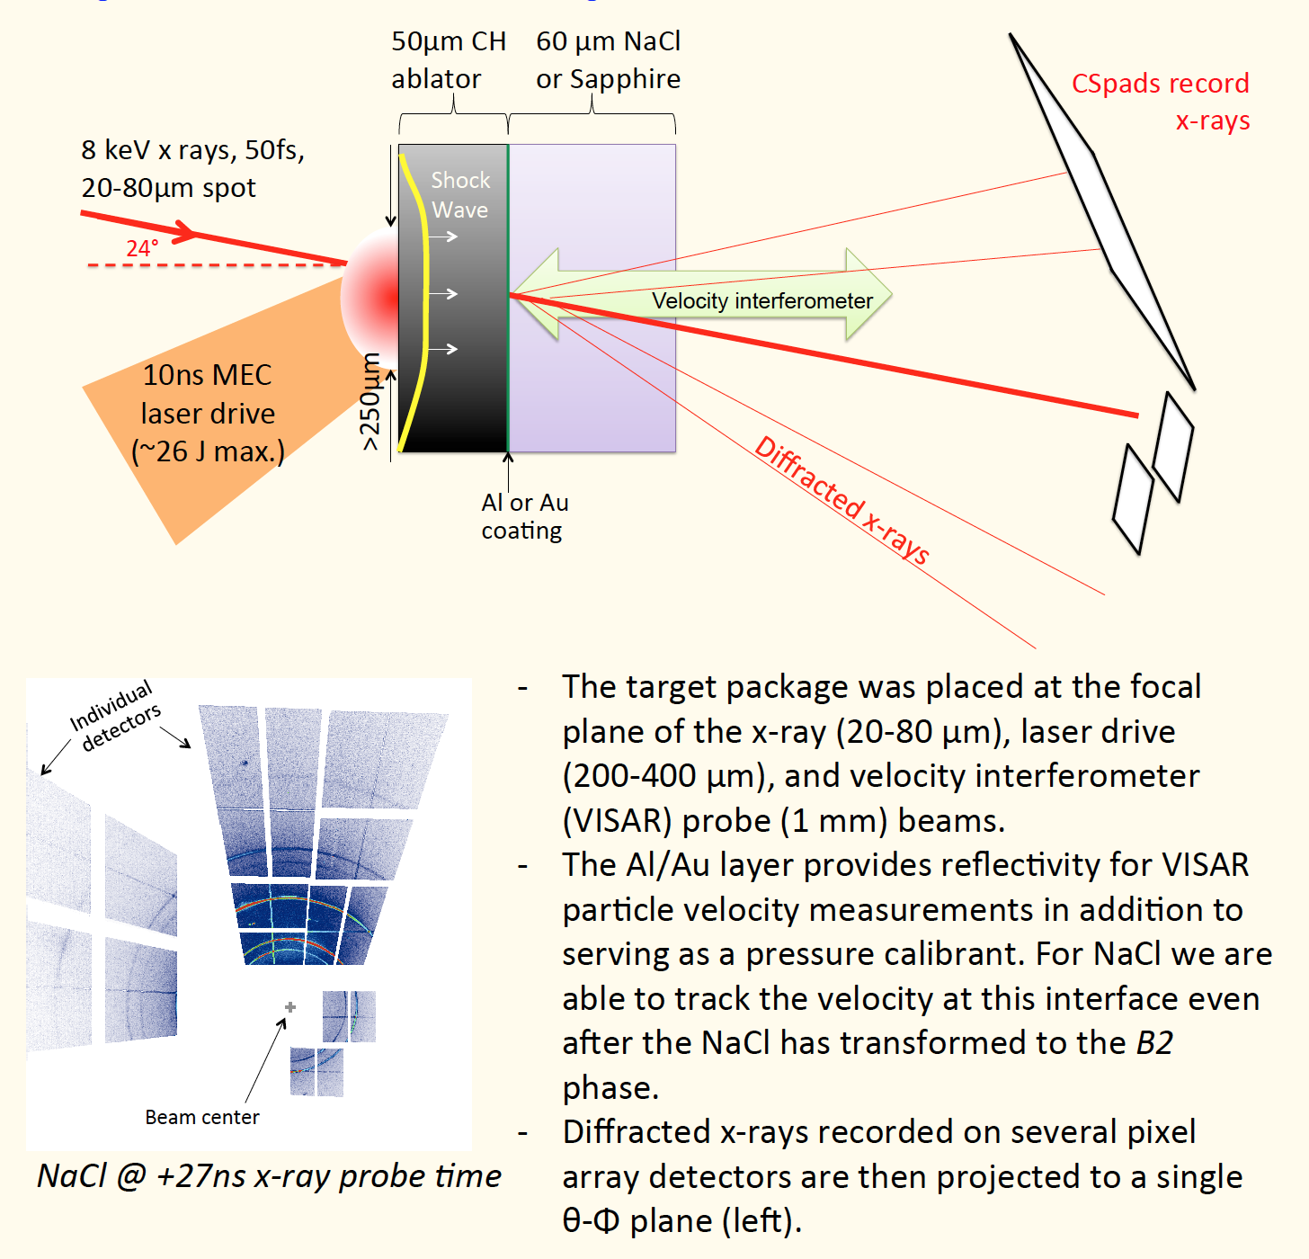
Diagnostics: other
Thanks, June

Slide 28
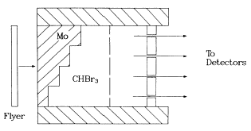
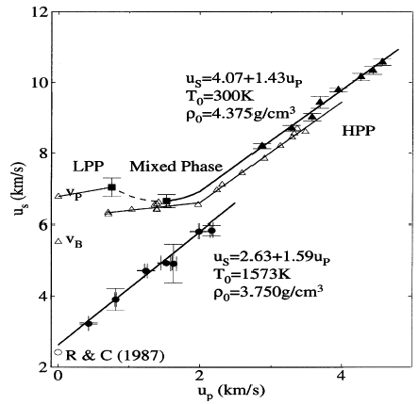
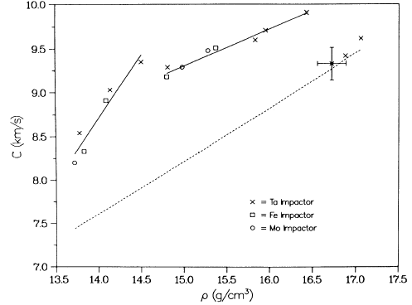
Phase Transitions
Anomalies in compression detect phase changes
Anomalies in shock temperature or sound speed behind shock can fingerprint melting transition in particular
Fayalite Hugoniot
Mo sound velocity
Chen et al. 2002
Hixson et al. 1989

Slide 29
Phase Transitions
Better show your error bars (here, as everywhere else)
Mo sound velocity
Nguyen et al., PRB 89 174109 (2014)

Slide 30
Phase Transitions
Better show your error bars (here, as everywhere else)
Jackson et al., EPSL 362:143-150 (2013)
Notes:
Fig. 6. Phase diagram of iron from experimental studies. The melting points from SMS are shown as red circles (this study). Squares note melting points from hcp- iron as reported from XRD: green (Shen et al., 1998), cyan (Ma et al., 2004), and black (Boehler et al., 2008) (Pth was not considered in these reports). Diamonds note melting points reported from shock-compression studies: brown (Brown and McQueen, 1986), orange (Bass et al., 1987), violet (Ahrens et al., 2002), and turquoise (Nguyen and Holmes, 2004). The grey dash–dot–dot curve represents the melting curve based on hcp-iron’s atomic displacements (Murphy et al., 2011b) (see text). Vertical arrows indicate the pressures of Earth’s core–mantle (CMB) and inner-core outer-core (ICB) boundaries.
g2E2liquid (dash-dotted, Komabayashi and Fei, 2010 using Komabayashi et al., 2009; Shen et al., 1998), g2E2liquid (dotted, Boehler, 1986, 1993; Liu and Bassett, 1975 up to 20 GPa), and g2E2liquid triple point (black filled square, Boehler et al., 2008)

Slide 31
Experiments: Shock wave liquid Equation of State measurement

Slide 32
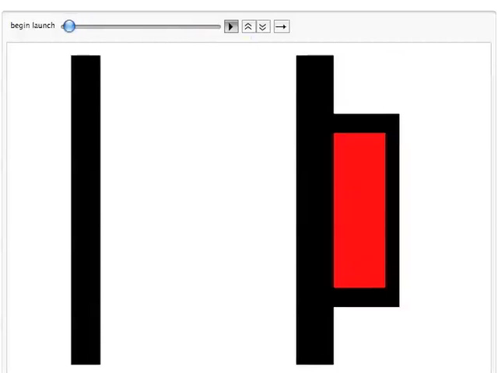
Experiments: Preheated, encapsulated liquid Equation of State
1 cm
Real time (1 s = 1 s)

Slide 33
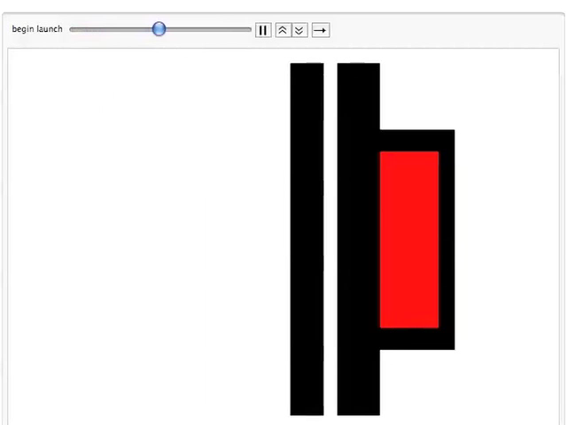
Experiments: Preheated, encapsulated liquid Equation of State
1 cm
Slowed down 10 million times (1 s = 100 ns)

Slide 34
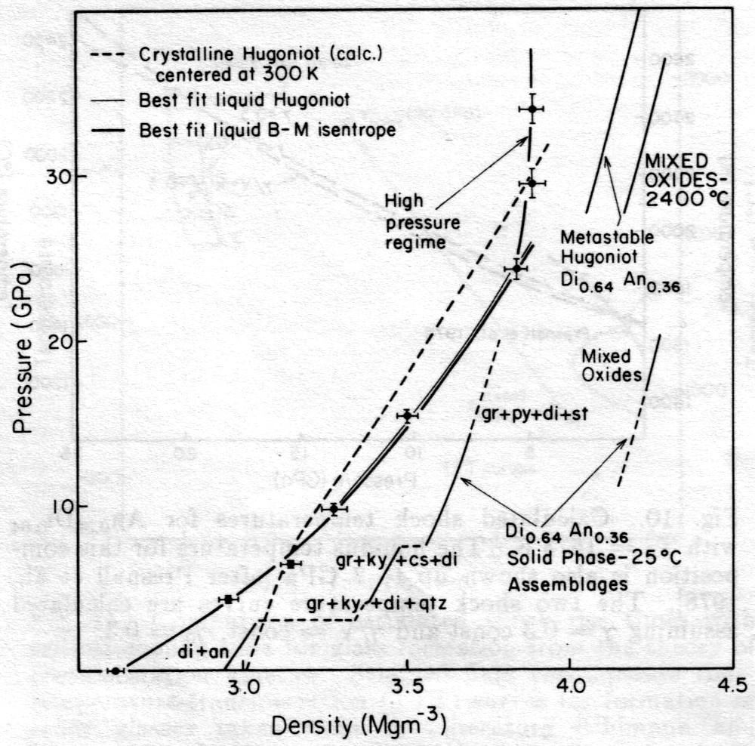
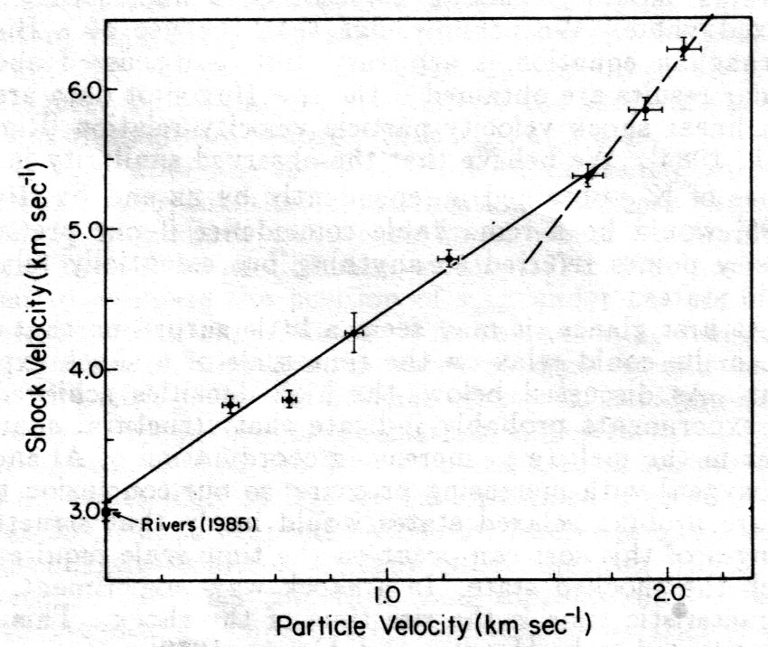
History: Rigden et al. (1988)
Studied Fe-free basalt analogue An_{0.36}Di_{0.64}
  Found anomalous stiffening of this composition above 24 GPa
  Extrapolated Hugoniot nearly incompressible, implies very low density liquids in lower mantle
  Exhaustion of bond-bending compression?

Slide 35
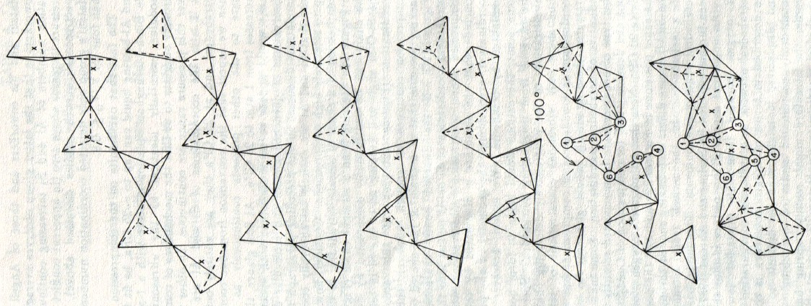
Some Ideas about Liquids
Stolper and Ahrens (1987) model for silicate network compression
  Continuous but non-statistical conversion from tetrahedral chains into face-sharing octahedra
  Constructed to explain sudden compression anomaly in shock compression data of Rigden et al. (1984, 1988)

Slide 36
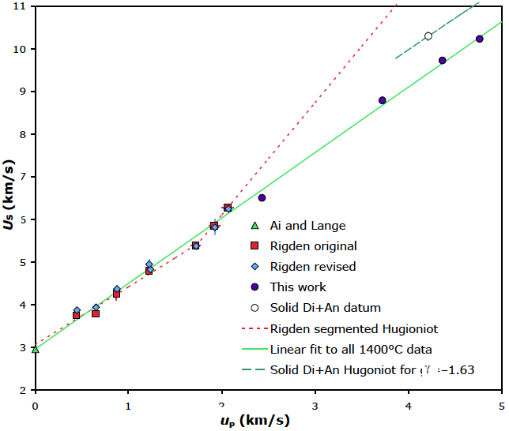
New data on An_{0.36}Di_{0.64}
Anomalous stiffening of intermediate composition above 24 GPa? NO
We’ll talk about the “Solid Di+An datum” later

Slide 37
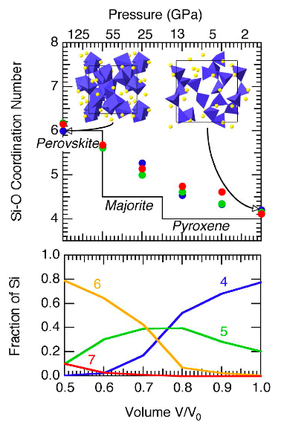
Some ideas about silicate liquids
Newer simulations and NMR data on silicate liquid structure imply statistical distribution of coexisting coordination states at any given pressure and continuous shift of average cation coordination over wide pressure range
So, should an EOS formalism for liquids explicitly include coordination change, or find parameters that implicitly account for it?
Stixrude and Karki, 2005

Slide 38
Agreement with static compression data
Fayalite (Chen et al., 2002)
  3rd-order fit to Hugoniot is good to 47 GPa
  Same K_{o} but MUCH lower K’ (5.4 vs. 10) than inferred by Agee (1992) from sink-float data to 6 GPa: a serious discrepancy!
Oops

Slide 39
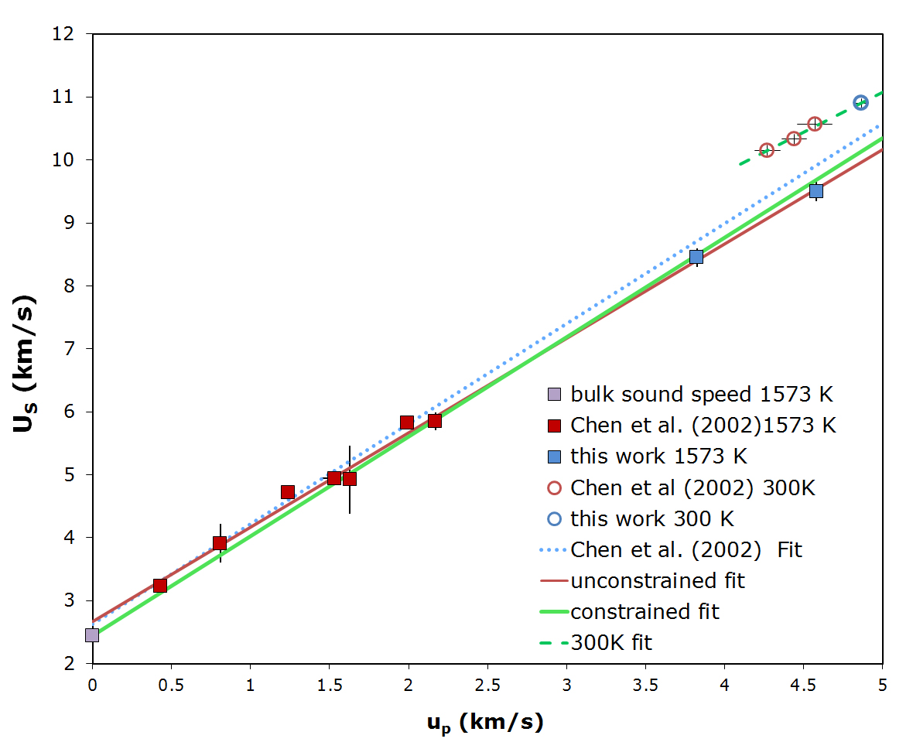
Agreement with static compression data
?
Fayalite: Collaboration with Becky Lange and Carl Agee to redo this composition using common starting material
  NEW Hugoniot points to 161 GPa precisely confirm Chen result!
Note we may need later:
The shots from hot liquid into liquid state and from cold solid into liquid state provide sets of points at known (P, V, E) that can be used to estimate the Grüneisen parameter by finite difference
Thomas et al., 2012

Slide 40
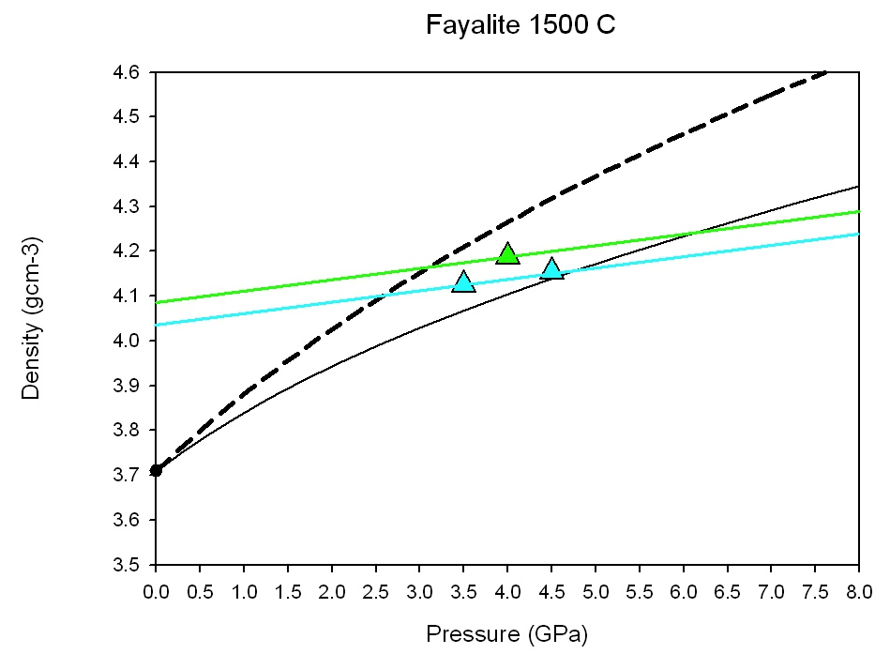
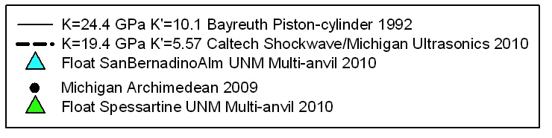
Agreement with static compression data
Fayalite: Collaboration with Becky Lange and Carl Agee to redo this composition using common starting material
  AND Agee’s new multi-anvil data demonstrate bad pressure calibration above 4 GPa in his Bayreuth piston-cylinder data from 1992!
Conclusion: all is well
Thomas et al., 2012

Slide 41
Agreement with simulation
NEW: Just published fayalite simulations (PBE+U), by Muñoz Ramo & Stixrude

Slide 42


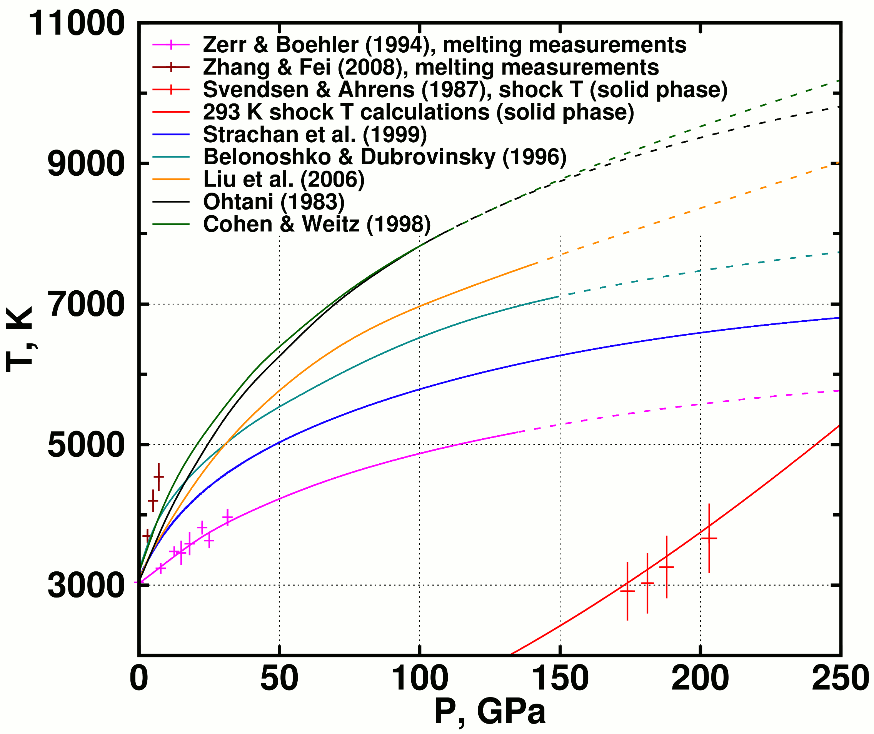
Appendix: Melting of MgO
De Koker & Stixrude (2009)

Slide 43
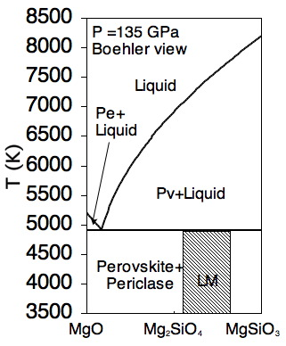
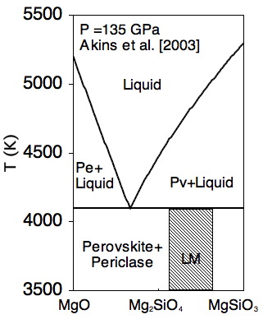
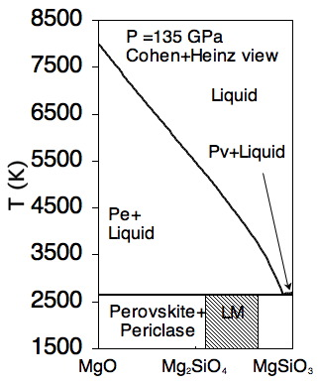
Motivation
  Periclase and Perovskite melting curves anchor the phase diagram and mostly determine the melting and crystallization behavior
  First melt could be almost pure MgO, almost pure MgSiO₃, even peritectic! Periclase might be liquidus mineral in parts of lower mantle, or it might not.

Slide 44
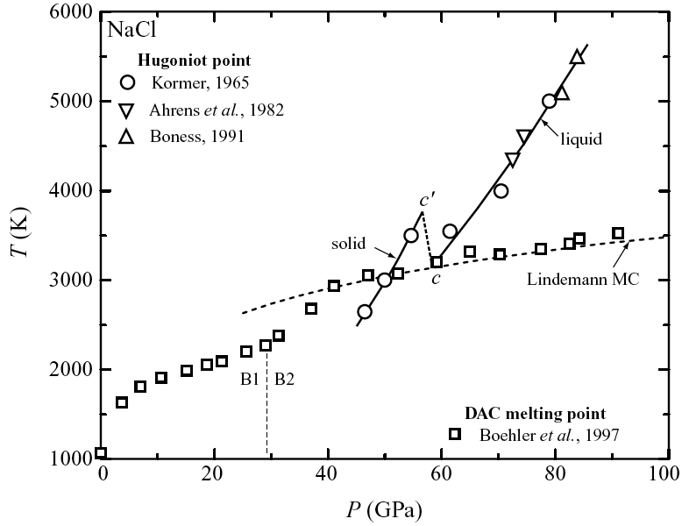
Shock temperatures and Melting
Temperatures of shocked transparent materials indicate melting due to latent heat effect
Ionic materials commonly display superheating followed by clear drop in T upon melting
Example: NaCl

Slide 45
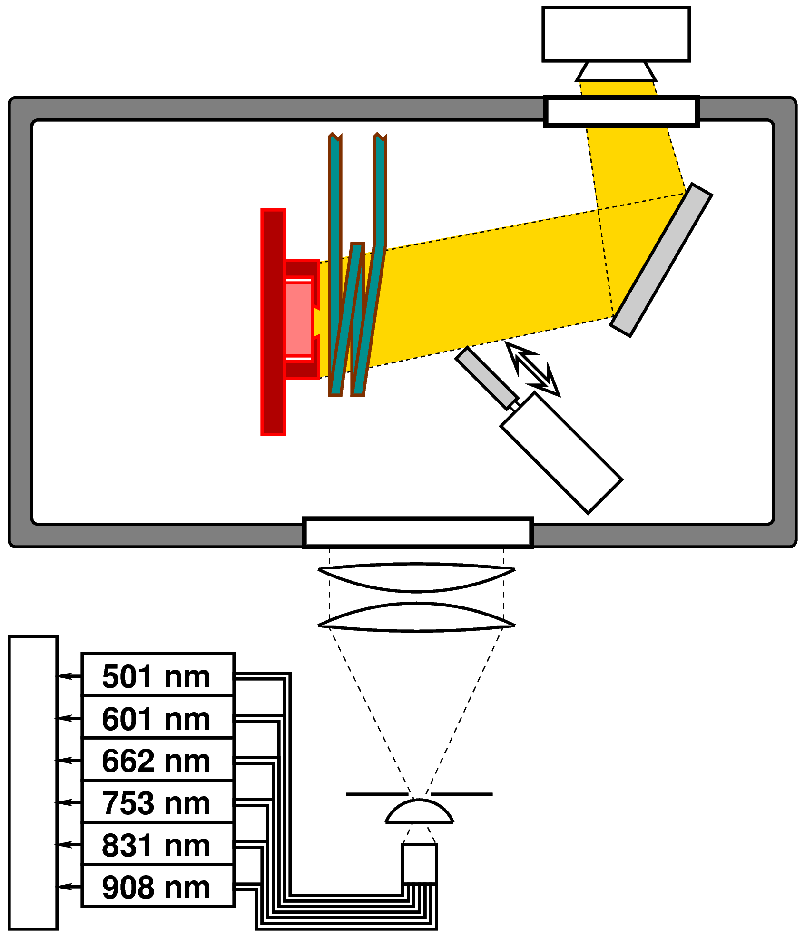
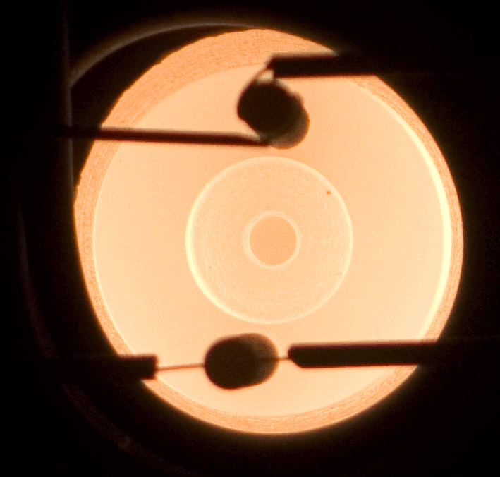
Experimental schematic, heating
Hot target photo

Slide 46
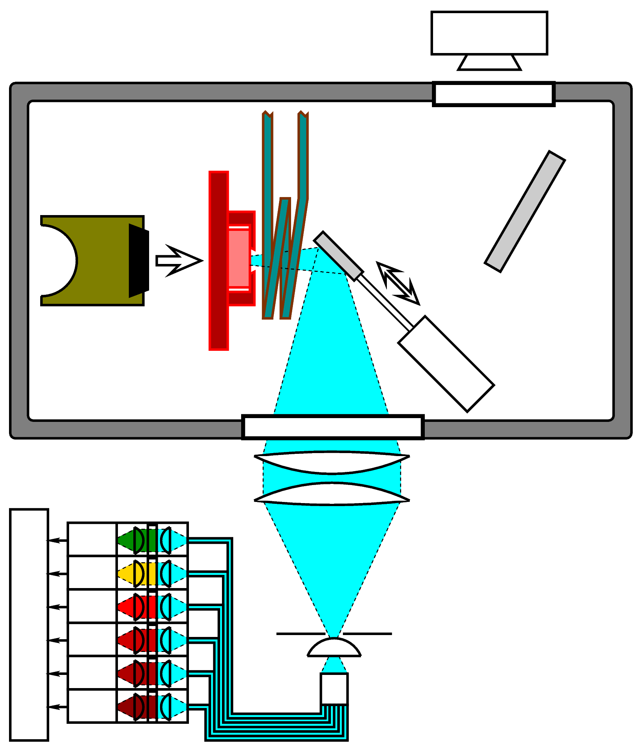
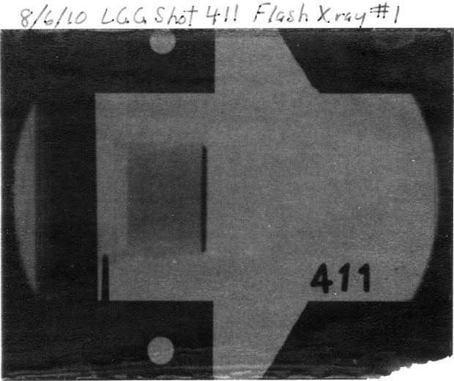
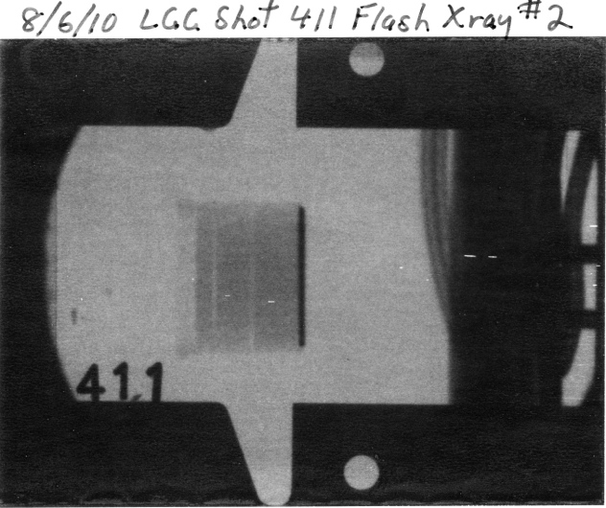
Experimental schematic, shot
X-rays of projectile in flight at 7507±15 m/s

Slide 47
1850 K results, Temperature
All data consistent (within error) with solid shock state … lower bound on melting curve

Slide 48
1850 K results, Temperature
Kraus et al. 2013
That’s as hard as we can shoot … but we’re so close! So tantalizingly close! How to go hotter?

Slide 49
Experiment schematic, fiber configuration
Heating to 2300 K not a problem per se, but:
• Surface of MgO degrades above 2000 K, so we use long crystal and axial T gradient
• Mirror surface degrades from heat exposure or vapor deposition, so we use fiber probe, as far from sample as possible
• Particles scatter light along path so we blow them out with He spray
• Shortest wavelength channel always anomalous so we got rid of it

Slide 50
2273 K results, Temperature and Sound Speed
About two years of work to raise initial pre-heat T by ~400 K … and still no clear indication of melting, but there is a possible indication of melting between at ~240 GPa and 9000 K.

Slide 51
Conclusions 2: MgO melting
Bound on melting curve of MgO suggests eutectic melt of lower mantle remains close to peridotite composition, consistent with new MD results of de Koker et al.
This implies…
  Narrow melting interval throughout lower mantle
  Sharp(ish) base of magma ocean
de Koker, Karki & Stixrude (submitted to Nature)

Slide 52
Conclusions
Our data suggest Zerr and Boehler’s melting curve is incorrect, at least above ~200 GPa. This implies:
  First melts of lower mantle are probably not particularly oxide-rich
  Liquidus field of ferropericlase probably restricted to upper part of lower mantle and SiO₂-poor compositions
  Fe probably partitions into melts at all mantle pressures
Need a few improvements to experiments at 2300 K initial temperature to get upper bound on melting curve. These are in progress…

Slide 53
SiO₂

Slide 54
SiO₂
Hicks et al. PRL 97 025502 (2006)

Slide 55
SiO₂
Hicks et al. PRL 97 025502 (2006)

Slide 56
Implications 2: The Grüneisen parameter, γ
To formulate an equation of state for any temperature and pressure and to convert between Hugoniot, isentrope or isotherm, we express thermal pressure using γ:
Convenient because γ ~ γ(V) only, because it can be determined from shock wave experiments, and because it directly gives thermal gradient in adiabatic system
  With linear mixing assumption, functional form for γ(V), and experimental data on γ(V) of enough endmembers, we can construct P-T curves for magma oceans

Slide 57
The Grüneisen Parameter, γ
γ is a particularly useful property because its behavior is relatively predictable; to a reasonable approximation, γ is a function only of volume for most materials.
However, γ is hard to measure at high pressure
  At ambient pressure, can combine thermal expansion, heat capacity, and sound speed measurements to define γ precisely (γ = K_{S}Vα/C_{P})
  At high pressure, these measurements are too imprecise (especially for non-crystalline materials!)
  Can define γ in molecular dynamics models (E, V, & P are all known)
  Can obtain γ from shock wave data (E, V, & P are all known)
    Simultaneous shock and release velocity data
    Multiple Hugoniot states of same composition and phase

Slide 58
The Grüneisen parameter, γ
In solids, the origin of γ in terms of anharmonicity of phonons is well understood, and always (?) decreases with increasing pressure
In liquids, physical meaning of γ variations is not as clear, though it has been empirically related to coordination changes or configurational entropy.
Experiments and computations, for a variety of silicate liquid compositions, show γ(V) increasing with pressure
  Jing & Karato hard-sphere model naturally does this!
In fact this behavior appears to be universal, with a remarkably narrow range of volume dependences

Slide 59
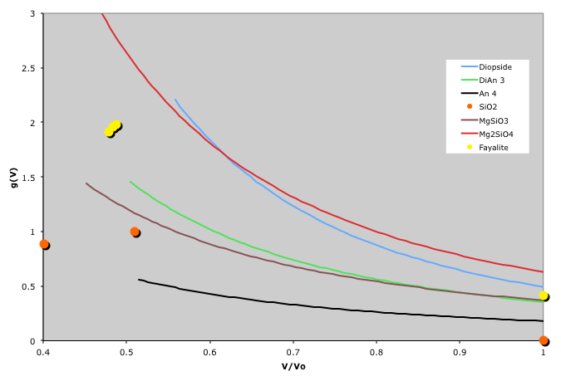
Grüneisen parameter: universal behavior?
Mg₂SiO₄ Forsterite
CaMgSi₂O₆ Diopside
CaAl₂Si₂O₈ Anorthite Di₆₄An₃₆
MgSiO₃ Enstatite
SiO₂ Silica
Fe₂SiO₄ fayalite
γ(V)

Slide 60
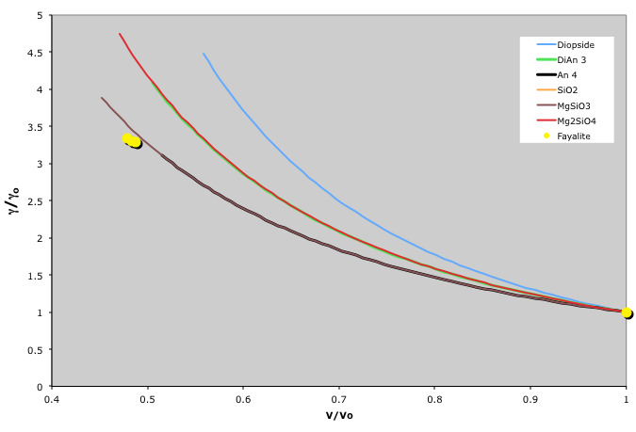
Grüneisen parameter: universal behavior?
Mg₂SiO₄ Forsterite
CaMgSi₂O₆ Diopside
CaAl₂Si₂O₈ Anorthite Di₆₄An₃₆
MgSiO₃ Enstatite
Fe₂SiO₄ fayalite
γ/γ_{o}
5
γ/V = constant

Slide 61
Results: magma ocean crystallization MAY begin in mid-lower mantle
Liquidus of Fiquet et al. (2010)
Liquidus of Andrault et al. (2011)
Currently depends on uncertainty about bulk composition and liquidus measurements. Furthermore, subsequent evolution depends on buoyancy/suspension of these early-formed crystals and later near-solidus steps

Slide 62
Trying to make a partial-melt ULVZ
What are the constraints (observational and theoretical)?
  Must be partially molten with melt fraction 10-30% to explain shear velocity drop (Williams and Garnero, 1996)
    (not a true constraint – solid Fe-enrichment models can do this also, Wicks et al. 2010)
  Must have aggregate density greater than ambient mantle (6-14% denser than PREM, Rost et al. 2005)
  Must (?) have small density contrast (≤±1%?) between melt and solids within ULVZ to prevent segregation into pure melt and residual solids
What model parameters are known, which can we play with?
  Liquid and solid density models reasonably well-defined
  Temperature – range from ~3700 to ~4400 K possible
  Bulk composition – in principle, can be anything
  Eutectic liquid composition – only constrained by long extrapolation
  Fe partition coefficient between melt and solid – few and contradictory experiments

Slide 63
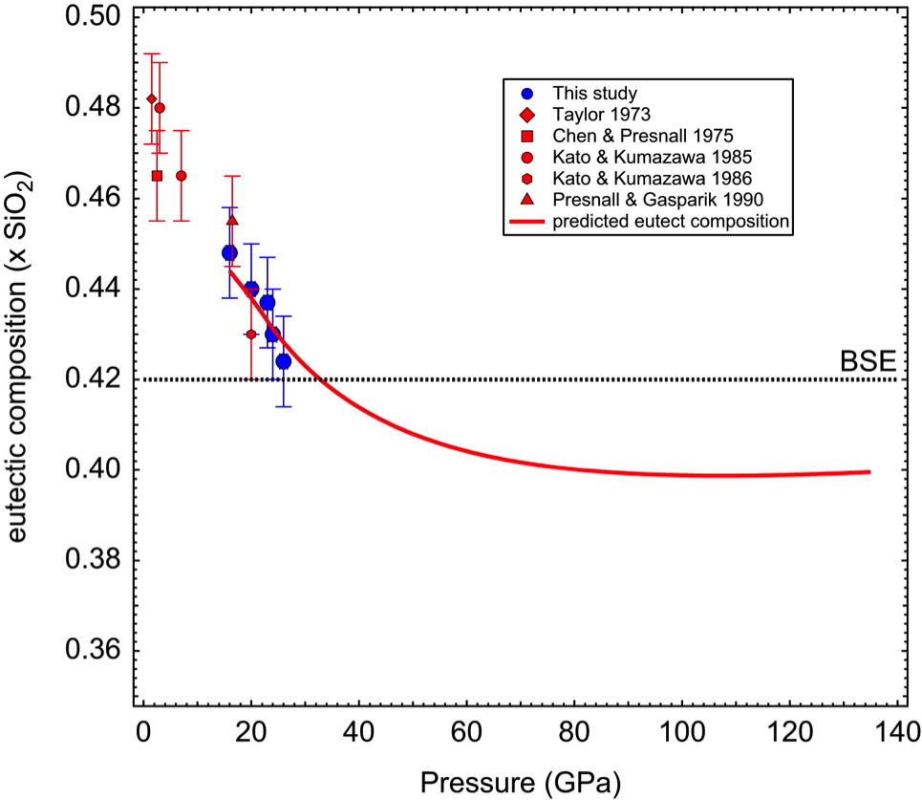
Trying to make a partial-melt ULVZ
Liebske & Frost, 2012
Eutectic position appears well-constrained, at least in MgO-SiO₂: f_{Pv}^{E} ~ 0.8
De Koker et al., 2013

Slide 64
Trying to make a partial-melt ULVZ
Nomura et al., 2011
Andrault et al., 2012
Mg-perovskite/Melt partition coefficient for Fe is not well-constrained: but let’s try D_{Fe}^{MgPv/Melt} ~ 0.47

Slide 65

Trying to make a partial-melt ULVZ: bulk density and melt/solid density contrast at 30% melting vs. ULVZ composition
Thomas et al., in press

Slide 66

Trying to make a partial-melt ULVZ: bulk density and melt/solid density contrast at 30% melting vs. ULVZ composition
Thomas et al., in press

