Slide 1
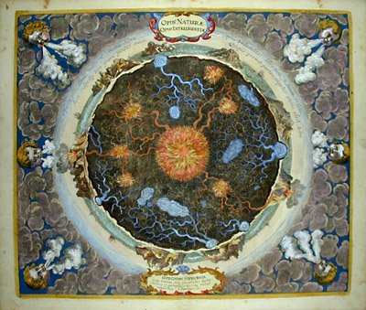
Seismology lecture 5:
“Seismic Tomography..
… and anisotropy”
Barbara Romanowicz
U.C. Berkeley
Collège de France, Paris
CIDER2014- KITP- Santa Barbara

Slide 2
Seismic anisotropy
In an anisotropic structure, seismic waves propagate with different velocities in different directions.
The main causes of anisotropy are:
  SPO (shape-Preferred Orientation)
  CPO (crystal-preferred orientation) (also LPO)
In the earth, anisotropy is found primarily:
  in the upper mantle (olivine+ deformation)
  in the lowermost mantle (D” region)
  in the inner core (iron crystals)

Slide 3
Isotropic medium (review):
μ = shear modulus
Compressional modulus
⬥ Anisotropic medium – more general case:
Up to 21 independent elements of the
elastic tensor C_{ijkl}
Notes:
Pour completement specifier le modele: ajouter la densite

Slide 4
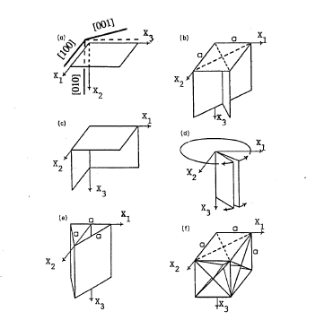
Examples of crystal symmetries
Monoclinic (13)
Tetragonal (6)
Orthorombic (9)
-> olivine
Hexagonal (5)
Ice
Trigonal (7)
Cubic (3)
garnet
After Babuska and Cara (1991)

Slide 5
Anisotropic medium
The propagation velocity (v_{n}) of a seismic wave in a particular direction defined by the normal direction to the wavefront: is found by resolving the Christoffel equation:
Where:
This is an eigenvalue problem, the solution of which is:
The 3 eigenvalues of this system give 3 velocities: V_{P} and V_{S1}, V_{S2} in the given direction n
is the wave’s polarisation vector

Slide 6
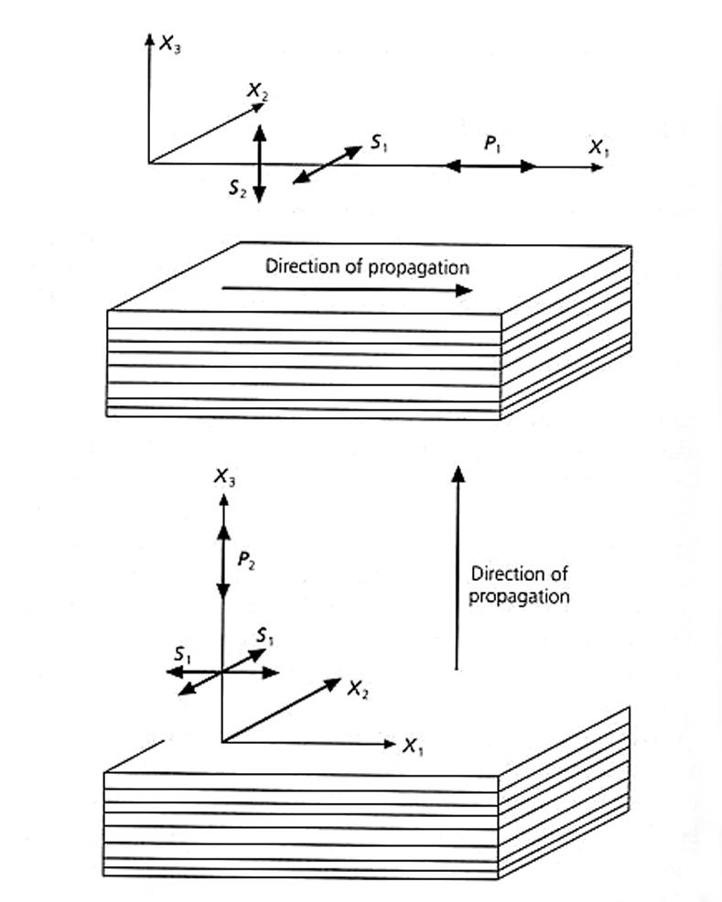
Radial Anisotropy
Radial anisotropy or
VTI (Vertical Transverse
Isotropy)
Hexagonal symmetry
=> 5 independent elements
of the elastic tensor:
A,C,F,L,N (Love, 1911)
  L = ρ V_{sv}²
  N = ρ V_{sh}²
  C = ρ V_{pv}²
  A = ρ V_{ph}²
  η = F/(A-2L)

Slide 7
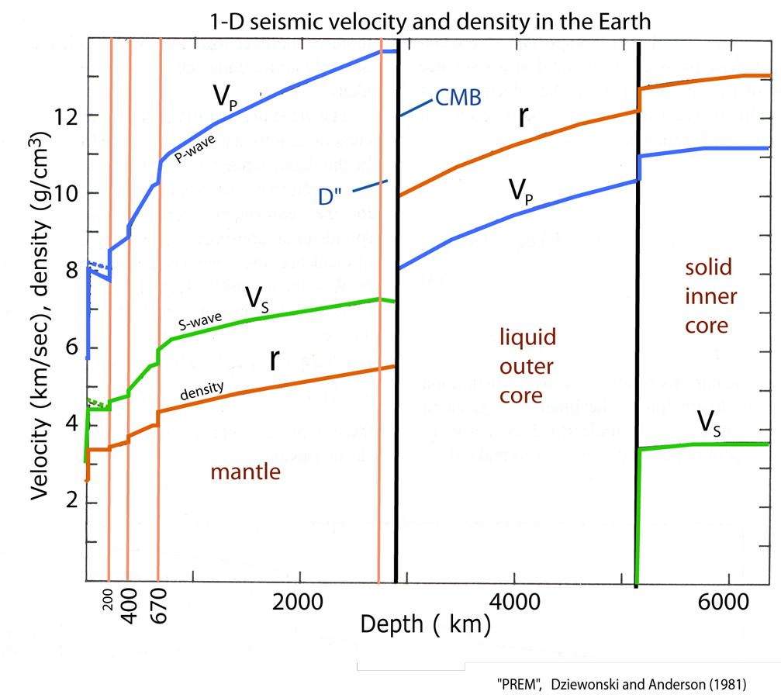
Vsh>Vsv in the top ~200 km of the mantle

Slide 8
Radial Anisotropy
Love/Rayleigh wave discrepancy:
  Vertical axis of symmetry
  A,C,F,L,N (Love, 1911)
Long period S waveforms can only resolve:
    L = ρ V_{sv}²
    N = ρ V_{sh}²
    (η in 1D)
    V_{s}^{iso} = 1/3(V_{sh}+2 V_{sv}) and ξ = (V_{sh}/V_{sv}) ²
    => δln ξ =2(δln V_{sh} – δlnV_{sv})

Slide 9
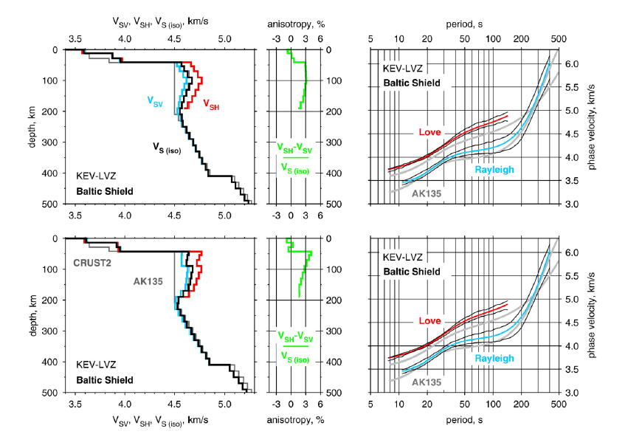
Models based on surface wave dispersion are non-unique but require VTI
Lebedev et al., 2009
Notes:
Starting from AK135 and crust2.0
bottom model by data when introducing a discontinuity at 90 km
top: smooth gradients. Slightly favored by the data.

Slide 10
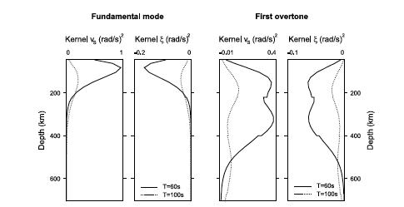
Anisotropic kernels (VTI)
Marone, Gung and Romanowicz., GJI, 2007

Slide 11
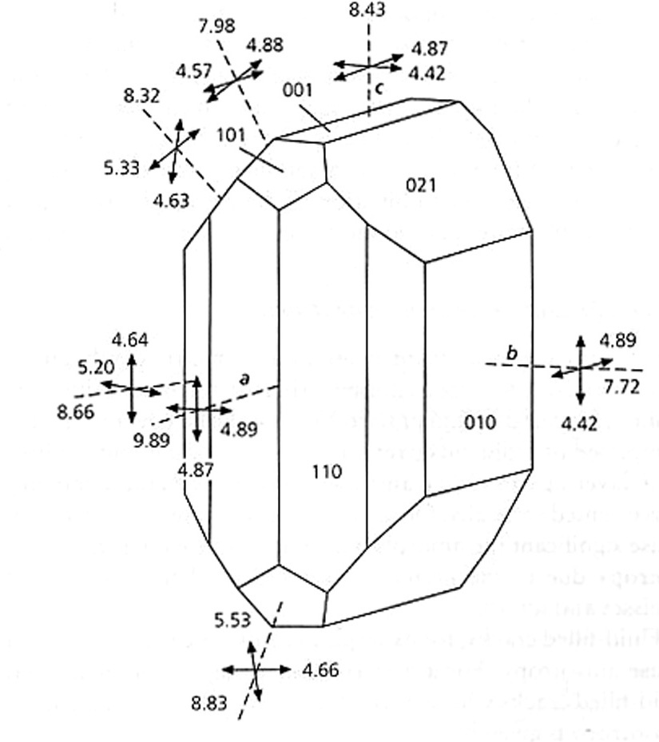
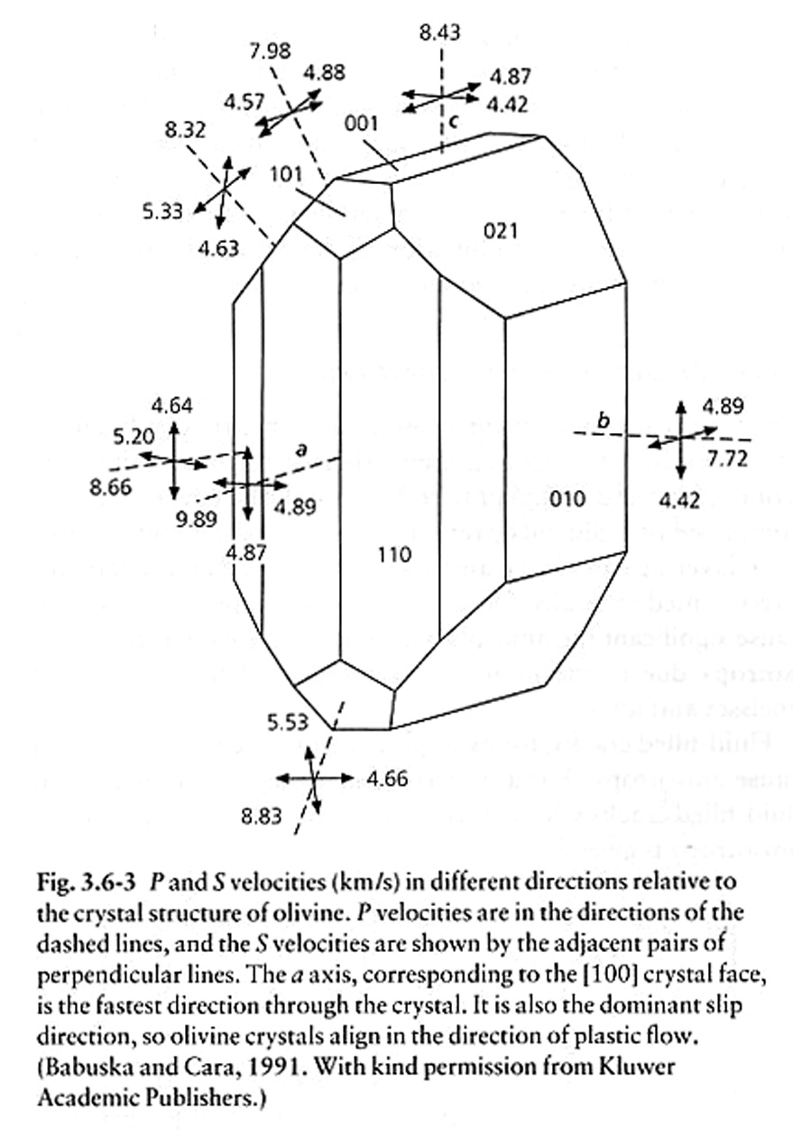
LPO: Anisotropy of olivine
Olivine crystal shows large anisotropy:
Different properties in different
directions. “a” is the fast axis it is also
the dominant slip direction:
P-velocities range from 9.89 km/s in
the fastest direction to 7.72 km/s
in the slowest; a difference of 22%.
If orientation of individual crystals
is random, a rock may appear isotropic.
A deformation process, like shearing,
can lead to a preferential orientation
of the crystal symmetry axes:
Olivine crystals align in the direction
of the flow
P velocities (fast axis = “a”= [100])
S velocities

Slide 12
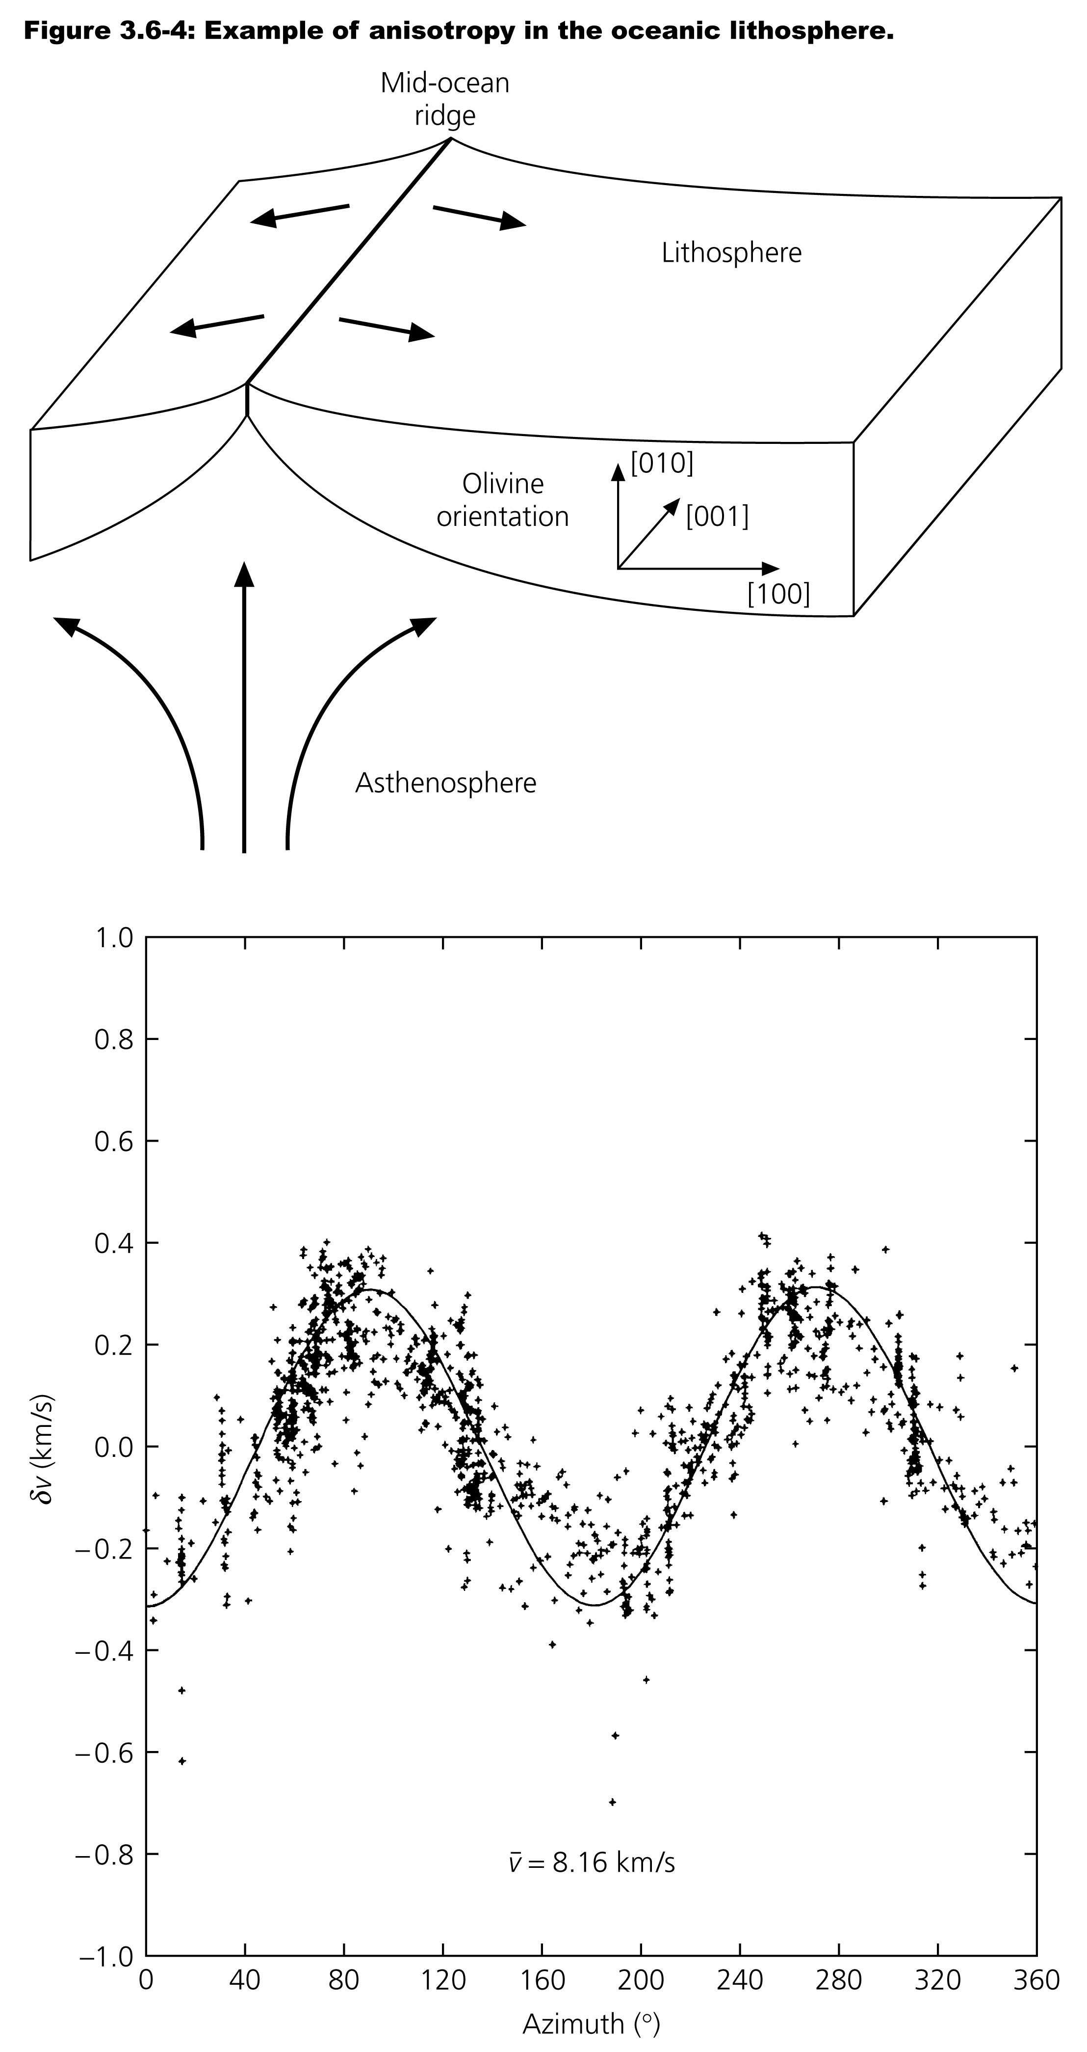
Evidence for LPO: alignment
of olivine crystals in flow
-> Azimuthal dependence of
seismic wave velocities supports
the idea that there is lattice
preferred orientation in the
Pacific lithosphere associated
with the shear caused by plate
motion.
Spreading direction
-> Fast direction of olivine: [100]
aligns with spreading direction
P_{n} wave velocities in Hawaii, where azimuth
zero is 90º from the spreading direction
P_{n} is a P wave which propagates right below
the Moho.
Hess, 1964

Slide 13
Azimuthal anisotropy:
  Velocity depends on the direction of propagation in the horizontal plane
  To first order:
Here ψ is the azimuth counted counterclockwise from North
a= f(A,C,F,L,N) and b,c+d,e are linear combinations of (6+2) elastic elements C_{ijkl}
In practice, only 2 radial anisotropy terms (L,N) and 2 “2ψ” terms can be
resolved [ in the upper mantle]: Gc, Gs
Where ψ_{f} is the fast axis direction

Slide 14
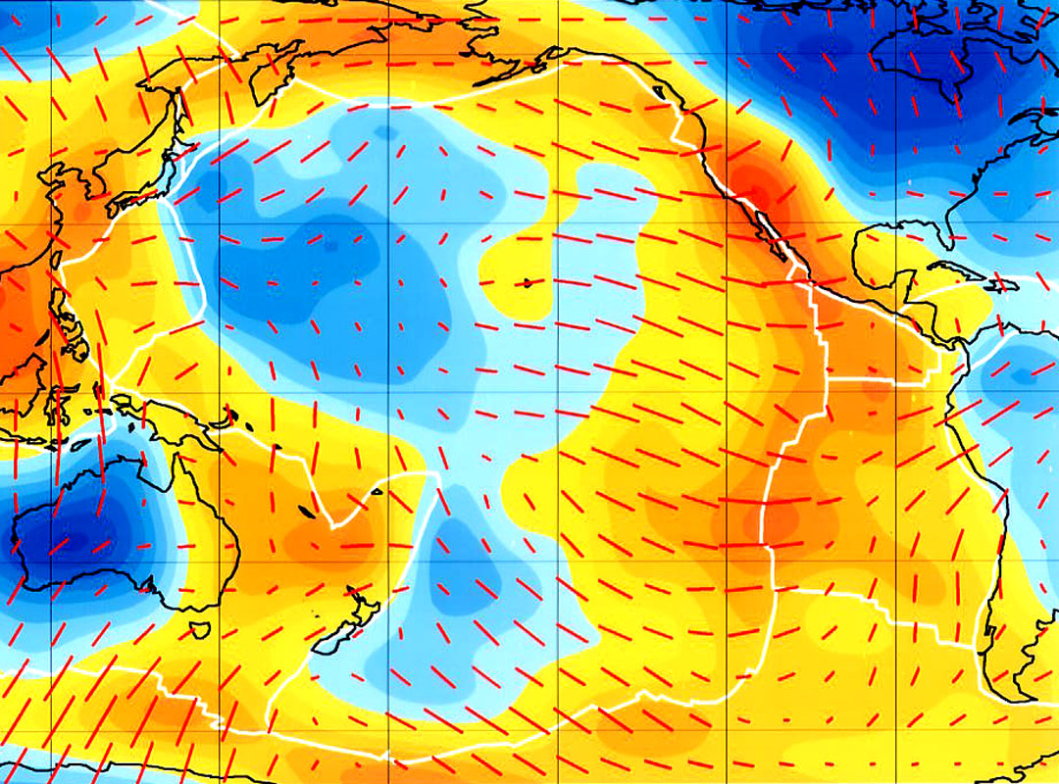
Surface wave azimuthal anisotropy
Dispersion of Rayleigh waves with 60 second period (most sensitive to depths
of about 80-100 km.
Orange is slow, blue is fast. Red lines show the fast axis of anisotropy.
Ekstrom et al., 1997 see also Ekström, 2011, GJI

Slide 15
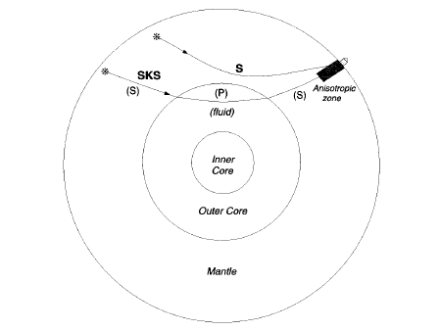
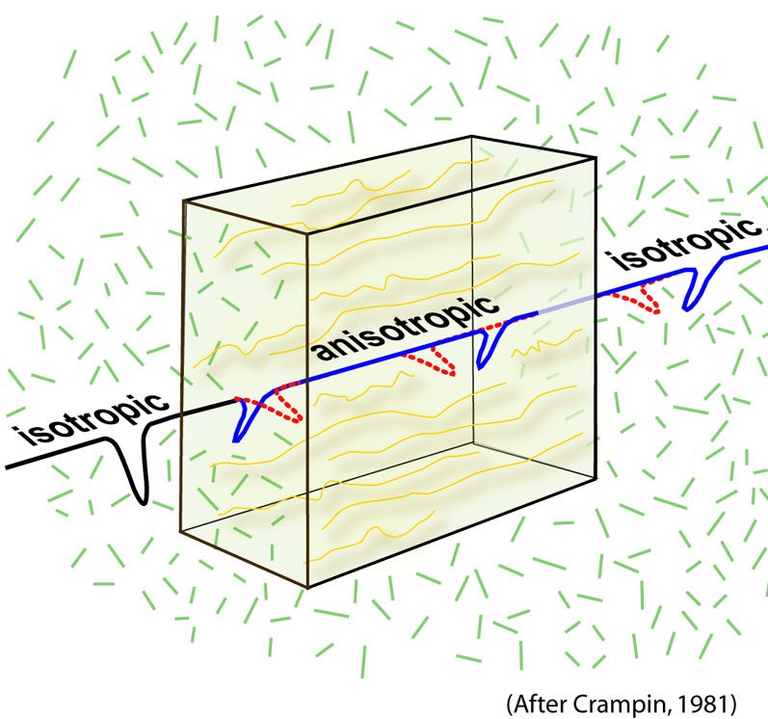
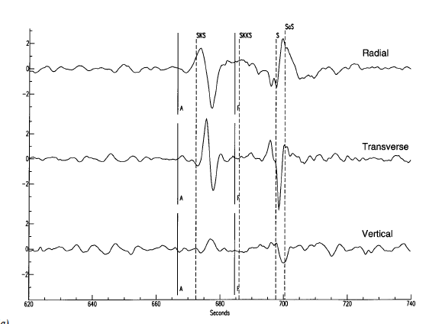
SKS Splitting: how it works
Garnero
webpage
Cartoon from Ed Garnero
In an isotropic
medium, SKS
should be
polarized as “SV”
and observed
on the radial
component, but not
on the transverse
component

Slide 16
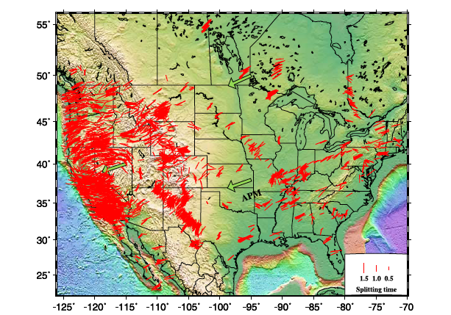
Example of SKS splitting measurements across north America
Liu, 2009

Slide 17
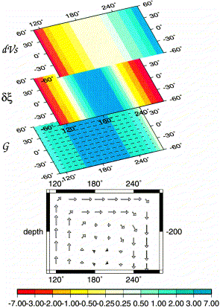
Isotropic
velocity
Radial
Anisotropy
ξ = (Vsh/Vsv)²
Azimuthal
anisotropy
Hypothetical
convection
cell
Montagner, 2002

Slide 18
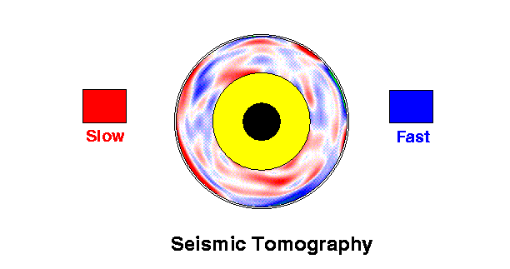
Mantle Tomography
(Isotropic)
(hot)
(cold)

Slide 19
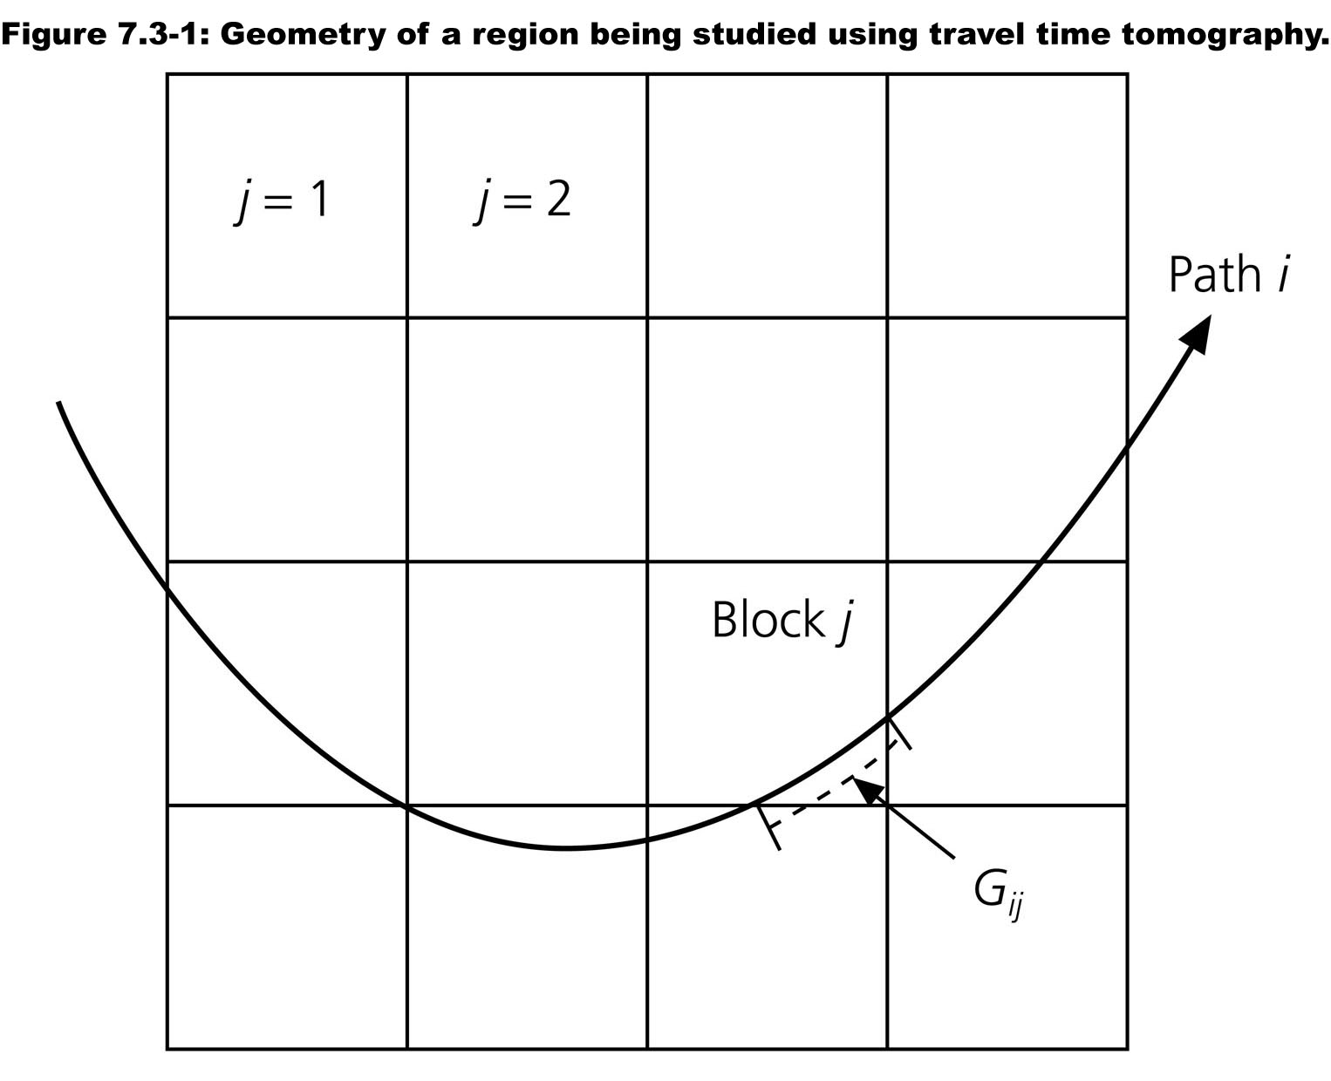
Reference model (typically 1D)
Physical parametrization (Vp)
Theoretical relationship:
  T = L/Vp
Spatial Parametrization (blocks?)
Homogeneous body:
l_{ij} is the distance travelled by ray i in block j
v₀^{j} is the reference velocity (“starting model”)
in block j j
Body with inhomogeneities:
l_{ij}

Slide 20
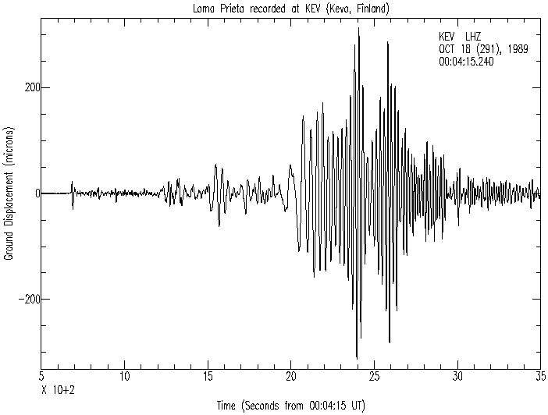
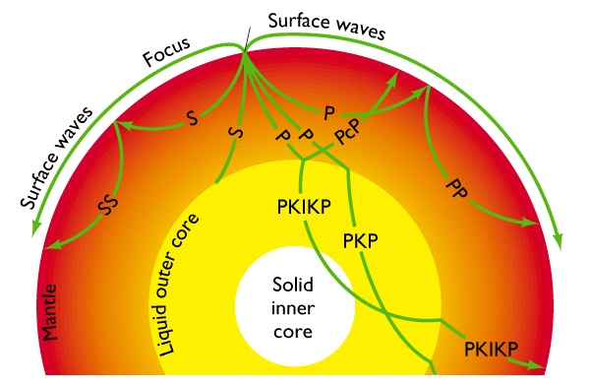
P, PP
S, SS
Arrivals well separated on the
seismogram, suitable for travel
time measurements
Generally, models based on these
types of data rely on:
Ray theory
Iterative back projection
techniques
- Parametrization in blocks
Surface waves
P
S
SS
50 mn

Slide 21
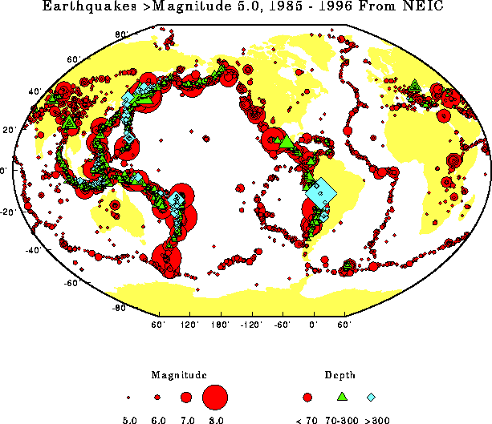
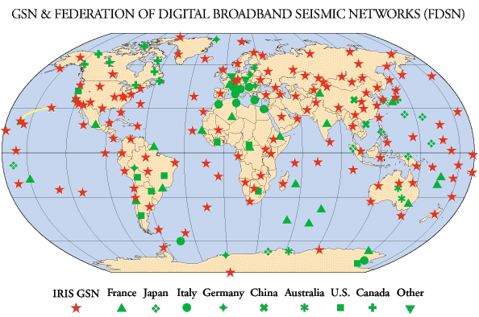
The distribution
of sources and
stations is not
uniform nor dense
around the globe

Slide 22
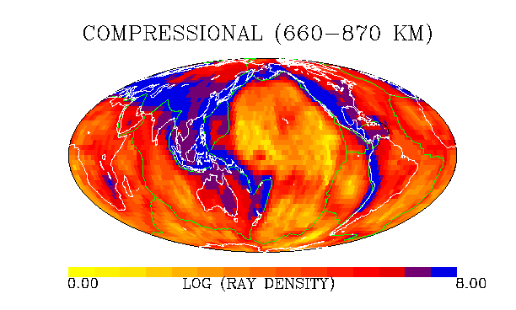
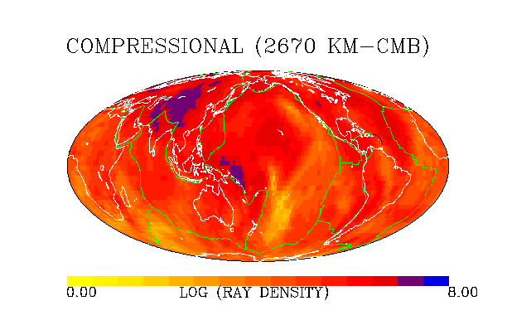
P Travel
Time
Tomography:
Ray
Density
maps
Vasco and
Johnson,1998

Slide 23
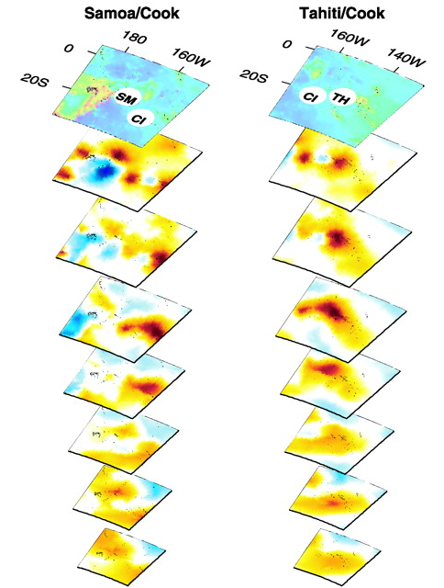
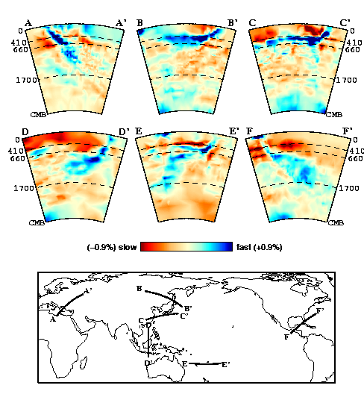
P velocity tomography
...and plumes
Slabs……
Van der Hilst et al., 1998
Montelli et al., 2004

Slide 24
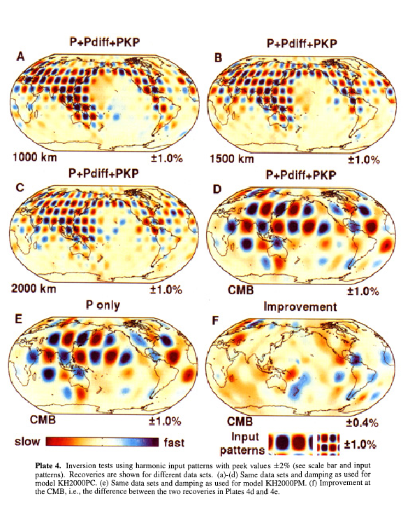
Checkerboard tests
Karason and
van der Hilst,
2000
Notes:
Need to check what’s shown….

Slide 25
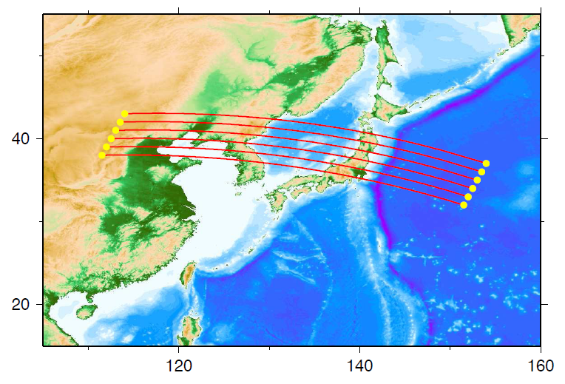
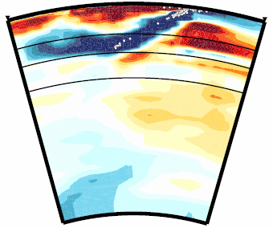
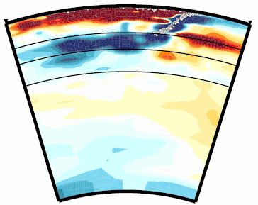
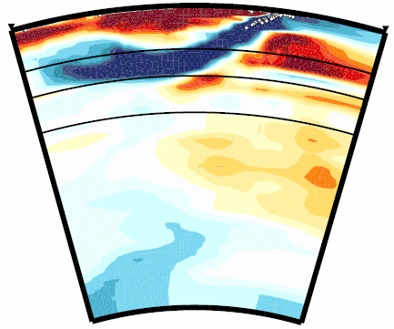
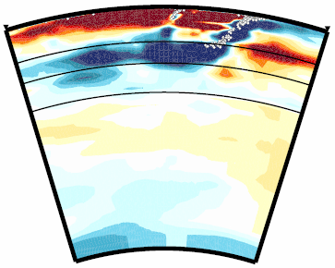
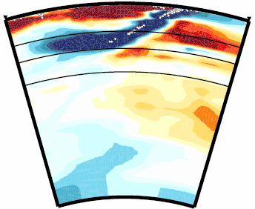
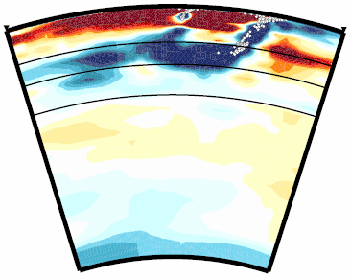
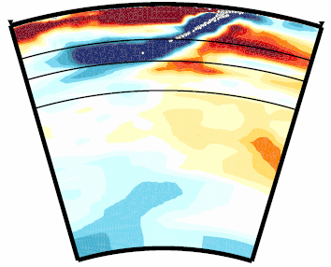
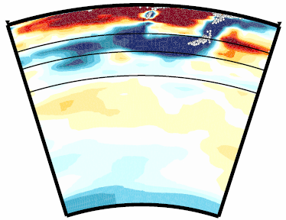
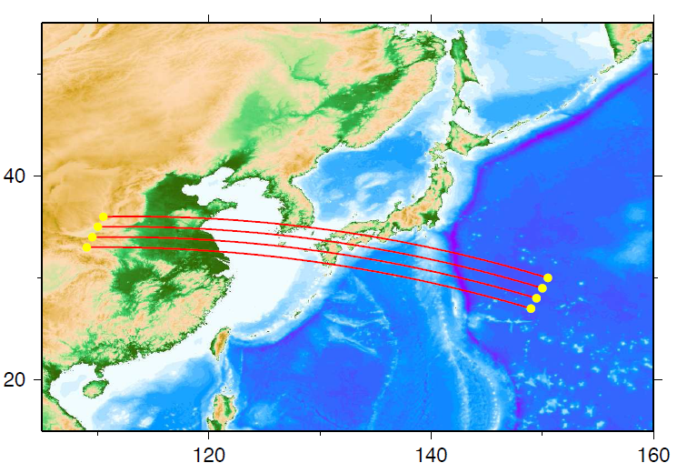
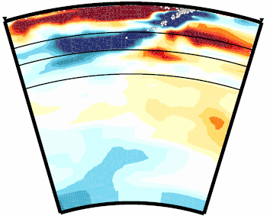
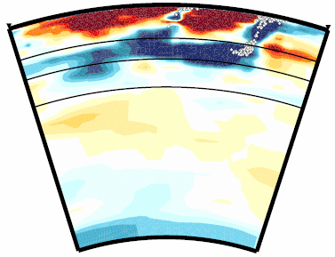
05
11
Honshu
06
12
Fukao and
Obayashi
2012
410
410
660
660
1000
±1.5 %
07
±1.5 %
13
13
northern Bonin
08
14
09
15
15
Notes:
These are the successively southward cross-sections across the Honshu arc and across the northern Bonin arc, showing typical images of stagnant slab above the 660. Here we define the uppermost lower mantle by the depth range between 660 and 1000 km. The white dots indicate hypocenters of earthquakes occurring within the slab.

Slide 26
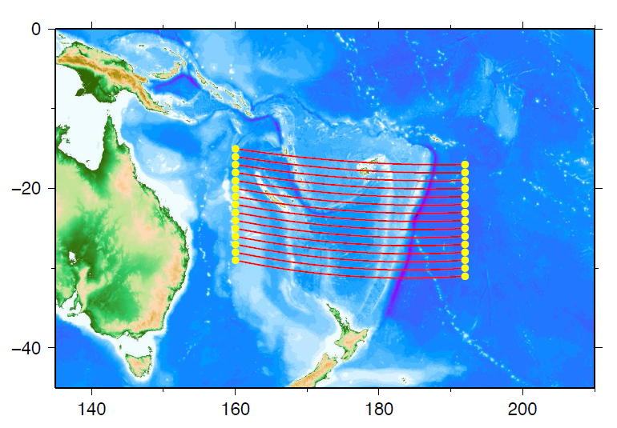
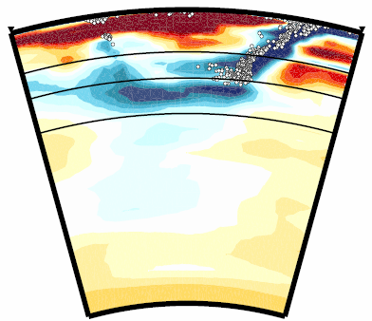
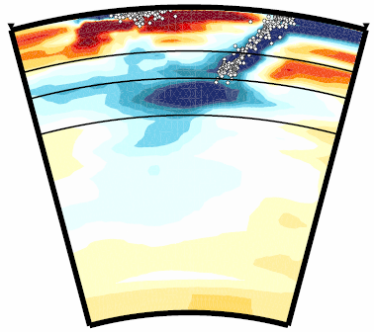
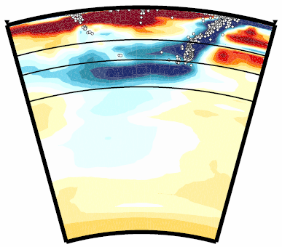
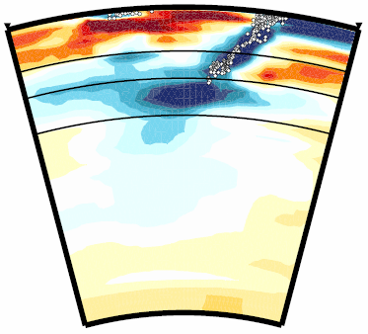
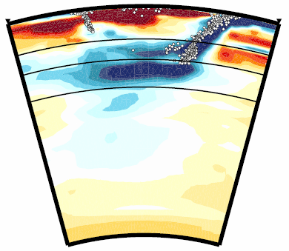
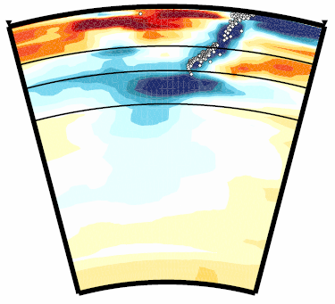
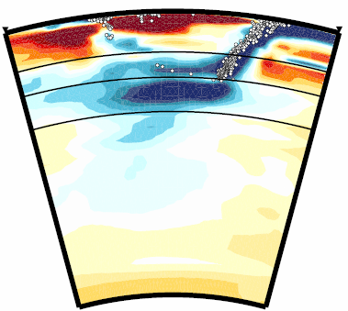
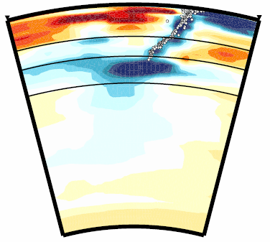
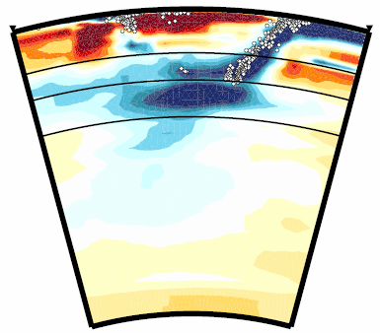
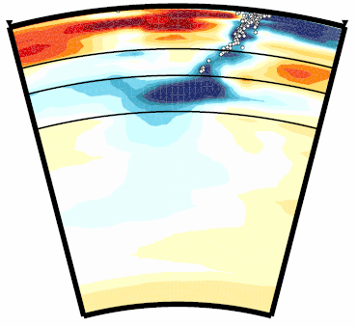
06
11
07
Tonga
12
410
660
±1.5%
1000
08
13
±1.5%
Kermadec
09
14
15
10
Fukao and
Obayashi
2012
Notes:
These are the successively southward cross-sections across the Tonga arc and across the Kermadec arc. In the Tonga region we see two horizontal slabs, one above the 660 and the other below it in the uppermost lower mantle. These two horizontal slab images are consistent with the two trends of seismicity at greatest depths, one in the down-dip direction and the other in the horizontal direction. In the Kermadec region the slab is trapped well in the uppermost lower mantle. The trapped slab extends subhorizontally both forward and backward of the subduction direction.

Slide 27
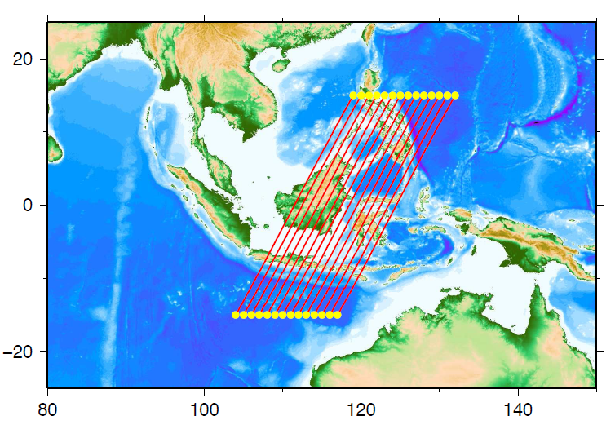










107
115
western Java
106
114
410
410
660
±1.2%
1000
105
±1.2%
113
104
112
eastern Java
111
103
Fukao and
Obayashi, 2012
Notes:
These are the successively westward cross-sections across the eastern Java arc and across the western Java arc. The slab of the Indo-Australian plate is stagnant above the 660 near the eastern end of the Java arc, where the subducted slab of the Philippine Sea plate is also seen. As we go to the west, the slab begins to penetrate the 660. Beneath western Java the penetrated slab is trapped well in the uppermost lower mantle. The trapped slab extends subhorizontally both forward and backward of the subduction direction.

Slide 28



Fukao and
Obayashi,
2012
400
660
1000
South Pacific
superswell
Tonga
EPR
S40RTS
Ritsema et al., 2011
PRI-S05
Montelli et al., 2005

Slide 29

Fukao and
Obayashi,
2012
400
660
1000
South Pacific
superswell
Tonga
EPR
S40RTS
Ritsema et al., 2011
PRI-P05
Montelli et al., 2005

Slide 30

Depth: Lowermost 1000 km
Montelli et al., 2004
=> Need seismic stations
in the oceans
Or
a combination of
different seismic phases
Karason and van der Hilst, 2000

Slide 31

V_{s} models from different data subsets
120 km
600 km
1600 km
2800 km
After Ritsema et al., 2004

Slide 32


Woodhouse and Dziewonski, 1984
Depth = 100 km
Ritsema et al., 2011
Notes:
Cosmic Micorwave background? Planck cosmology probe

Slide 33

Isotropic Vs
Depth = 100 km
Velocity
Long period S, SS, ScS, SKS…travel times
- Surface waves and
overtones
- Normal Mode splitting
- High frequency Approx.
20,000 time
domain
waveforms
+NACT
Surface waves
S
SS

Slide 34

Colder
hotter
Colder
hotter
Slices through the Earth’s mantle at different depths

Slide 35

hotter
Slices through the Earth’s mantle at different depths

Slide 36
Colder
hotter
Colder
hotter
Slices through the Earth’s mantle at different depths

Slide 37



Spectrum of
heterogeneity
Shear velocity
Depth = 2800 km
“LLSVP”
“Superplumes”
Lekic et al, 2012, EPSL
Notes:
Depth = 2800 km indicate

Slide 38

Meschede and Romanowicz, GJI submitted
Depth = 100 km

Slide 39
Meschede and Romanowicz, GJI submitted

Slide 40
Meschede and Romanowicz, GJI submitted

Slide 41

Higher resolution?
Improve sampling:
  Other phases
  Waveforms
Improve the wave propagation theory:
  Finite frequency effects
    Resolving slow anomalies

Slide 42


Finite frequency sensitivity
Liu & Zhou, 2013

Slide 43


Full Waveform Tomography:
UC B e r k e l e y
UC B e r k e l e y

Slide 44


SEMum (Lekic and Romanowicz, 2011)
S20RTS (Ritsema et al. 2004)
-12%
-7%
70 km
+8%
+6%
-7%
-6%
125 km
+9%
+8%
-6%
-4%
180 km
+8%
+6%
-5%
-3.5%
250 km
+5%
+3%

Slide 45

Validation by comparison with
“local” results

Slide 46
Validation by comparison with
“local” results
French et al. (2013)

Slide 47

Map of SEMum2 at 70 km depth
Cross-section along the East
Pacific Rise
Isotropic
velocity
Vs
Radial
anisotropy
ξ

Slide 48

French and Romanowicz, submitted
Notes:
Obayashi et al. 2013

Slide 49

Looking from the south…..
SEMum2, French et al., 2013

